Slide 1
Document change record
Date published | Document Version Number | Slide(s) affected | Description of changes | Author
2017 | v1.0 | All | New course
4/7/24 | v1.1 | 1 | Add document change record | Adrian Collier

Slide 2
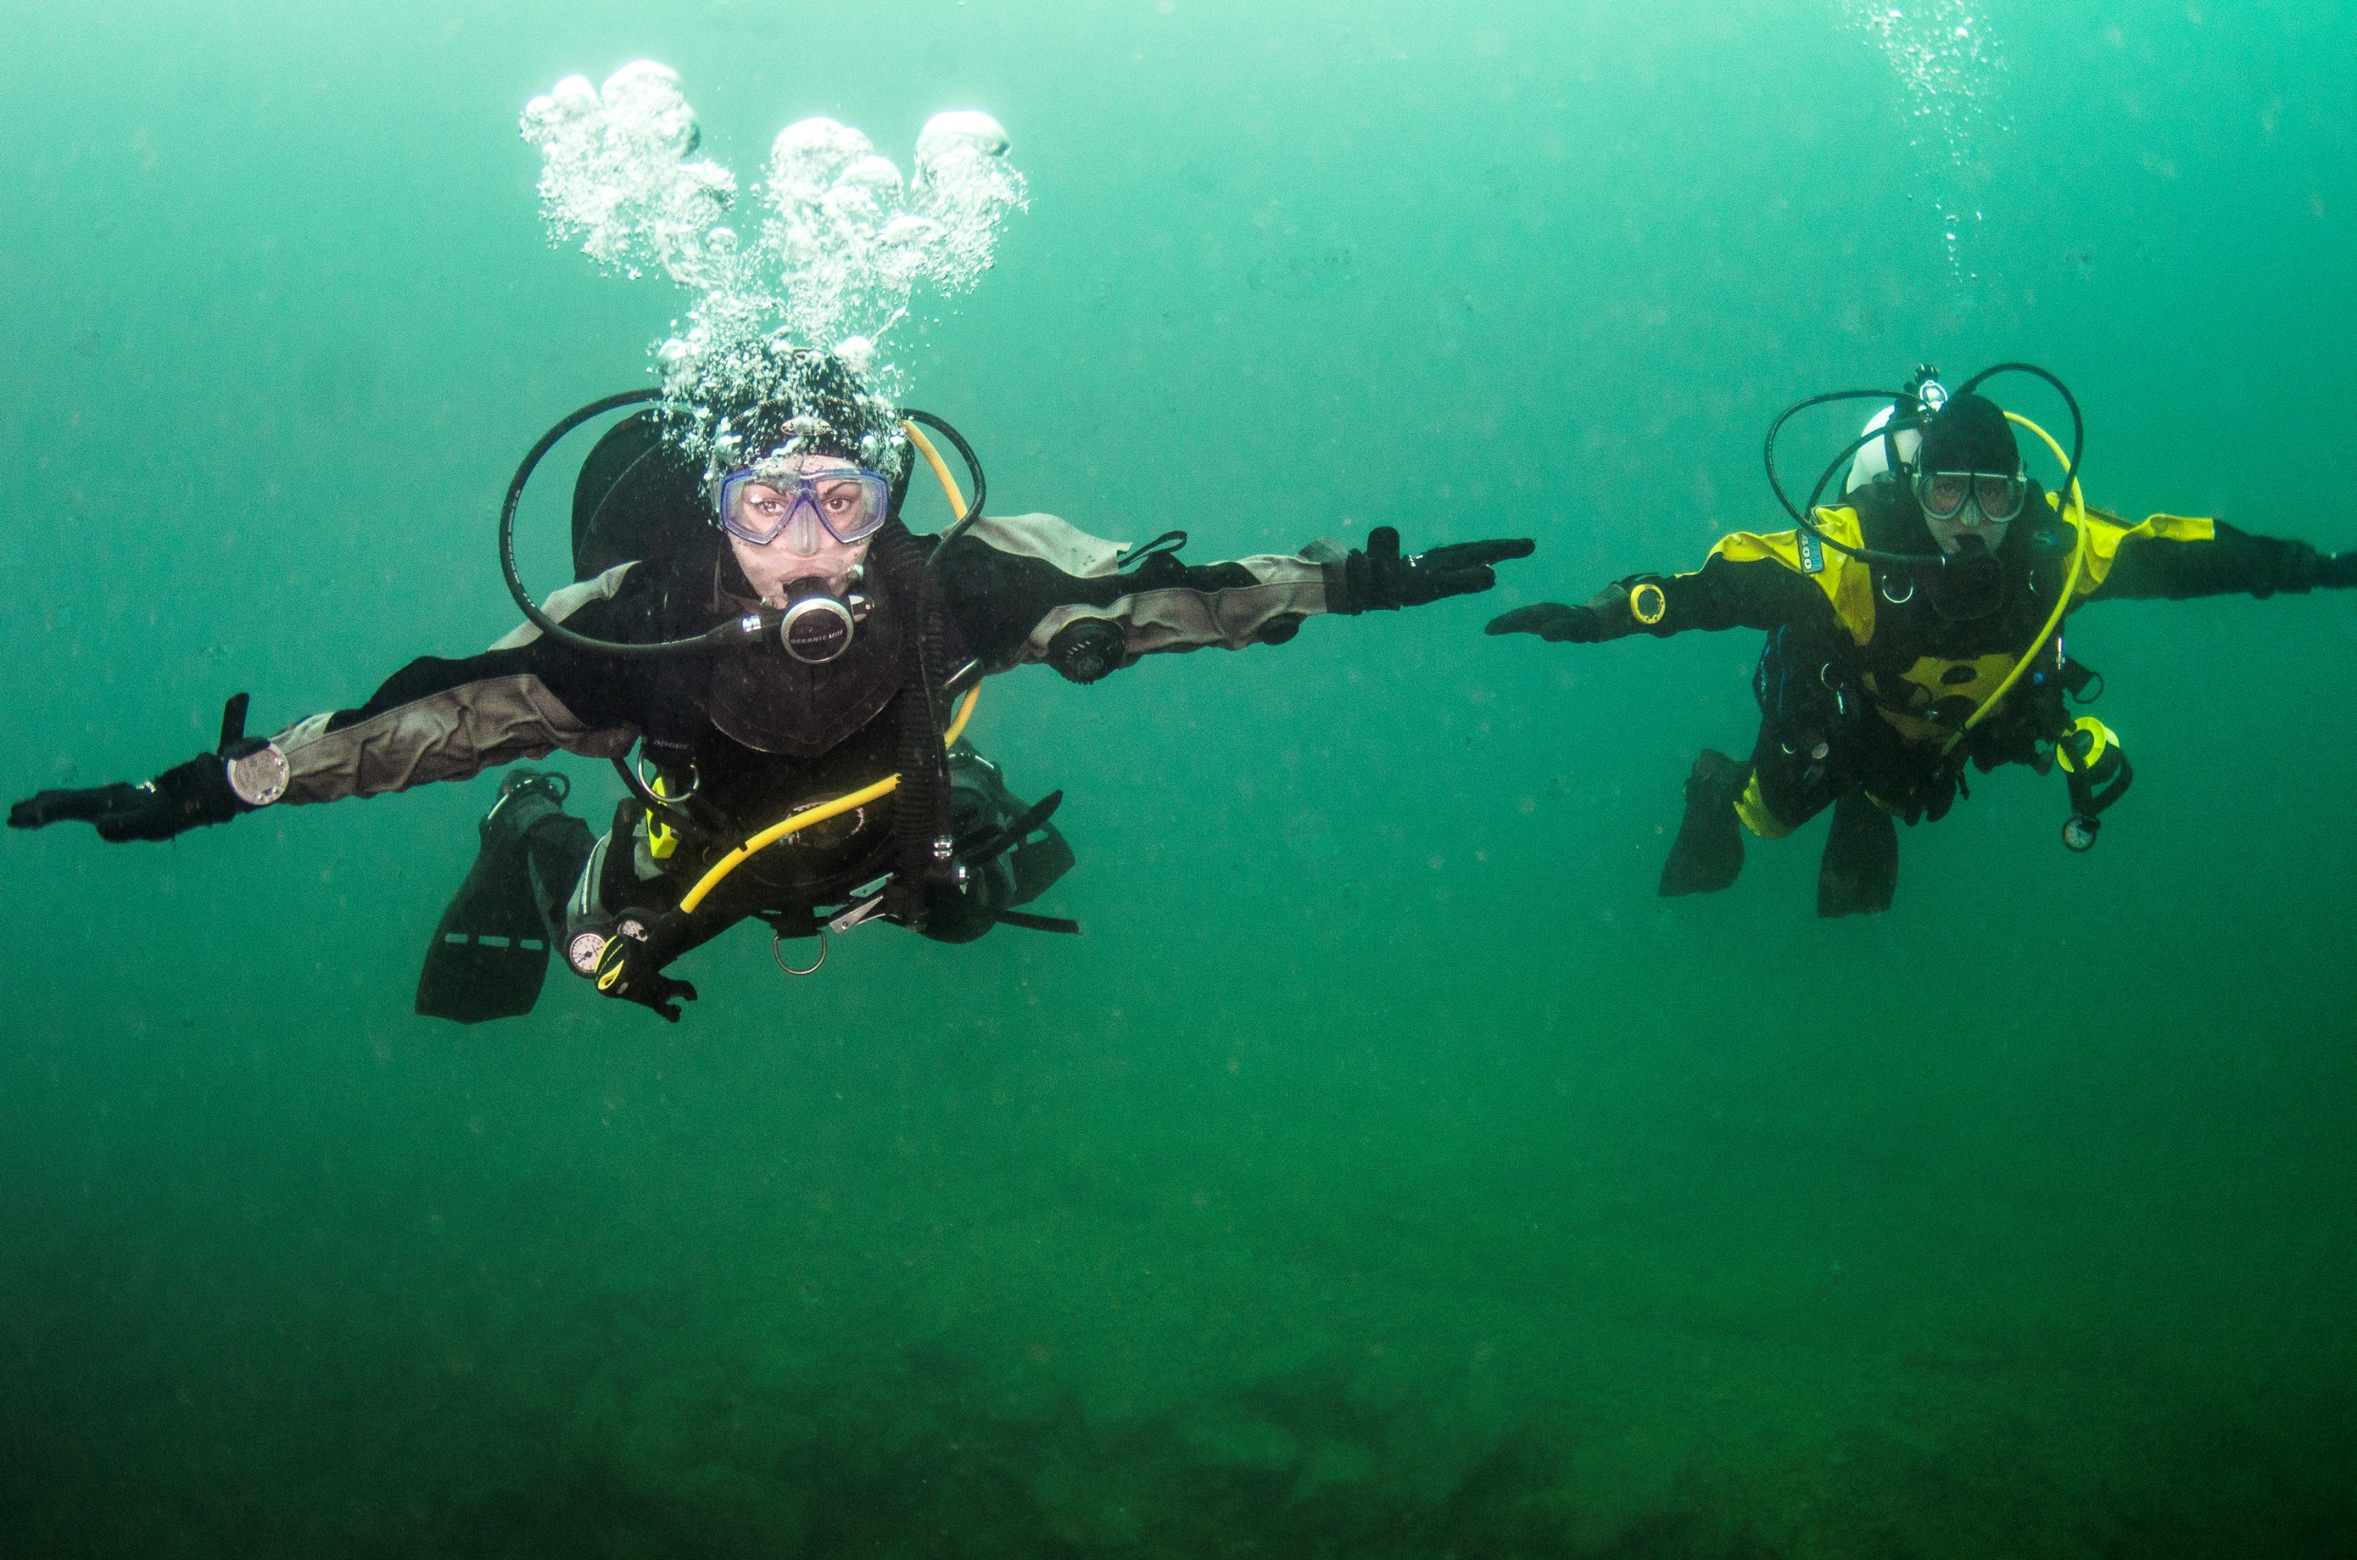

Adapting to the underwater world
Module OT1
Ocean Diver

Slide 3
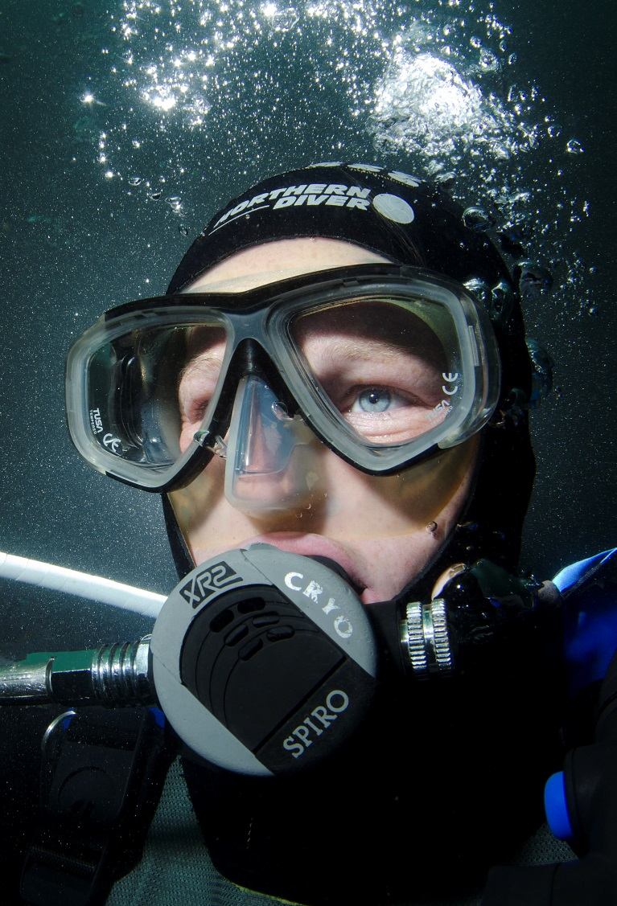
Module content
Understanding air and water pressure and the physical effects on the diver in the underwater environment
  Effects of depth and pressure
  Snorkelling equipment
  Scuba equipment
  Buoyancy
  Thermal protection

Slide 4
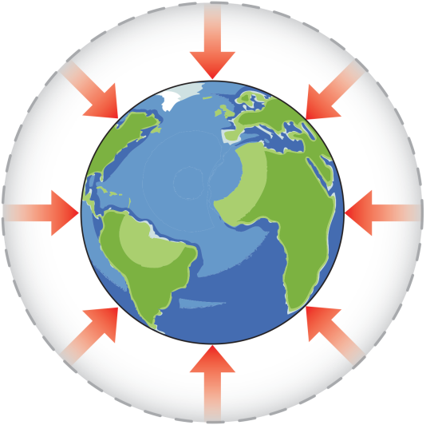
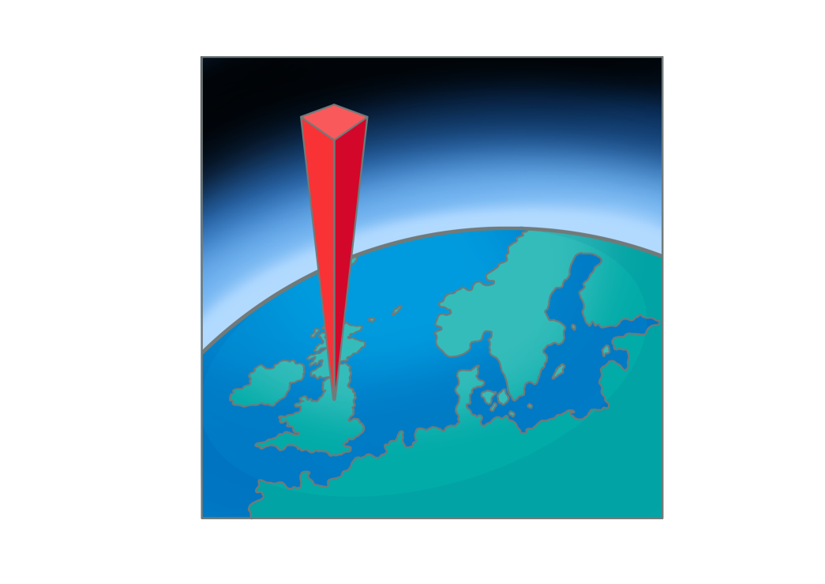
Air pressure
Air
  Compressible gas
  Surrounds the Earth
  Exerts force in all directions
Atmospheric pressure
  What is atmospheric pressure?
  1kg/cm² = 1 bar
1 square cm
1 bar pressure
at the surface

Slide 5

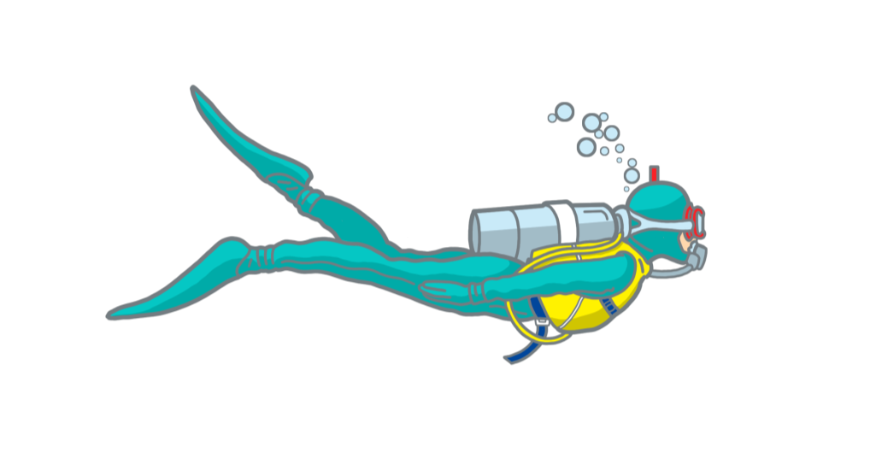
Water pressure
10,000 metres
AIR
Sea surface = 1 Bar
Water
  Non-compressible liquid
  Exerts force in directions
  Weight of water exerts a pressure of one bar for every 10m of depth
Absolute pressure
  Water (or gauge) pressure + atmospheric pressure
    at 10m depth, absolute pressure = two bar
WATER
10 metres = 1 Bar
10m
Absolute pressure = 2 Bar
20m
Pressure = 3 Bar
30m
Pressure = 4 Bar

Slide 6
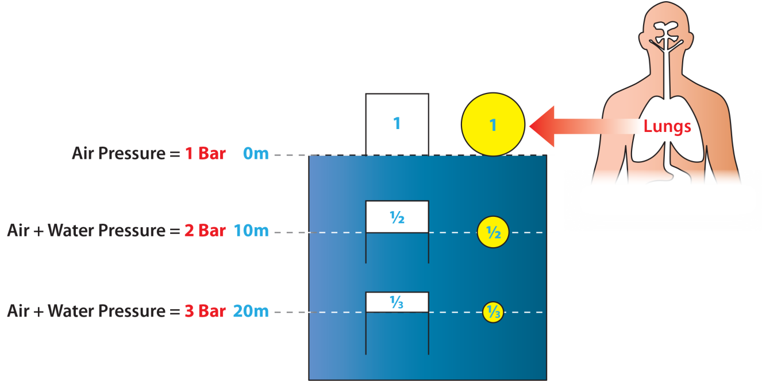
Depth and pressure
Effect of pressure on an air space
  As pressure increases, volume decreases
  As pressure decreases, volume increases
Impact on divers
  Lungs
  Diving equipment

Slide 7
Quiz 1
A diver is at a depth of 15m; what is the water pressure?
  1.5 bar
What is the absolute pressure?
  2.5 bar
The diver now descends to 25m; what is the absolute pressure?
  3.5 bar

Slide 8
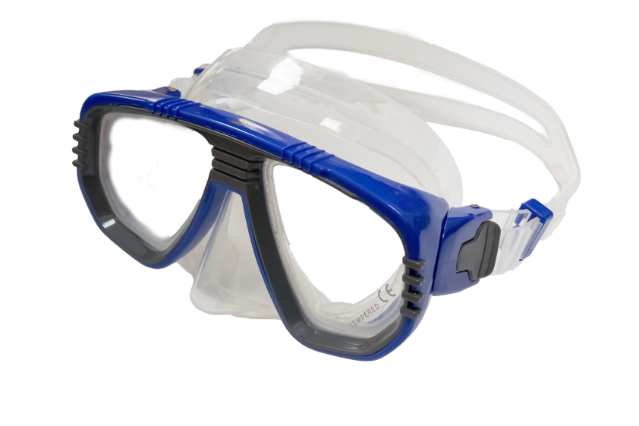
Snorkelling equipment – mask
  Allows underwater vision
Features
  Rigid frame
  Tempered glass
  Prescription lenses, if needed
  Flexible seal or ‘skirt’
  Nose pocket
  Adjustable strap
Fit
Care
  Rinse in fresh water
  Dry before storing
Flexible seal
Adjustable strap
Tempered
glass
Frame
Nose pocket

Slide 9
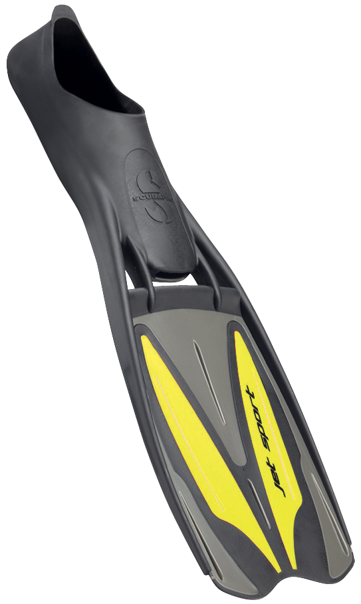
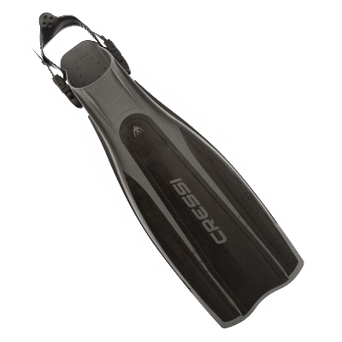
Snorkelling equipment – fins
  Give underwater propulsion
Features
  Two basic styles
  Flexible blade
  Stiffening ridges
  Shaped to maximise efficiency
Fit
  Comfortable foot pocket
Care
  Rinse in fresh water
  Dry before storing
Shoe fin
Strap fin

Slide 10
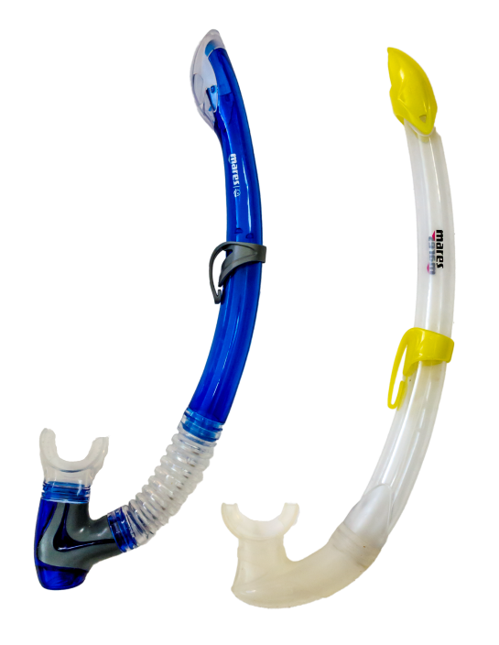
Snorkelling equipment – snorkel
Splash guard
Allows surface breathing
Features
  Tube
  40-45cm long
  20mm diameter
  Self-drain valves
Fit
  Mouthpiece
Care
  Rinse in fresh water
  Dry before storing
Drain valve

Slide 11

Breathing underwater
Snorkelling
Equipment
SCUBA
Equipment
Air
1 Bar
Air
Pressure
1 bar
Air
1 Bar
Snorkelling equipment
  Diver breathes gas at atmospheric pressure
  Lungs are compressed on descent
Scuba equipment
  Diver breathes gas at surrounding pressure
  Lungs are not compressed on descent
Depth
0m
Air + Water
Pressure
2 bar
Air
2 Bar
1/2
10m
Air + Water
Pressure
3 bar
Air
3 Bar
20m
1/3

Slide 12
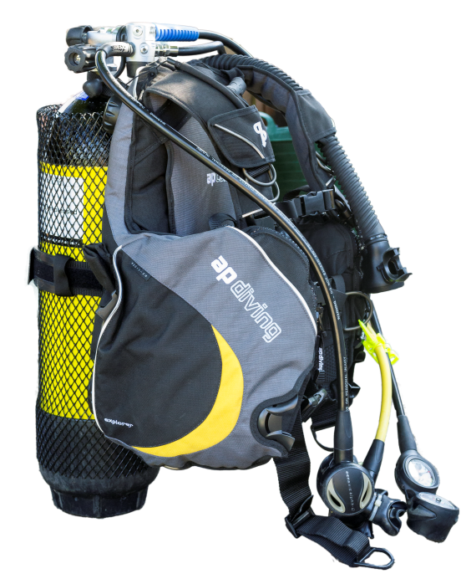
Scuba equipment
Scuba
  Self
  Contained
  Underwater
  Breathing
  Apparatus
Components
  Cylinder
  Buoyancy compensator
  Regulator

Slide 13
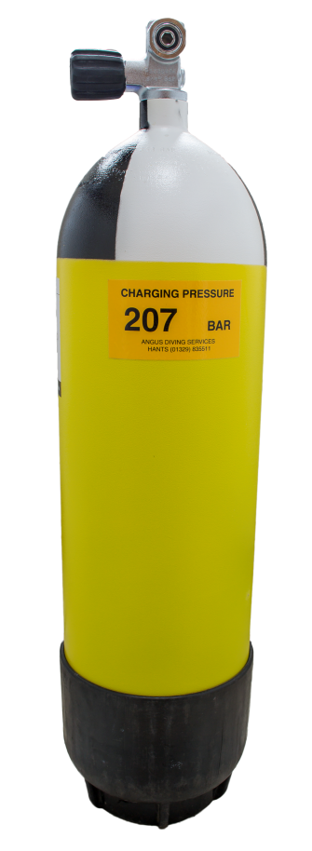
The cylinder
Features
  Contains breathing gas at high pressure
  Steel or aluminium
  BS/EN standard; CE mark
Testing
  Hydrostatic every 5 years
  Visual every 2.5 years
Care
  Rinse in fresh water
  Dry before storing
  Do not store empty

Slide 14
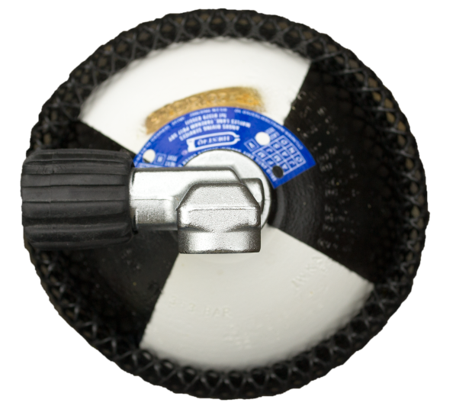

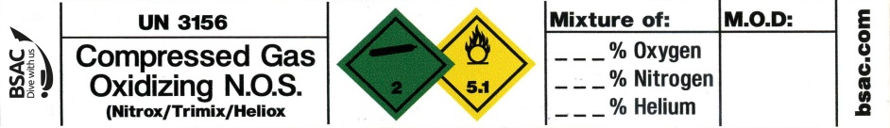
Cylinder markings
Breathing gases
  Air (21% oxygen)
  Nitrox (32% or 36% oxygen)
Key marks and labels
  “Breathing Air” or “Nitrox” labels
  Cylinder size
  Working and test pressures
  Test dates
Cylinders used for nitrox need periodic cleaning
BS/EN5045/7
12L
WP232
TP348
3/01
Cylinder size
Working Test
Pressures
Test
date

Slide 15
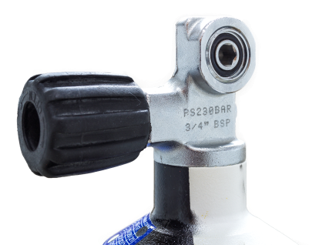
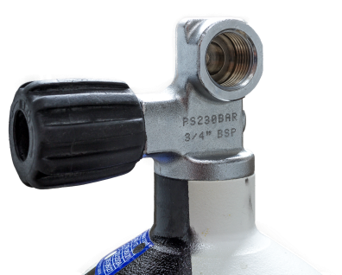
Pillar / crossflow valves
A-clamp (yoke)
  232 bar cylinders (max)
DIN
  232 - 300 bar cylinders
M26
  Nitrox cylinders
A - clamp
DIN

Slide 16
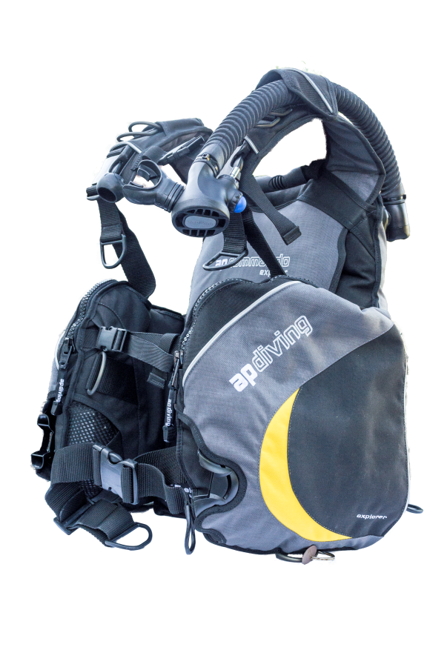
Buoyancy compensator
Direct feed
Pull dump
Supports the cylinder
Buoyancy adjustment
Features
  Gas bladder
  Direct feed
  Oral inflator
  Dump valves
  Over-pressure relief valve
Care
  Rinse in fresh water (inside and out)
  Dry before storing slightly inflated
  Service to manufacturer recommendations
Oral inflator
Cylinder
support
Push dump
Integrated bladder

Slide 17
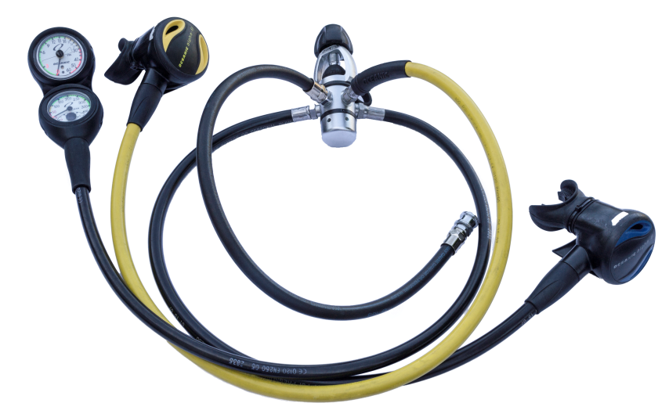
Regulator
First Stage
Delivers breathing gas
Features
  First and second stages
  Hoses
  Alternative supply (AS)
  Contents/pressure gauge
Types
  Cold water (less than 10ºC)
  Nitrox
Care
  Rinse in fresh water
  Dry before storing
  Service to manufacturer recommendations
AS
Second Stage
Contents gauge
Direct feed hose

Slide 18
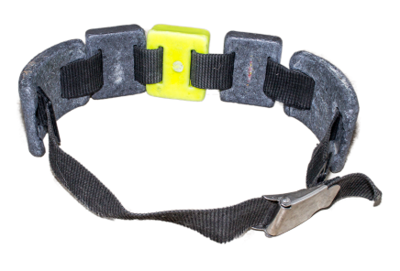
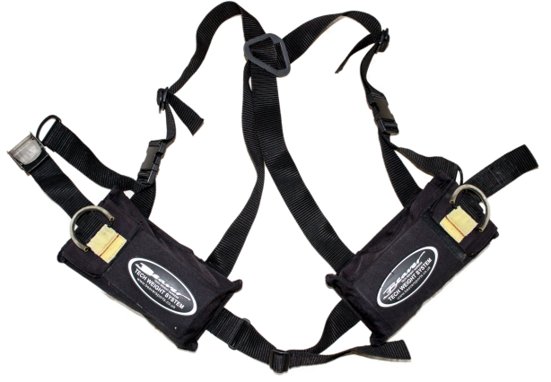
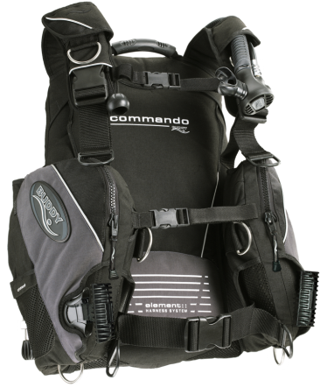
Weights
Weight belt
Types
  Weight belts
  Weight harness
  Integrated weights
Quick-release mechanisms
Trim
Care
  Wash in fresh water
  Dry before storing
Weight harness
Integrated
Weight BC

Slide 19
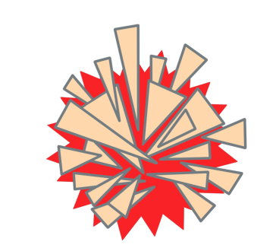
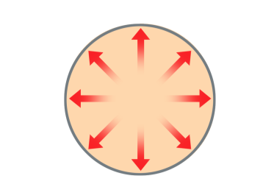

Using scuba equipment
Air
1 Bar
Warning
  Scuba delivers breathing gas at ambient pressure
  Breathe normally at all times
  Or gas in lungs will expand on ascent resulting in damage
  Breathe normally on ascent
Depth
Pressure
0m
1 bar
Air
2 Bar
Air
2 Bar
10m
2 bar
Air
3 Bar
Air
3 Bar
20m
3 bar

Slide 20
Buoyancy
Water displacement
  Occurs when an object is placed in water
  Creates an upwards force equal to the weight of water displaced
Density is relevant
  Objects sink when they are heavier than water displaced
  Objects float when they are lighter than water displaced
0.5 kg
Displacement
1.25 kg
1 kg
1 kg
Float
Sink
Upwards force equal to weight of displaced water

Slide 21
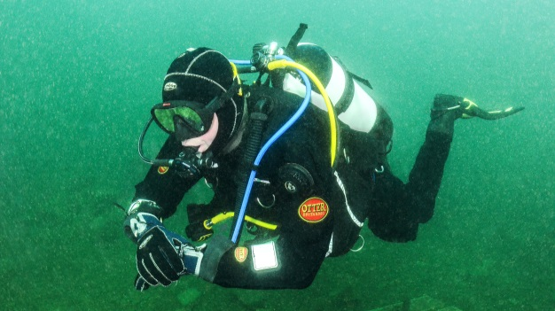
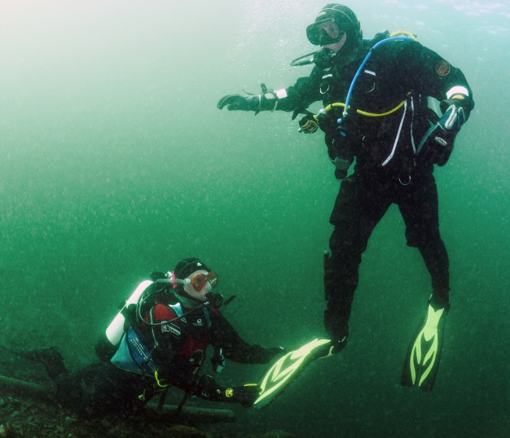
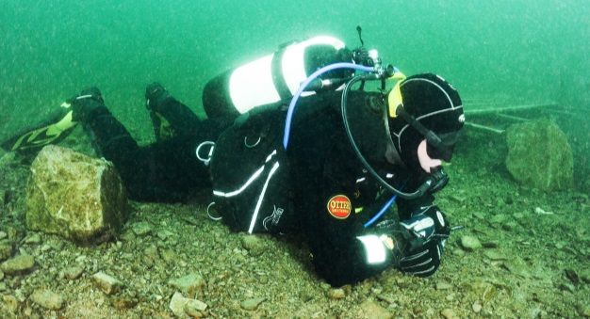
Buoyancy and divers
Neutral buoyancy
  Weightless state
  Reduces physical effort
Positive buoyancy
  Too light
  Physically tiring
  Uncontrolled upward movement
Negative buoyancy
  Too heavy
  Physically tiring
  Risk of going too deep
  Self or marine life damaged
  Sinking on surface

Slide 22
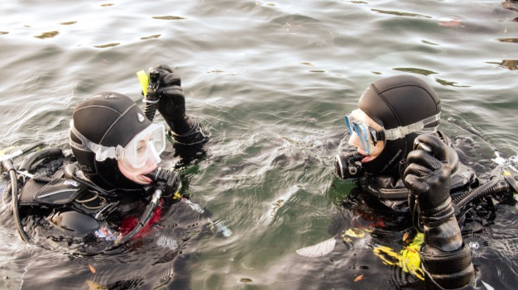
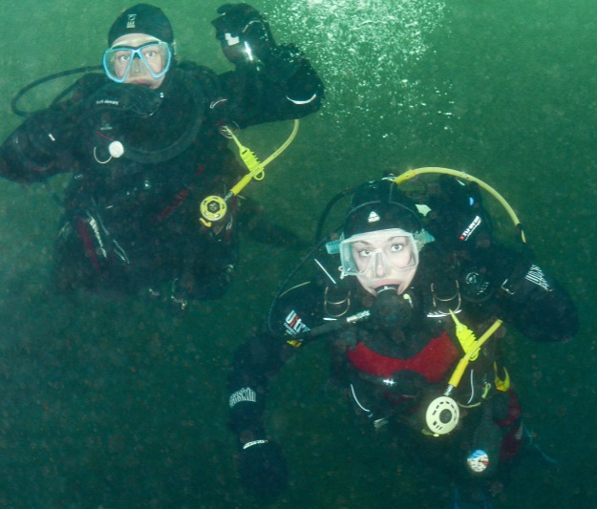
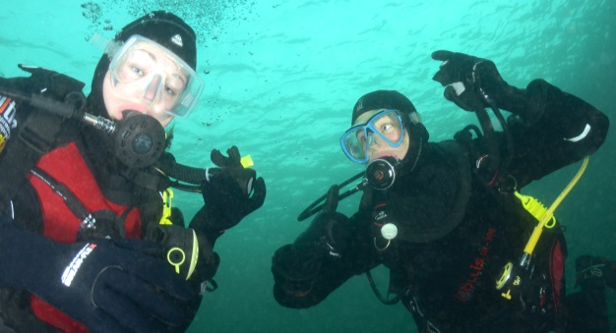
Buoyancy in practice
Descent
  Diving suits + scuba kit normally cause positive buoyancy at surface
  Add weight to achieve neutral buoyancy
During dive
  Compensate with BC or drysuit
  Fine tuning with lungs
Ascent
  Gas will expand
  Controlled dumping of air equalises diver’s buoyancy
Buoyancy check – correct weighting

Slide 23
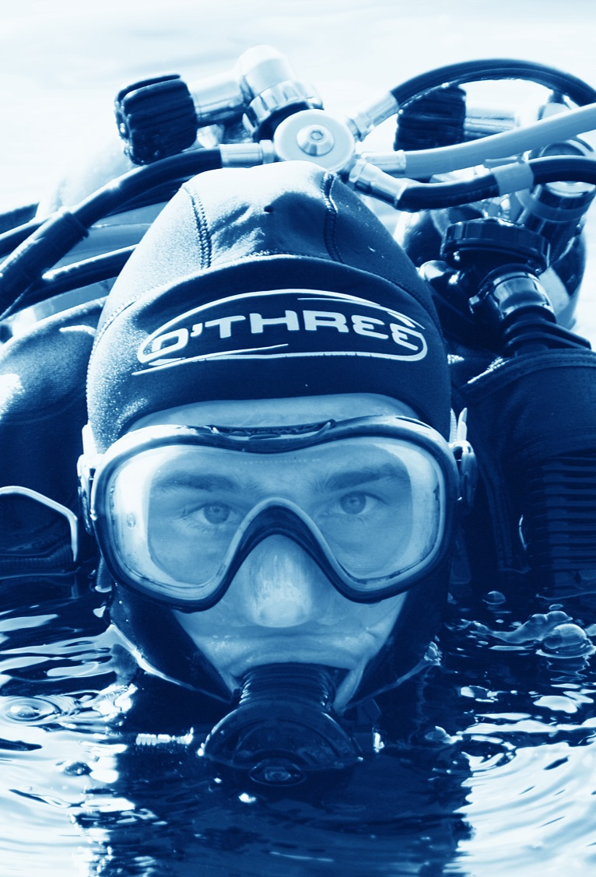
Body temperature and heat loss
Core body temperature
  Maintained at 37°C
Heat loss
  Caused by cooler surroundings
  Blood supply to periphery is restricted to reduce heat loss
Signs and symptoms
  Blue/numb extremities
  Shivering
  Hypothermia

Slide 24
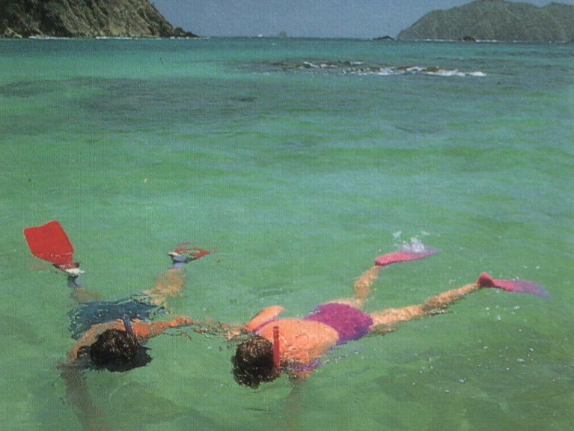
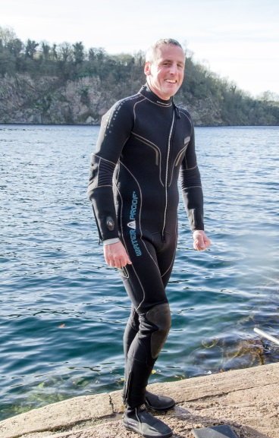
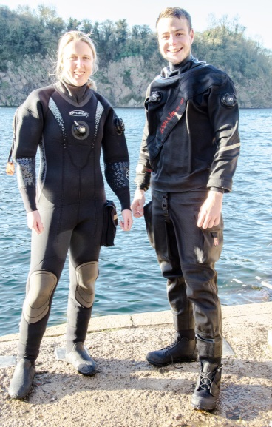
Heat loss (2)
In water
  Heat loss is 25 times faster than in air
  Water temperature determines
  insulation required
  End the dive if getting cold

Slide 25
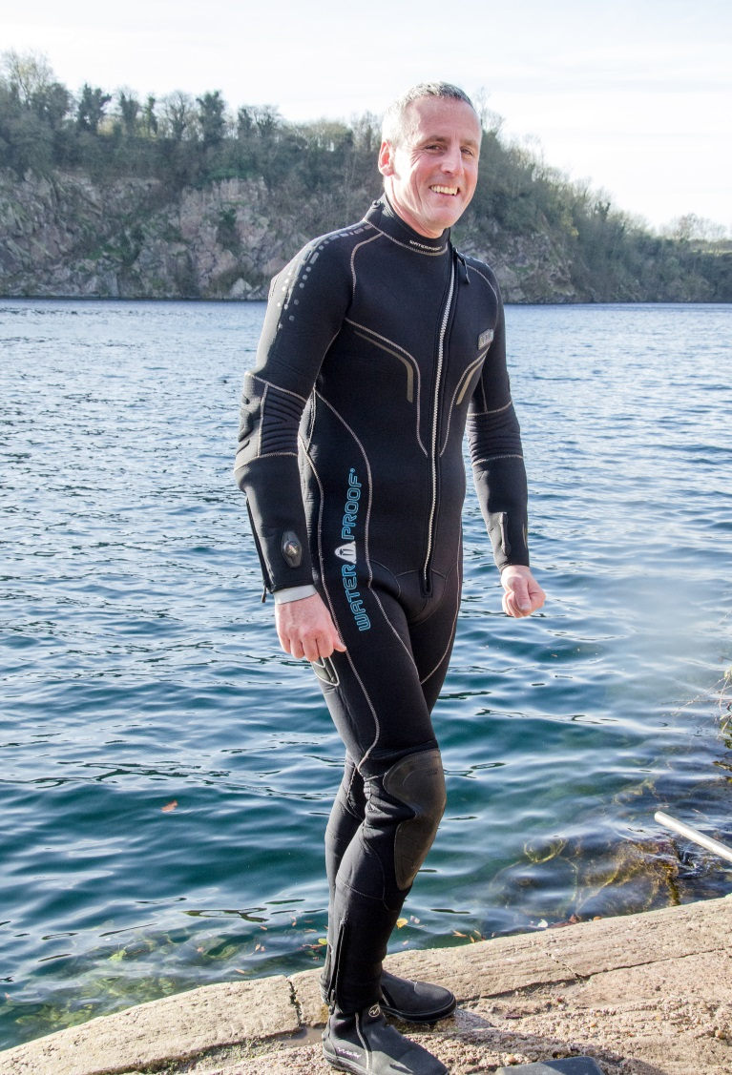
Insulation – wet and semi-dry suits
Features
  Comfortable close fit
  One or two piece
  Semi-dry suits have seals to reduce flushing
  Hood and gloves
  Boots with strap fins
Care
  Wash in fresh water
  Dry before storing

Slide 26
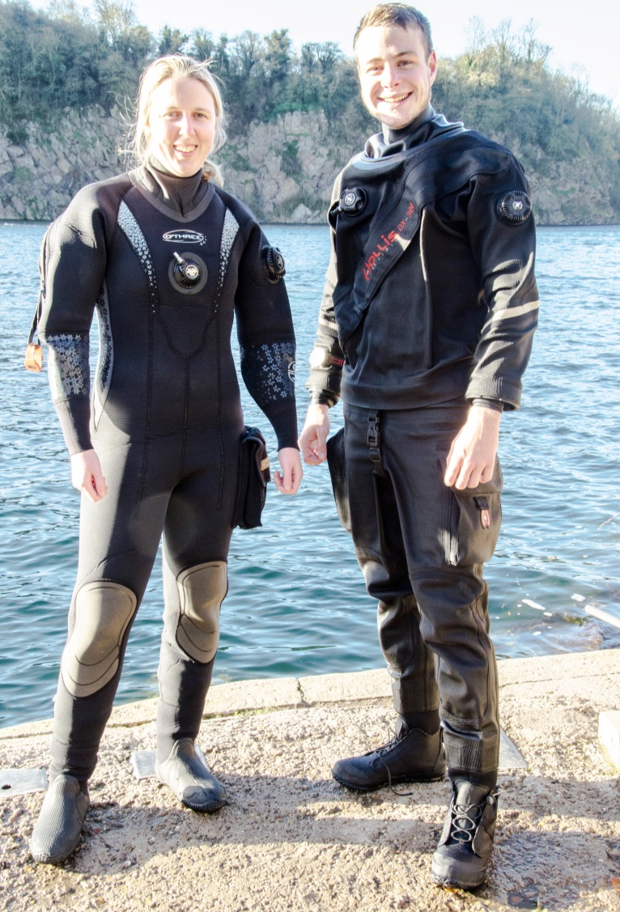
Insulation – drysuits
Neoprene
Membrane
Types
  Neoprene
  Membrane
Features
  Comfortable fit
  Seals to prevent water entering
  Waterproof entry zip
  Under suits
  Hood and gloves
Care
  Wash in fresh water
  Dry before storing
  Dust seals, lubricate zip

Slide 27
Quiz 2
What are three main parts of a scuba set?
  Cylinder, BC and regulator
When breathing from scuba, equipment what must you never do?
  Hold your breath
While underwater, divers should maintain, what type of buoyancy?
  Neutral

Slide 28
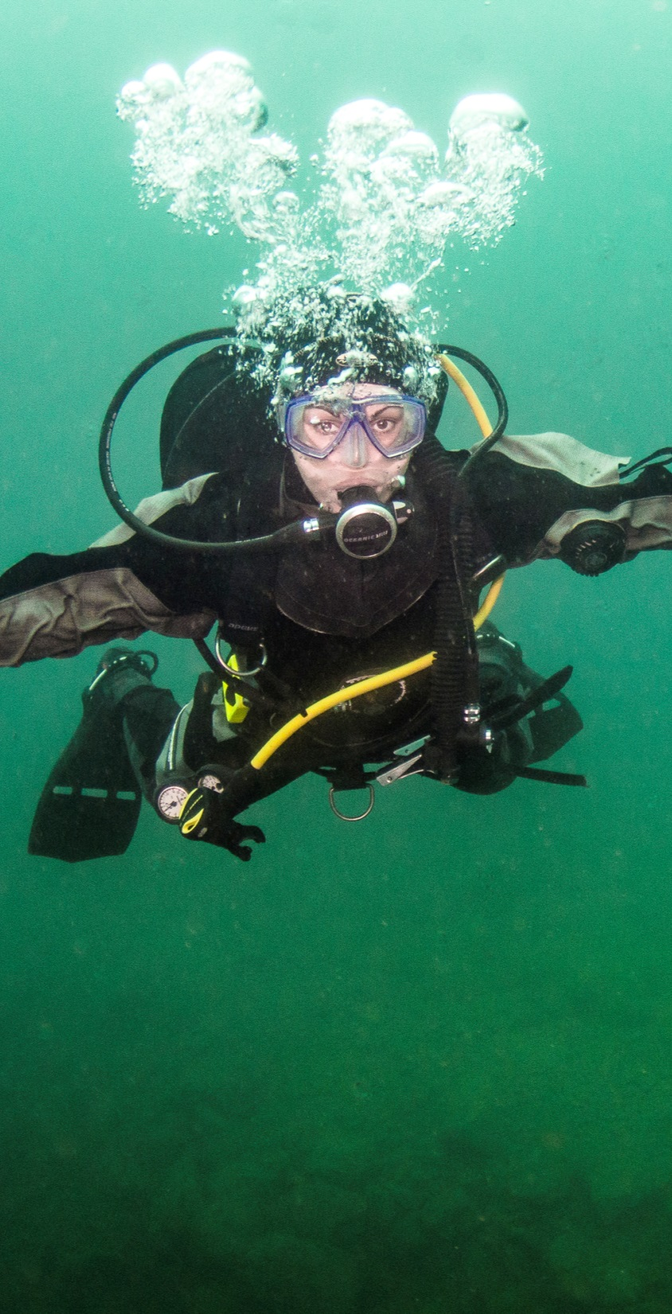

Understand the significance of the physical effects of the diving environment
Module OT1
  Effects of depth and pressure
  Snorkelling equipment
  Scuba equipment
  Buoyancy
  Thermal protection

