Slide 1
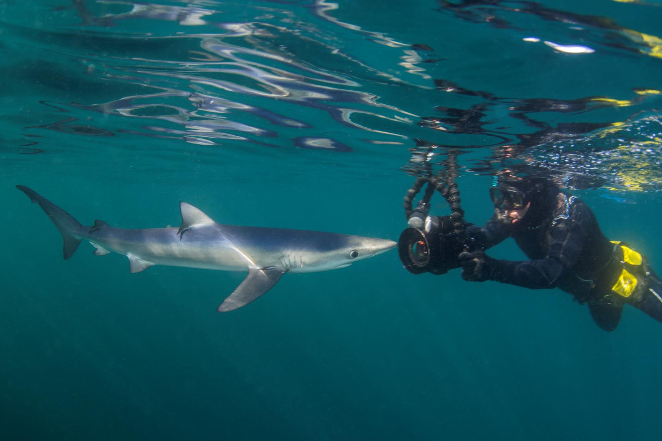

Underwater Photography
Introduction

Slide 2
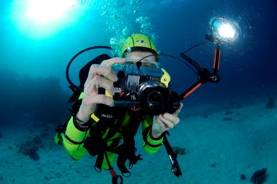
Underwater Photography
Course aims
Domestic arrangements
Locations
Timings

Slide 3
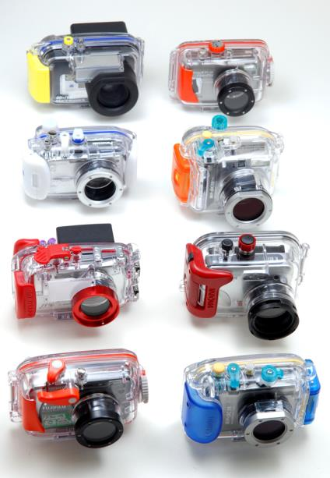
Course outline
Basic Theory
  Optics
  Camera fundamentals
  Housings
  Camera functions
  Shooting techniques
  Photography underwater
Practical
Downloading
Review

Slide 4
Underwater Photography
Optics

Slide 5
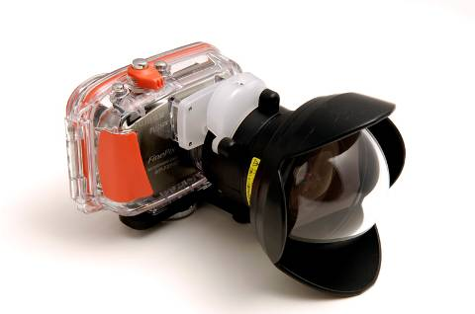
Optics
Refraction
Distortion
Loss of light
Loss of colour
Loss of contrast

Slide 6
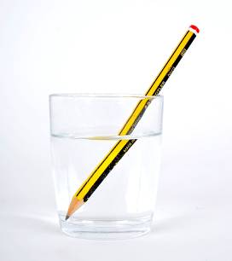
Refraction physics
Bending of light when it travels from one substance to another
  Caused by different speed of light in different substances
  Amount of refraction depends on:
    angle of incidence
      bigger angle = more bending
      ‘normal’ incidence = no bending
    substance – eg, glass > water
    direction – eg air to water, water to air
      dense to less dense - away from normal
      less dense to dense - towards normal
    wavelength of light – red > violet
  Lenses and prisms

Slide 7

Refraction and cameras
Light bends when medium changes
  Simplified camera
  No refraction effect on land
  Refraction effect underwater
Magnifying effect
Reduced coverage
  a = angle of coverage on land
  b = angle of coverage underwater
Case
Lens
a
b
Film/sensor

Slide 8

Distortion
Light is bent more at the edges due to refraction
A dome port can reduce the effect
  Dome ports may require an extra lens
  Alternative is accept some distortion

Slide 9



Loss of light
Absorption of light
  By the water
  By clouds and waves
Height of sun
  Midday sun gives maximum light
  Morning and evening sun gives minimum light

Slide 10
Loss of colour
Effect of depth on colour
5m
10m
15m
20m
25m
30m

Slide 11
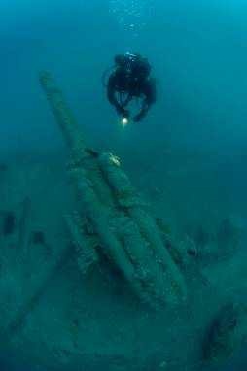
Loss of contrast
Higher density of water and particles give a similar effect to that of fog on land

Slide 12

Summary
Refraction
Distortion
Loss of light
Loss of colour
Loss of contrast

Slide 13
Underwater Photography
Camera Fundamentals

Slide 14
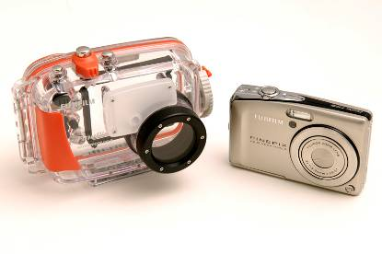
Camera fundamentals
Parts of a camera
Sensor
Resolution
Memory
File types
Exposure
Compacts and housings

Slide 15
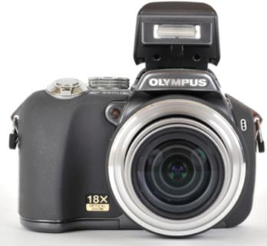
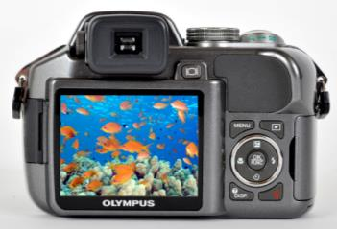
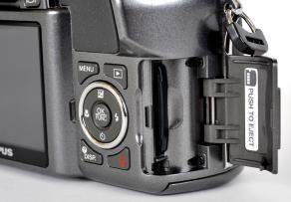
Parts of a camera
Lens assembly
  Lens – focus / zoom
  Aperture
  Shutter
Sensor
Processor
Memory
Batteries
Controls
Viewfinder / display
Flash

Slide 16
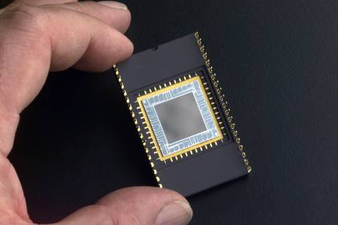
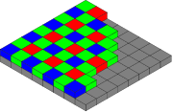
Sensor
CCD or CMOS chip
Image made up of dots called pixels

Slide 17
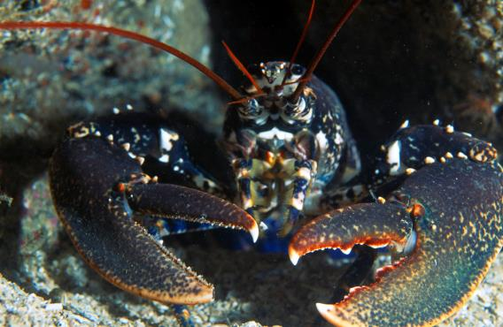
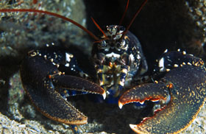
Resolution
Millions of pixels in one image
Typically 3000 x 2000 = 6MP
Quality described as dpi - dots (pixels) per inch
At 300dpi could print 10 by 6.66 inches

Slide 18
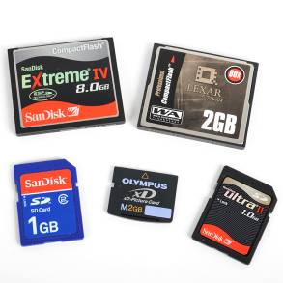
Memory
Memory cards come in various physical sizes and capacities
Typically 512MB - 8GB

Slide 19
File types
RAW = uncompressed
Card size | jpeg images | RAW images
256MB | 56 | 14
512MB | 113 | 28
1GB | 222 | 55
2GB | 444 | 111
4GB | 888 | 222
jpeg = compressed

Slide 20
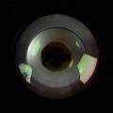

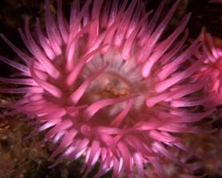
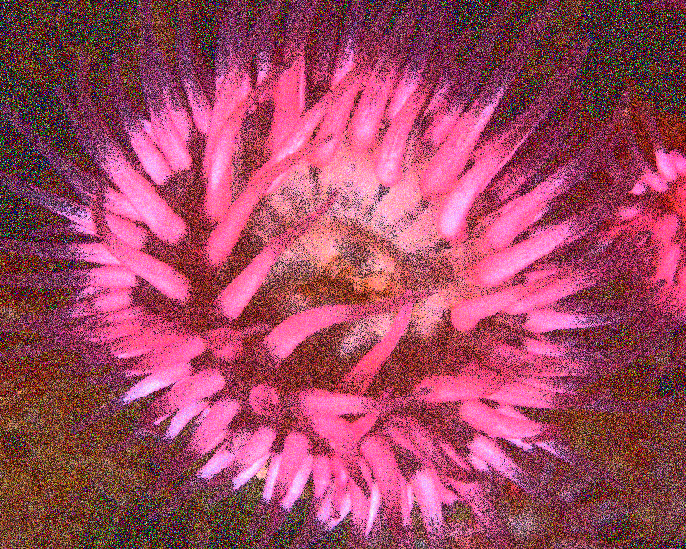
Exposure
Aperture
  Lets light into camera - variable
  f22 small f2.8 big hole
Shutter
  Opens to let light through aperture
  Shutter speed – 1/15th, 1/250th.......
Exposure
  Amount of light allowed in = shutter speed and aperture
  Big hole short time = small hole long time
Sensitivity
f22
f16
f11
f8
f5.6
f4
f2.8
Low
High

Slide 21
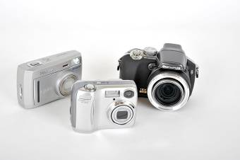
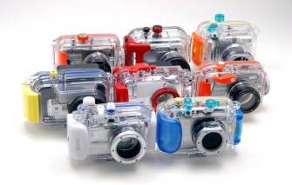
Compacts and housings
Compacts
  Inexpensive
  Many features
  Shutter lag
  Limitations underwater
Housings
  Predominantly made from inexpensive polycarbonate
  Specific to camera
  Supplementary lenses and strobes needed for optimum performance

Slide 22

Summary
Parts of a camera
Sensor
Resolution
Memory
File types
Exposure
Compacts and housings

Slide 23
Underwater Photography
Housings

Slide 24
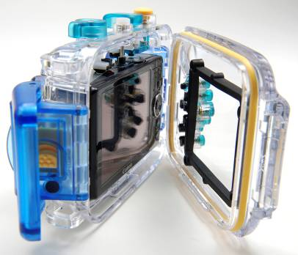
Housings
Pre-dive checks
Post-dive checks
Maintenance
Dry practical

Slide 25
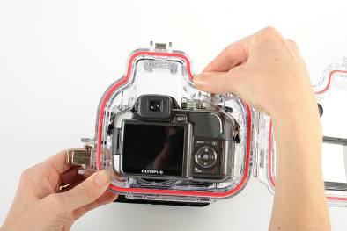
Pre-dive checks
  O Ring
  Port
  Controls alignment
  Lanyard
  Power
  Settings
  Take a test exposure

Slide 26
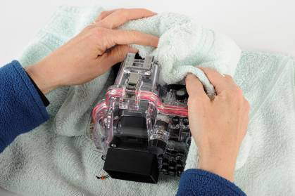
Post-dive checks
Still water tight
Power down
Soak in fresh water
Dry
Remove camera
Check O ring condition

Slide 27
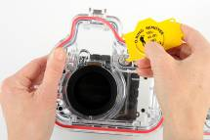
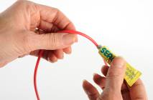
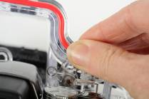
Maintenance
Cleaning O ring
  Remove using blunt instrument or credit card
  Wipe clean
  Lightly grease with silicone
  Replace
  Check for sand, hair etc

Slide 28

Summary
Pre-dive checks
Post-dive checks
Maintenance
Dry practical

Slide 29
Underwater Photography
Camera Functions

Slide 30
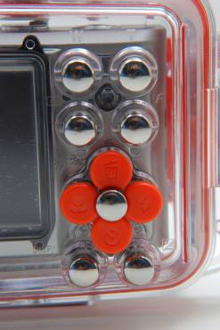
Camera functions
Shooting modes
Exposure modes
Light meter
Exposure compensation

Slide 31



Shooting modes
Auto
Program auto-assist
Movie / video

Slide 32
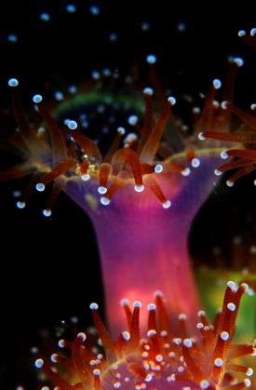
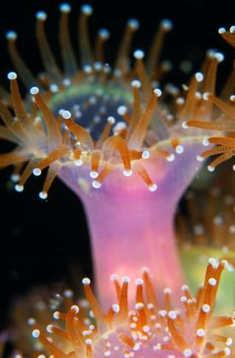
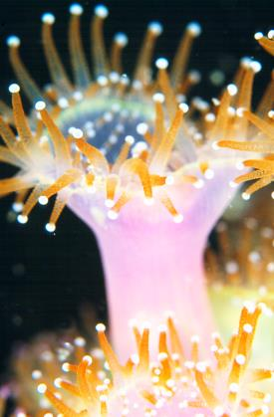
Exposure
Shutter speed
Aperture
1/15
f16
All these combinations give the same exposure
  increase aperture: decrease shutter speed
  vice versa
Correct exposure
1/30
f11
1/60
f8
1/125
f5.6
1/250
f4
under-exposed
just right
over-exposed

Slide 33











Exposure modes
Macro / close-up
Party / night
Portrait
Landscape
Sports
Stitch
Aperture priority
Shutter priority
Manual

Slide 34
Light meter
Some more advanced cameras have a light meter for use in manual mode
Bars towards + overexposed
Bar in centre correct exposure
Bars towards - underexposed
+…IIIIIII0………-
+………0………-
+………0IIIIIII…-

Slide 35
Exposure compensation
You may prefer more or less exposure than your camera suggests
Shutter speed
Aperture
EV change
1/60
f8
0
1/30
f11
0
1/15
f16
0
1/125
f5.6
0
1/250
f4
0
1/60
f11
-1 image will be one stop darker
1/60
f16
-2 image will be two stops darker
1/60
f5.6
+1 image will be one stop lighter
1/60
f4
+2 image will be two stops lighter

Slide 36

Summary
Shooting modes
Exposure modes
Light meter
Exposure compensation

Slide 37
Underwater Photography
Shooting Techniques

Slide 38
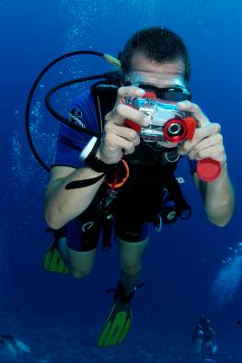
Shooting techniques
Camera to subject distance
Natural light
Artificial light
Balanced light
Freezing the action
Depth of field
White balance
Filters
Composition

Slide 39
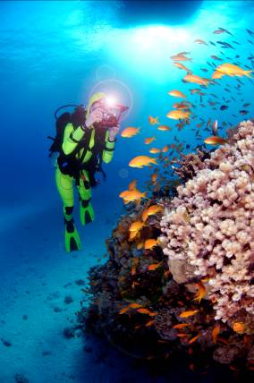
Camera to subject distance
Aim to get as close as you can
Minimise the amount of water between the lens and subject
Don’t use zoom

Slide 40
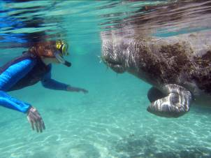
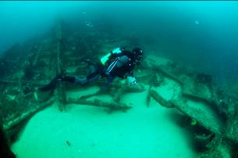
Natural light
In shallow waters use natural light
At depth for ‘monochromatic’ subjects

Slide 41
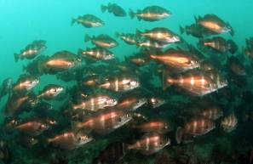
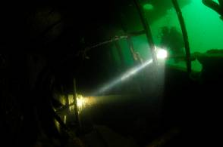
Artificial light
Can either be from a strobe
Or a diver’s torch

Slide 42
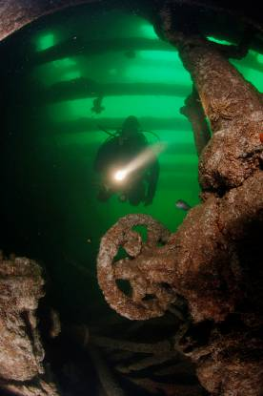
Balanced light
Exposure for the natural light and artificial lights are identical

Slide 43
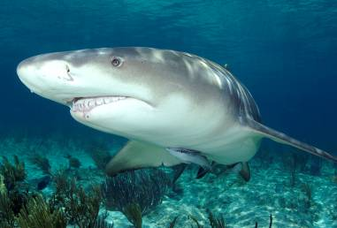
Freezing the action
Use a fast shutter speed, above 1/125s to keep the subject sharp

Slide 44
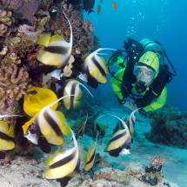
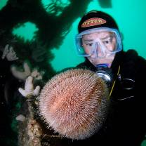
Depth of field
Small aperture (eg f11) or landscape mode increases range of subjects in focus
Large aperture (eg f2.8) or portrait mode decreases range of subjects in focus

Slide 45
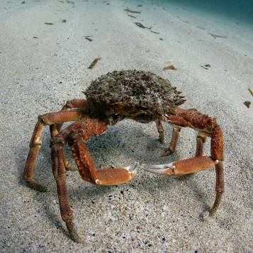
White balance
Manually set the camera for the correct white balance for that particular depth - use a white or grey card.
Palm of hand also can work

Slide 46
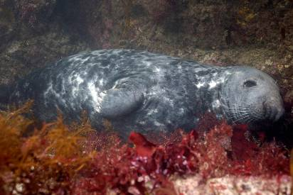
Filters
Filters can correct for the lack of red light - use in conjunction with manual white balance

Slide 47
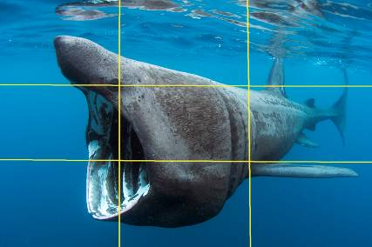
Composition
Use the rule of thirds and position the focal point of your image at one of the points
Picture should read from left to right

Slide 48
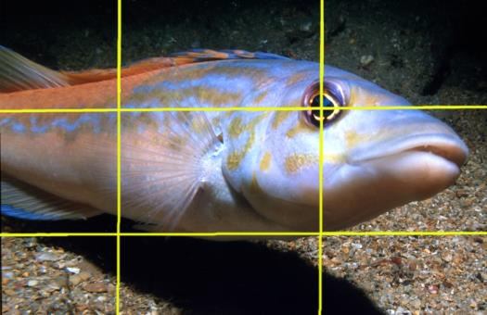
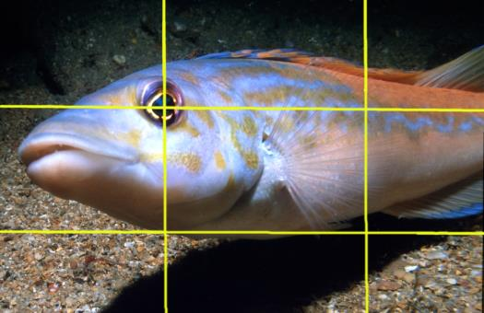
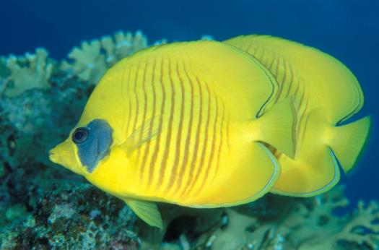
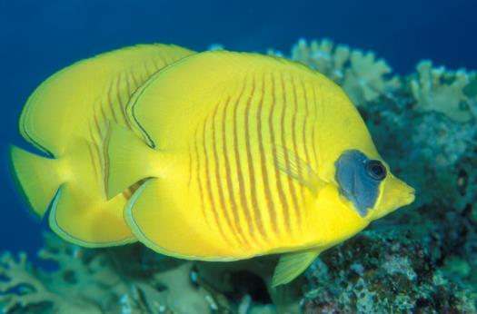
Composition – left to right
Picture should read from left to right
8
4
8
4

Slide 49

Summary
Camera to subject distance
Natural light
Artificial light
Balanced light
Freezing the action
Depth of field
White balance
Filters
Composition

Slide 50
Underwater Photography
Photography Underwater

Slide 51
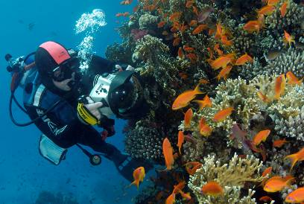
Photography Underwater
Safety and skills
Shooting tips
Code of Conduct

Slide 52
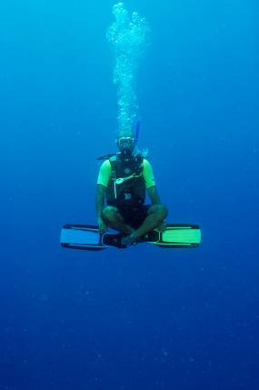
Safety and skills
Normal safety rules apply PLUS
  Task fixation
  Awareness
  Buddy diving
Skills
  Buoyancy and trim
  Task loading

Slide 53
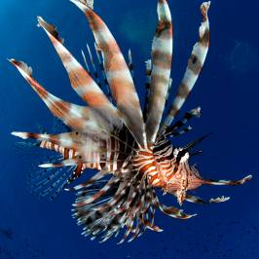

Shooting tips – dive planning
Obstructed lens
Patience
Approach down-current
Get close
Dive in middle of day
Stay shallow

Slide 54



Shooting tips – Composition
Shoot up not down
Use bubbles
Frame the subject
Interesting shape, shine, shadow, silhouette, surroundings

Slide 55


Shooting tips – Composition
Look for colour contrasts
Interesting shape

Slide 56


Shooting tips – Composition
Isolate subject from background
Shoot up not down

Slide 57



Shooting tips – Technical
Read the manual
Use slower shutter speeds
Bracketing
Wide angle and macro
Retouching software

Slide 58

Code of Conduct
Code of Conduct
  produced by MCS
  supported by all diving agencies
Contents summary
  No novices
  No danglies
  Good buoyancy
  Take the easy options
  Choose willing subjects
  Thou shalt not kill

Slide 59
Code of Conduct
Code of Conduct
  produced by MCS
  supported by all diving agencies
Contents summary cont’d
  Don't be greedy
  Don't stress
  Night dives - dip don't dazzle
  Don't leave trapped bubbles
  Watch where you're going
  Report pollution and damage

Slide 60
Summary
Safety and skills
Shooting tips
Code of Conduct

Slide 61
Underwater Photography
Practical

Slide 62

Practical
Underwater
Logistics
First session
Review
Second session
Review

Slide 63
Underwater Photography
Downloading

Slide 64

Post-processing introduction
Golden Rule
Back-up your images!
Duplicate
Work on copied images

Slide 65


Levels
Correct for the desired exposure

Slide 66


Contrast
Boost contrast to make image stand out
Use ‘S’ curves if available

Slide 67


Saturation
Add up to 10% to make the colours more vibrant

Slide 68

Sharpening
Use unsharp mask to sharpen
Experiment with values
Don’t over sharpen

Slide 69

Image storage
Rename the file to something meaningful
  baskingshark100507.jpg
  CHood_anglerfish1_Cornwall.jpg
Keyword and use image library software
Back it up!

Slide 70
Underwater Photography
Summary

Slide 71
Review
Practical lessons learnt
Open forum
Advanced underwater photography courses
Buoyancy & trim workshop
All images © Charles Hood

