Slide 1
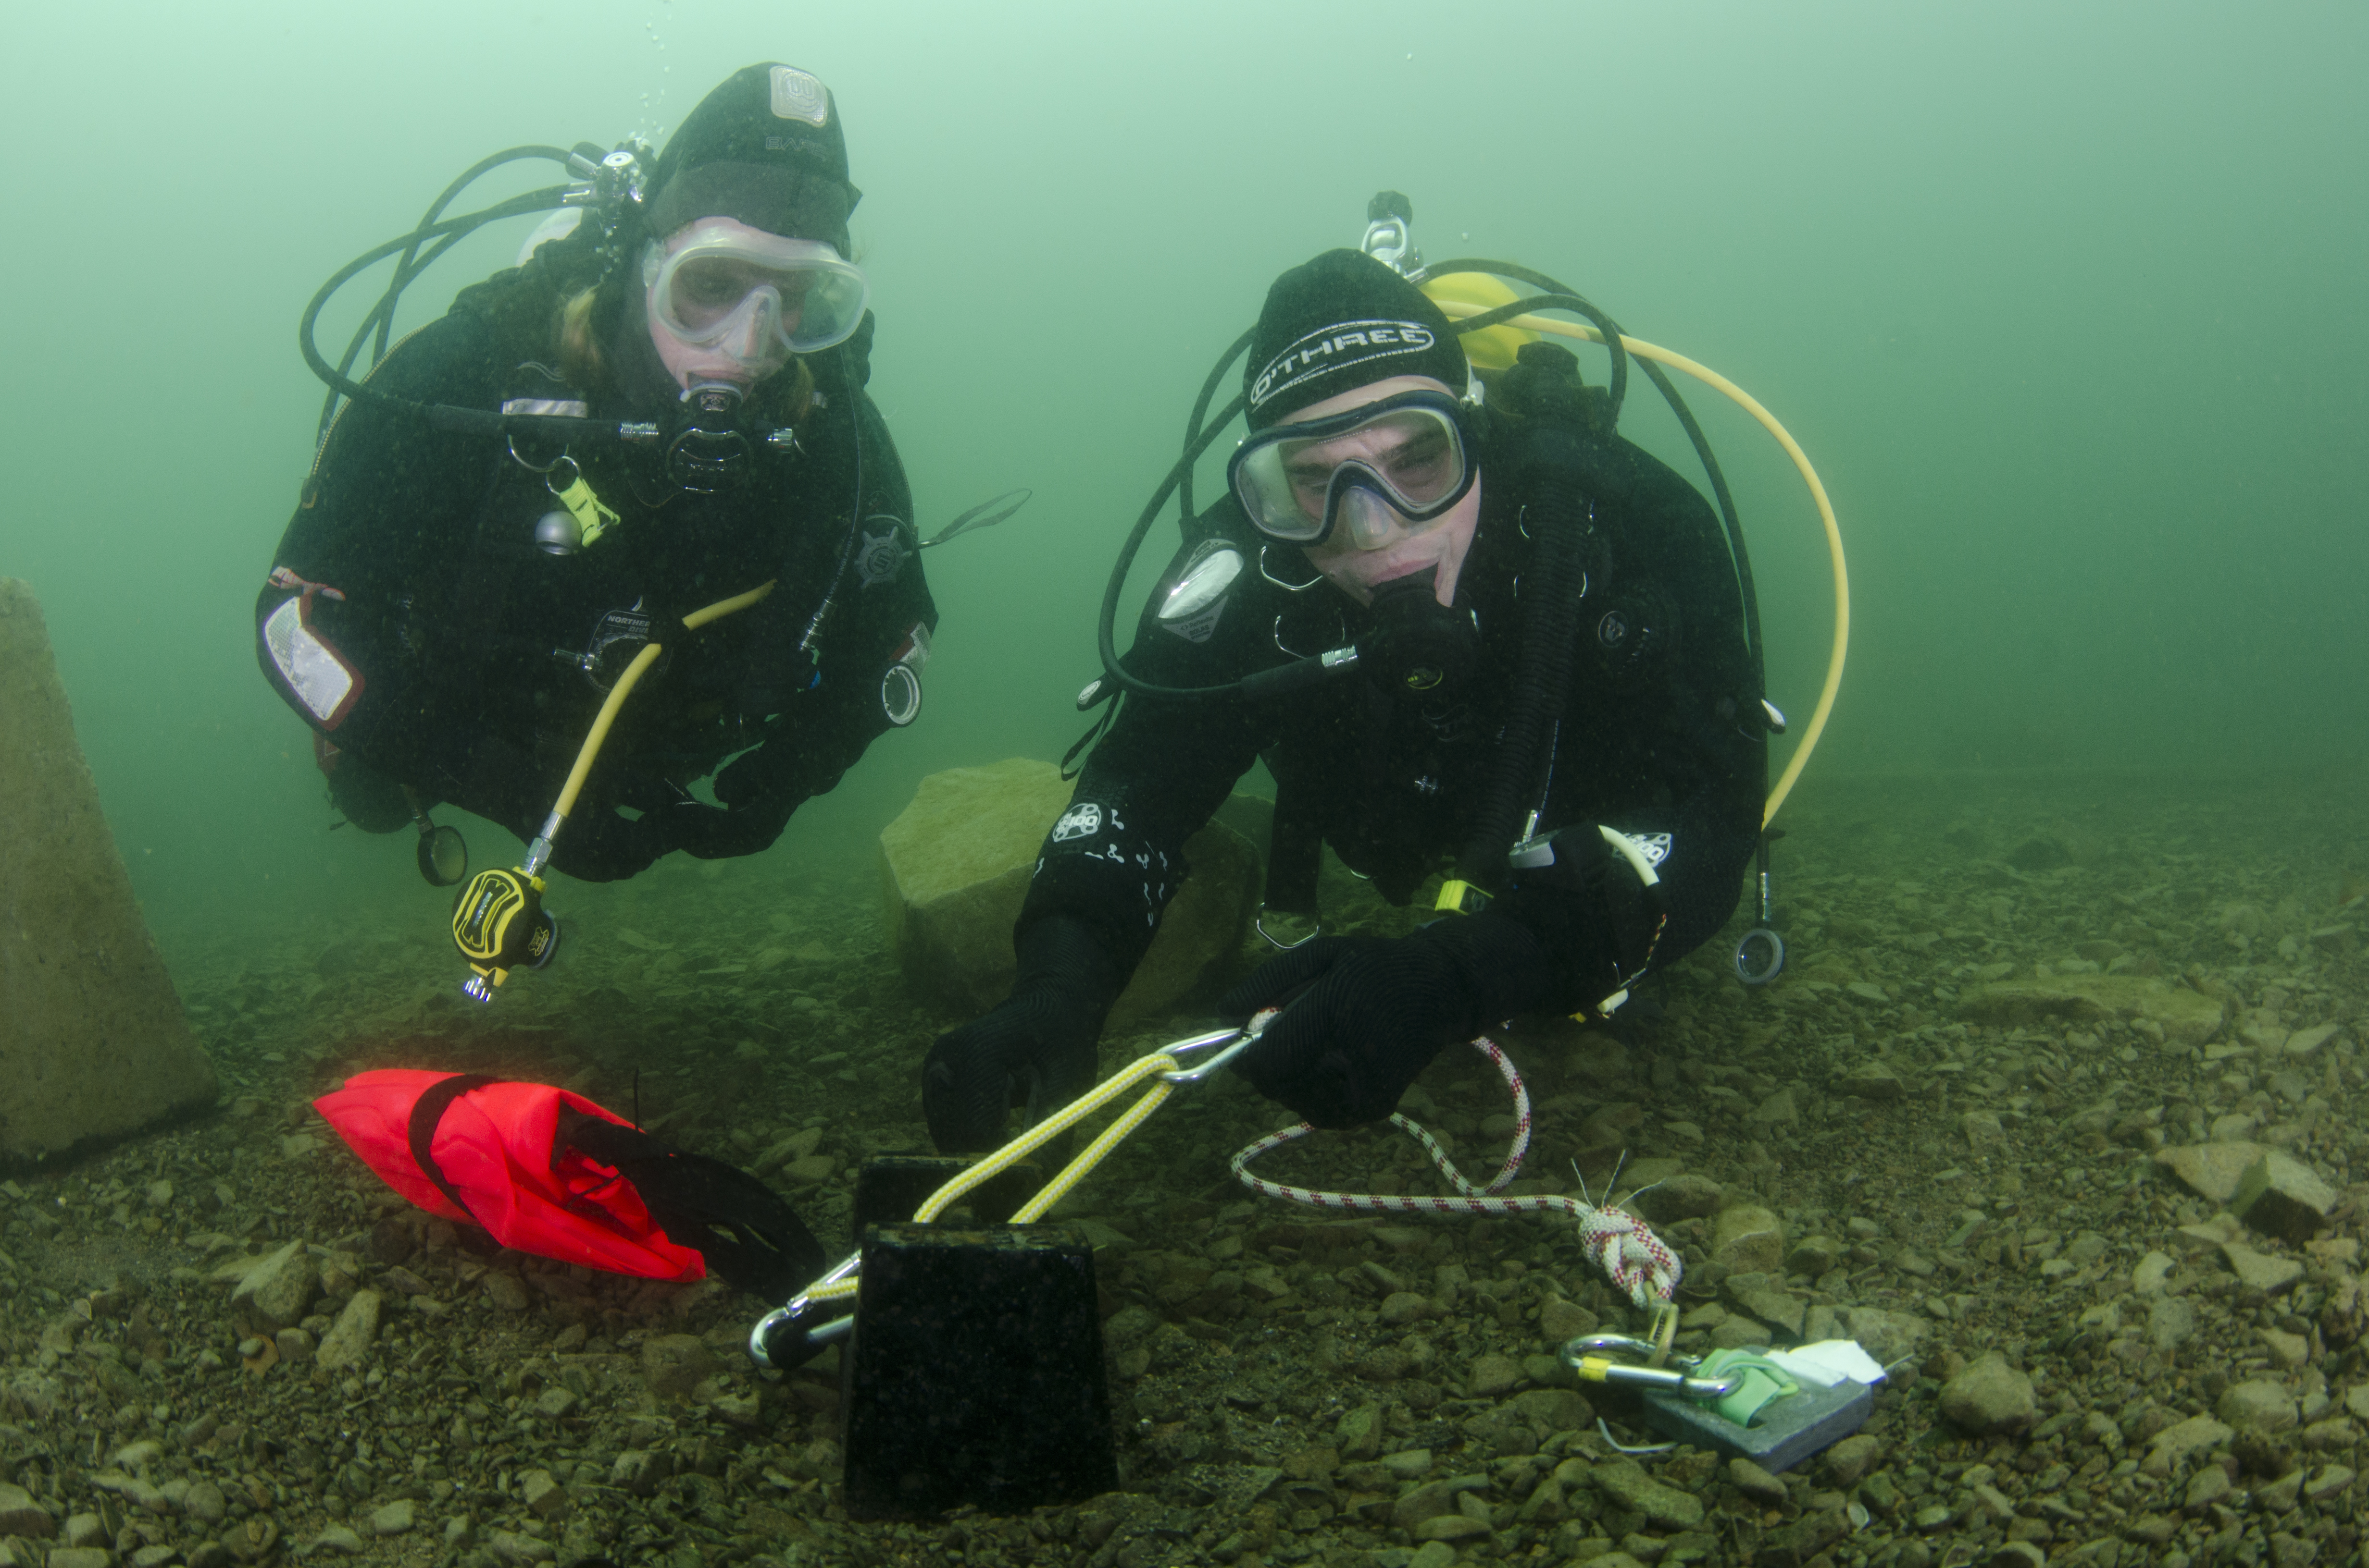

Search and Recovery
The Shot-line and its Uses

Slide 2
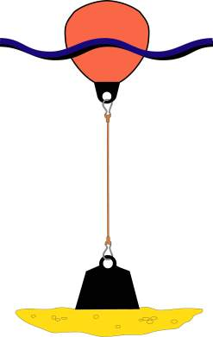
Simple shot-line
Simple shot
  Advantages - it’s simple
  Disadvantages
    not easily made vertical
    does not adjust for tidal rise / fall
Keep line as short as practical

Slide 3
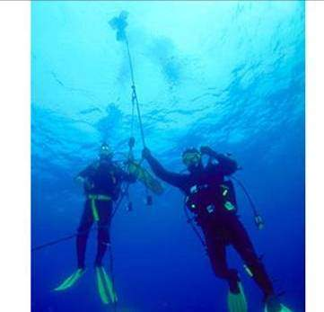
Outline
Why use a shot-line?
Types of shot-line
Construction
Deployment / recovery

Slide 4
What is a shot-line?
A datum point comprising:
Buoy
Line
Weight

Slide 5
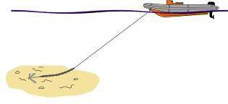
Shot-line usage
Why use a shot line?
  Marked entry / exit point - aids dive management and boat cover
  Shortest route to / from surface
  More comfortable/secure
  Datum point for searches
Why not use boat’s anchor?
  Not vertical - useful dive time is shortened
  Line moves with boat movement
  Cover boat should be mobile at all times

Slide 6
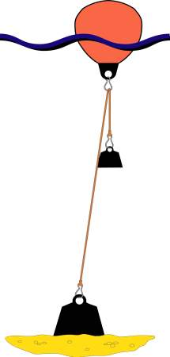
Top tensioned shot-line
Adjusts for tidal rise and fall
Near vertical line for descent / ascent
Doesn’t remain vertical in a current
More complex
Top weight can become entangled
Counterweight

Slide 7
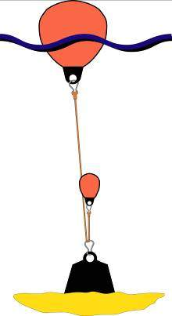
Bottom tensioned shot-line
Similar to top tensioned
  Adjusts for tidal rise and fall
  Near vertical line for descent / ascent
  Doesn’t remain vertical in a current
  Can tangle
Aids shot recovery
May require work / effort at depth to set up

Slide 8
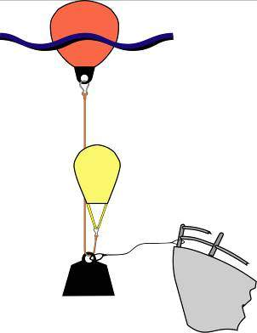
Shot-line with waster
Keeps shot-line securely on wreck
Reduces risk of shot entanglement on recovery
Strength of ‘waster’ line critical
Requires work / effort at depth
Dive management

Slide 9
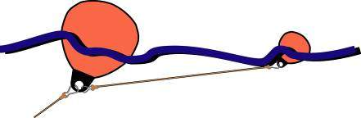
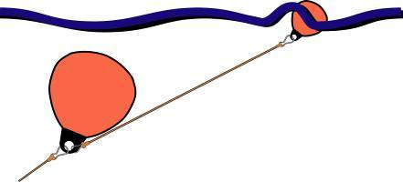
Trail or ‘tide’ buoy
Tide
Tide

Slide 10
Shot-line construction
Line
  Ease of handling: 15-20mm diameter
Length
  Depth plus a couple of metres
  Surplus line tidied at surface
Buoy
  50% more buoyancy than total hanging weight
Shot weight
  Adequate size to prevent dragging ~25kg
Counterweight
  5-10kg dependent on conditions

Slide 11





Shot-line connections
Buoy, line, weights
  Karabiners
Attachments
  Karabiners
  Prusik knots
  Rolling hitch
Shortening line
  Karabiners
  Chain senneting
  Knotted sheepshank

Slide 12
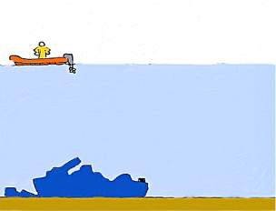
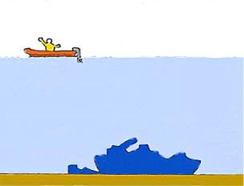
Shot-line deployment
Prepare before reaching the site
GPS / transits position fix
Deploy on command from cox’n
Tidal flow considerations
Once deployed, re-check

Slide 13
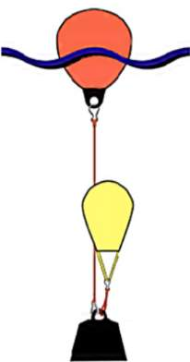
Lifting the Shot
Controlled recovery
  Lift bag rating = weight of shot
  Fill bag
  Lift to surface from boat, by pulling on line
Buoyant recovery
  Lift bag rating > weight of shot
  Fill to send up, stay well clear
  Boat should stay clear of area
Recovery into boat
  Coil or ‘flake’ line
  Do not tip lift bag

Slide 14
Summary
Why use a shot-line?
Types of shot-line
Construction
Deployment / recovery

