Slide 1
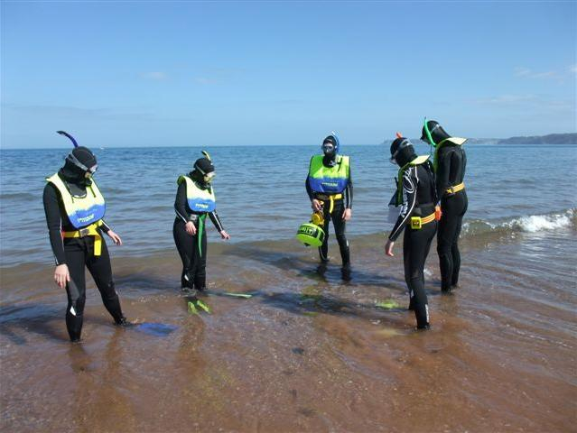

Risks and Emergencies
Module SMT3
Snorkel Dive Manager

Slide 2
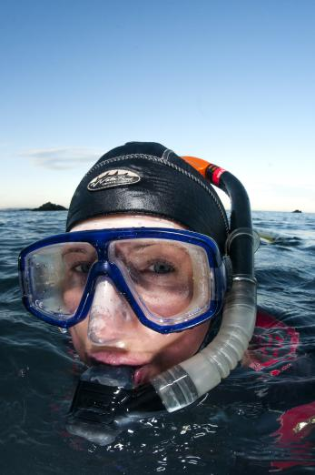
Module content
Understanding Risks to Snorkel Divers and controlling them
  Understanding Risk
  Emergency Planning
    Shore
    Boat
  Group Management
  Problems
  Delegation
  Managing issues
  Logging and Reporting
  Safeguarding

Slide 3
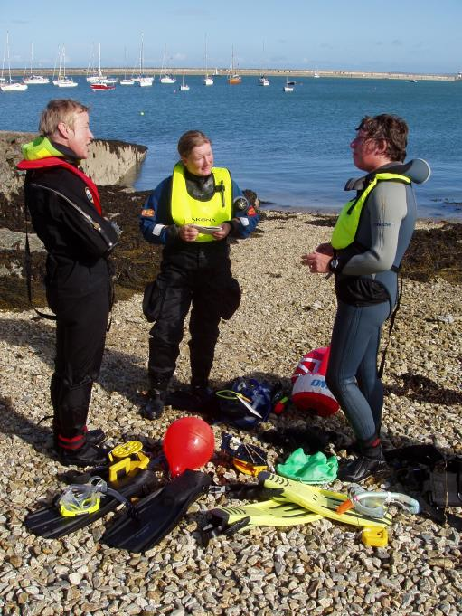
Understanding Risk
Who
  Who can be at risk during activities?
  What risks
  Consider the full day of snorkel activities.
  What action
  How can we mitigate the risk?
  Dynamic Risk Assessment
  Reassess the possible risks throughout the day

Slide 4
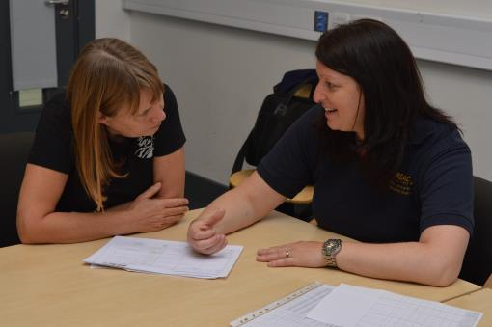
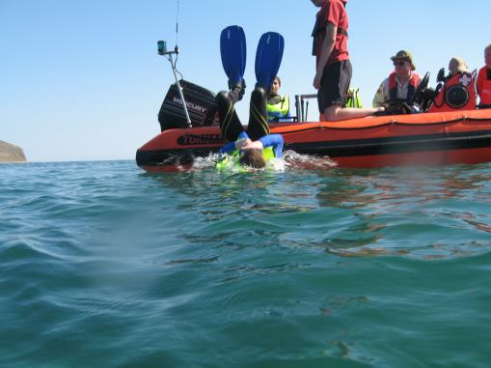
Emergency Plan
Why Do We Need a Plan?
  Pulls together information from risk assessment
  Planned response to follow
  Helps with briefing team
  Difference between boat and shore
  Boat
    Offers mobile support
    Can present additional risks
  Shore
    Plan to return to shore
    Plan to recover casualty

Slide 5
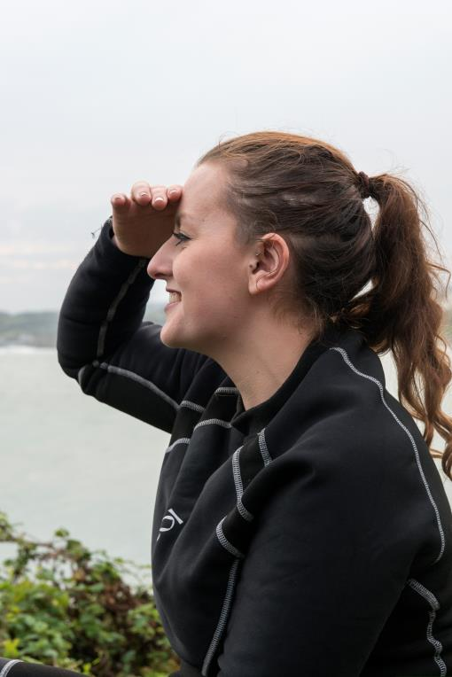
Emergency Plan
Recall Signals
  Monitor shore for recall signal
  Wave, whistle or klaxon
  Responsibilities
  Snorkel Dive Manager
    Safe management of all snorkel activities
  Lead Snorkel Diver
    In-water lead
    Initial responsibility for in-water issues
    Communicate with SDM
Equipment
  First aid kit, oxygen, whistle, SMB

Slide 6
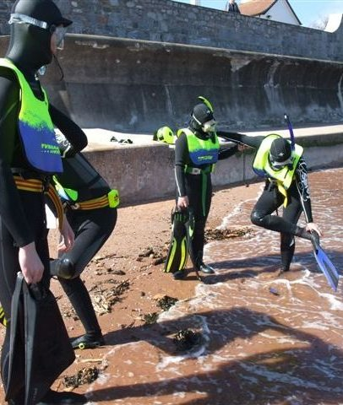
Emergency Plan - Shore
Shore Cover
  What cover is available?
  Assess Issues
  Entry/exit
Safety Equipment
  What do we have and who can use it?
Contacts
  Who to speak to

Slide 7
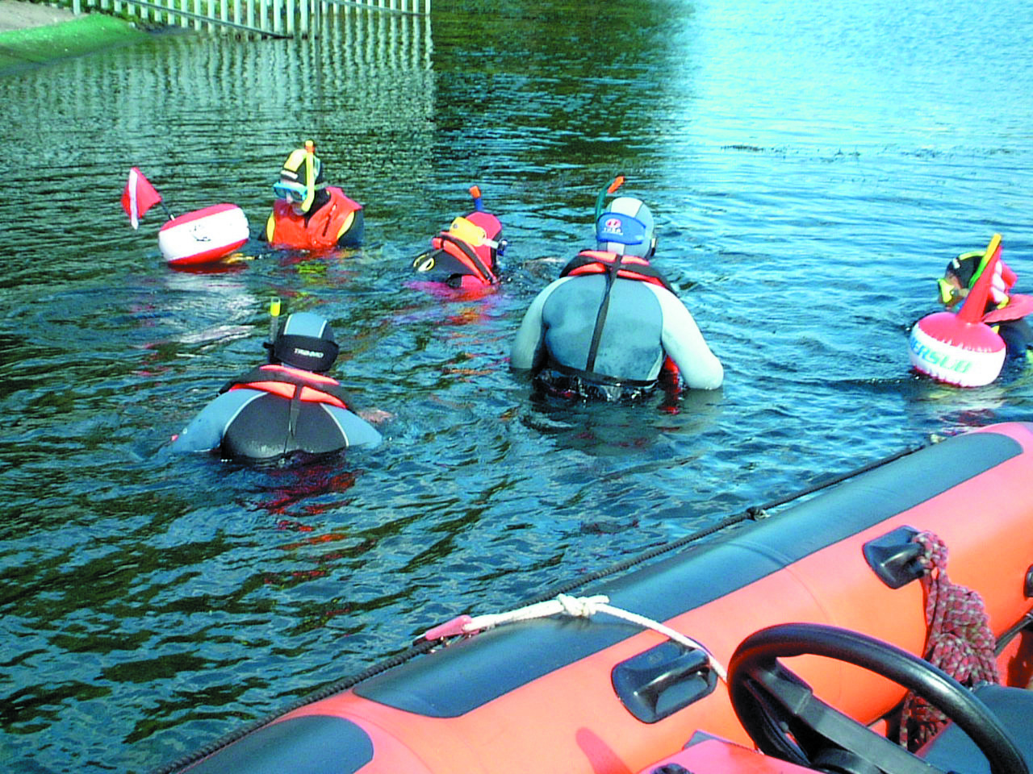
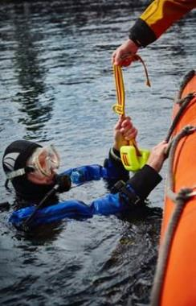
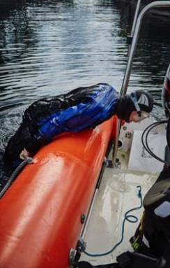
Emergency Plan - Boat
Working with the skipper/cox
  Create a plan together
  Radio
  Emergency use
Safety Equipment
  What does the boat carry?
Shelter
  Cabin
Recovering Snorkel Divers
  Lift
  Assistance

Slide 8
Quiz 1
What can you use as a recall signal?
  Wave
  Whistle
  Klaxon
What should you consider for a shore dive?
  Shore cover
  Entry and Exit
  Safety equipment
  Contacts

Slide 9
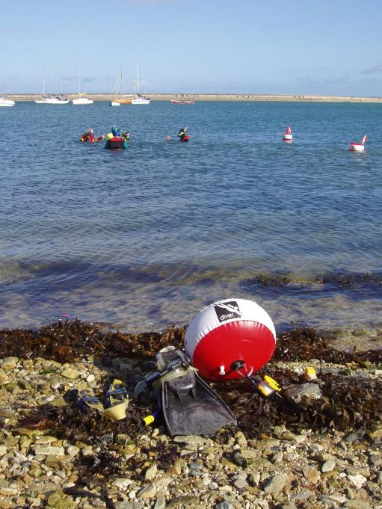
Managing the Group
Keeping Together
  Everyone back to shore safely
  Could be delegated
  Group Skills
  Lifesaver
  First Aid
  VHF

Slide 10
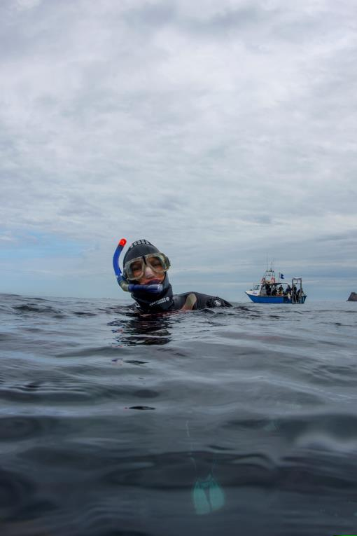
Problems
Equipment
  Entanglement
  Cold
  How to identify
  Separation
  How to prevent
  Bunching
  How to prevent
  How to manage each

Slide 11
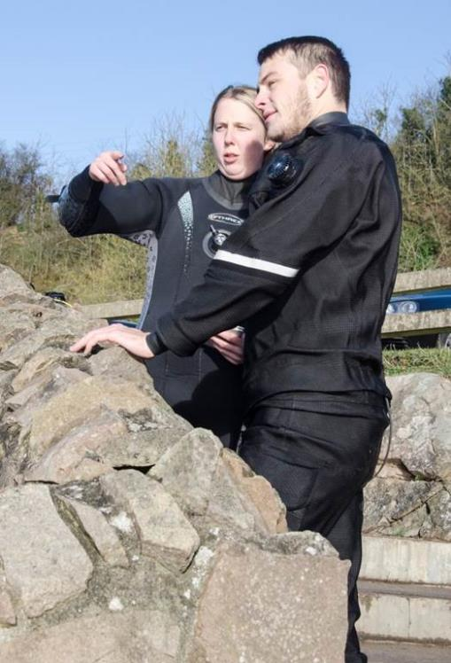
Delegation
Casualty Care
  First aid
  Reassurance
  Group Management
  Return to shore
  Dealing with incident
    Initial response from the Lead Snorkel Diver
    Support from SDM
  Communication
  Updating the Snorkel Dive Manager
  Asking for assistance

Slide 12
Emergency Services
Contacting
  999 on land
  Radio coastguard from a boat
  Information to Provide
  Problem
  Location
  Help needed

Slide 13
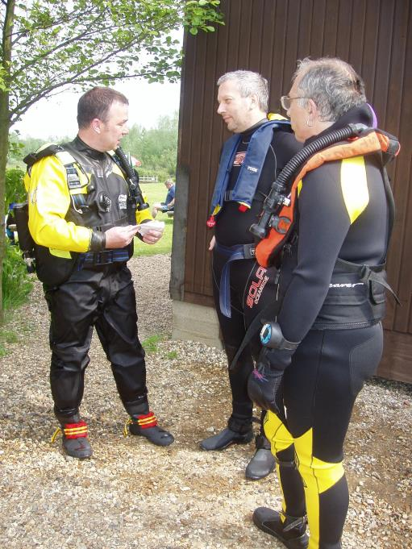
Managing Issues
Issues may not be immediate
Provide advice for Divers or Parents
What to Look Out For
  Impact of cold
  Signs of secondary drowning
  Stings
  Action to Take
  Warm gently
  Monitor. Seek medical attention
  Topical creams. Severe reaction seek medical attention

Slide 14
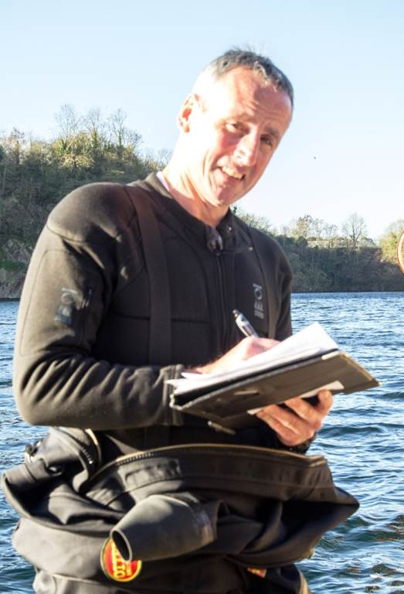
Logging and Reporting
Casualty Form
  Record during incident
Incident Form
  bsac.com/incidentform
Group Debrief
  Update other snorkel divers

Slide 15
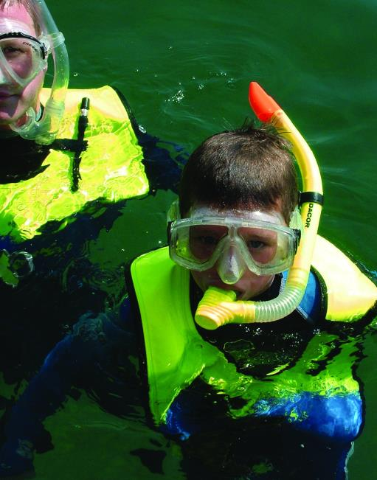
Safeguarding
BSAC Buddyguard
  How Does this Apply?
  What Should You Do?

Slide 16
Quiz 2
What information should go on the casualty form?
  Problem
  Who involved
  Action taken with times
What sort of things might snorkel divers or their family need to look out for after a day of snorkelling?
  Impact of cold (or sun), dehydration
  Difficulty breathing
  Extreme fatigue, irritability

Slide 17
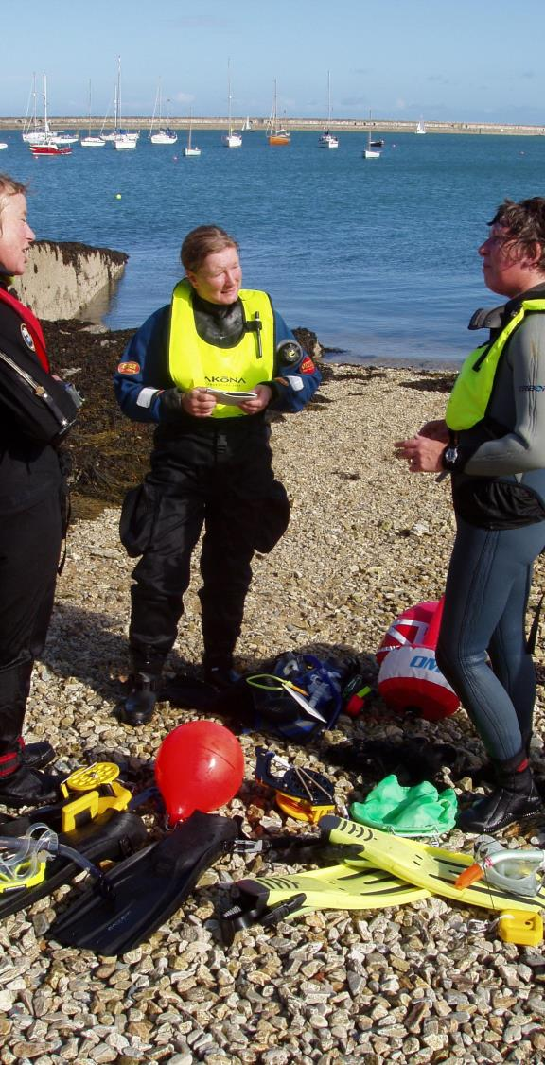
Summary
Understanding Risks to Snorkel Divers and controlling them
  Understanding Risk
  Emergency Planning
    Shore
    Boat
  Group Management
  Problems
  Delegation
  Managing issues
  Logging and Reporting
  Safeguarding

