Slide 1
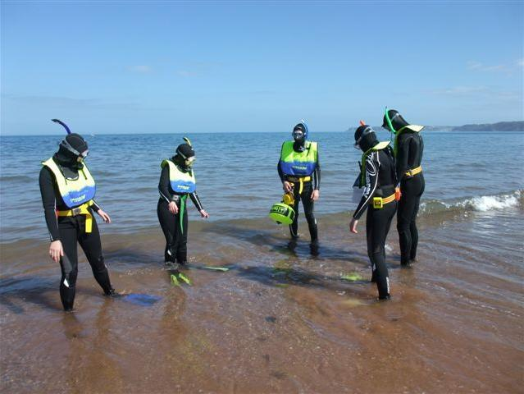

Leadership
Module SMT2
Snorkel Dive Manager

Slide 2
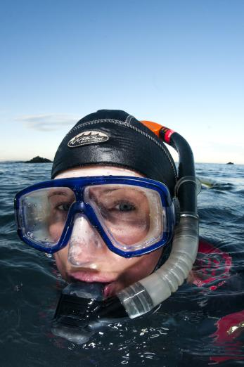
Module content
Leading a group of Snorkel Divers
  Preparation
  Entries
  In-Water
  Additional Equipment
  Monitoring
  Keeping Safe and Fun
  Managing Exits
  Post-dive activities
  Self-evaluation

Slide 3
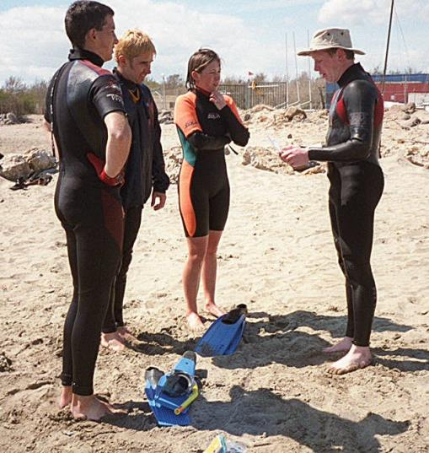
Preparation
Kitting Up
  Take the lead
  Manage time
  Temperature
  Over heating
  Getting cold
  Role of Buddy Pairs
  Coordinate plans
  Lead Snorkel Diver enable communication between pairs

Slide 4
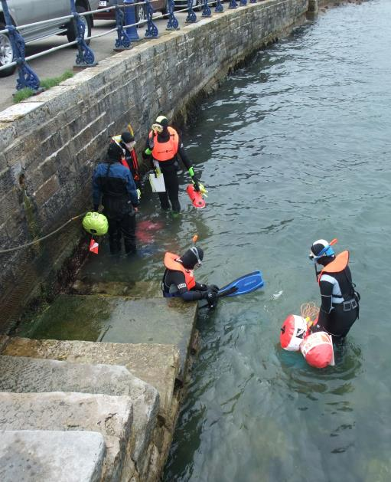
Entries
State of Tide
  Be aware how this can affect your entry
  Assistance
  Will any of the snorkel divers need assistance?
  Sand, Steps, Wading
  Take a lead and demonstrate a safe entry

Slide 5
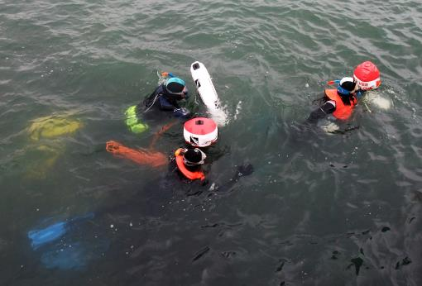
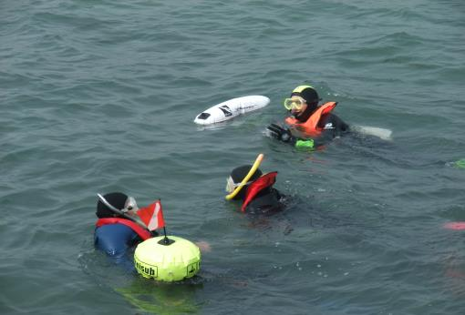
In-Water
Maintaining Buddy Pairs
  Act as leader
  Keep pairs together
  One up – One down
  Communications
  Keep clear contact with all pairs

Slide 6
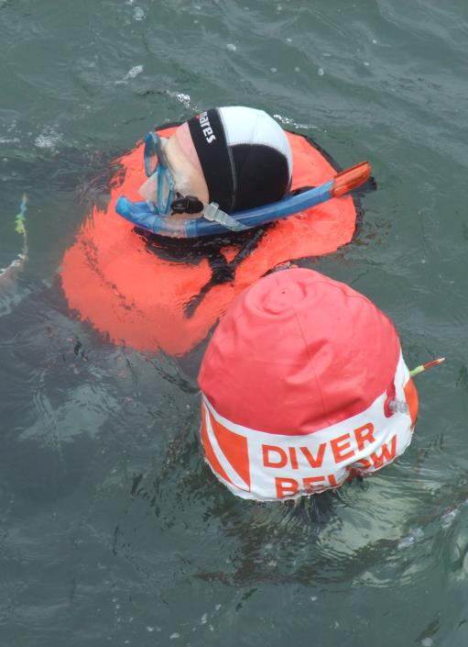
In-Water (2)
  Use of SMBs
  Marked point for group
  Surface support
  Signals
  Communicate with surface support
  OK and Not OK

Slide 7
Quiz 1
What is your role in a buddy pair?
  Act as leader
  Keep pairs together
  Ensure one up – one down
What would you use an SMB for?
  Marker for the group
  Surface support

Slide 8
Additional Equipment
Personal Location Beacons (PLB)
  Provide position in case of an incident
  Boat VHF Radio
  Communicate between boats and emergency services
  Marine Life Guides
  Help others to develop knowledge
  Goody Bag
  Collect litter
  Collect scallops (in line with local laws)

Slide 9
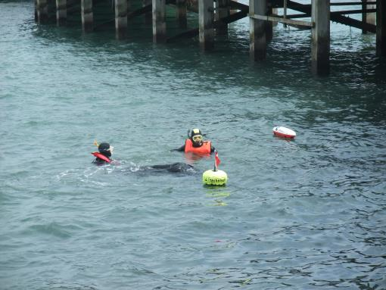
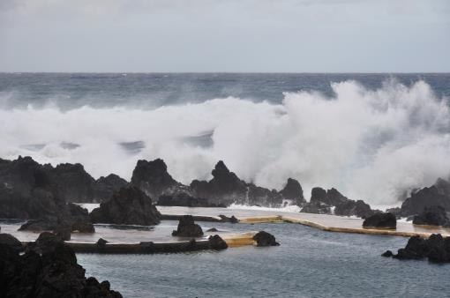
Monitoring
One up – One down
  Usual time under water
  Longer
  Shorter
  Conditions
  Weather
  Visibility
  Sea state
  Snorkel Divers
  Cold/heat
  Exhaustion

Slide 10
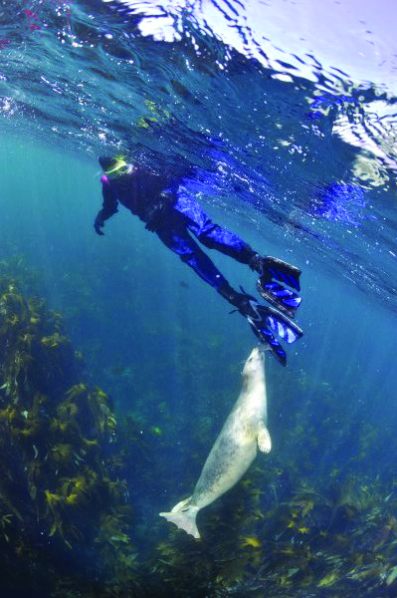
Keeping it Safe and Fun
Finding things
  Parts of a wreck
  Sea bed features
  Marine Life Identification
  Things that move (fish, crabs, lobsters)
  Things that don’t move! (Anemones, hydroids, bryozoans)
  Litter pick
  Improve the underwater environment
  Planning and risk assessment

Slide 11
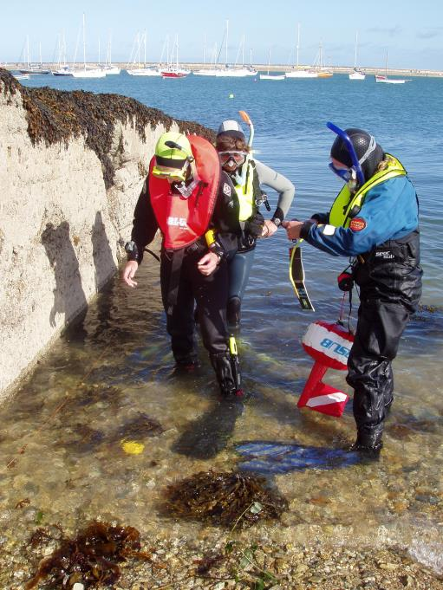
Managing Exits
Types of Exits
  Demonstrate safe exit
  Impact of tides and conditions
  Leader Assistance
  Last one out of water
  Assist other snorkel divers

Slide 12
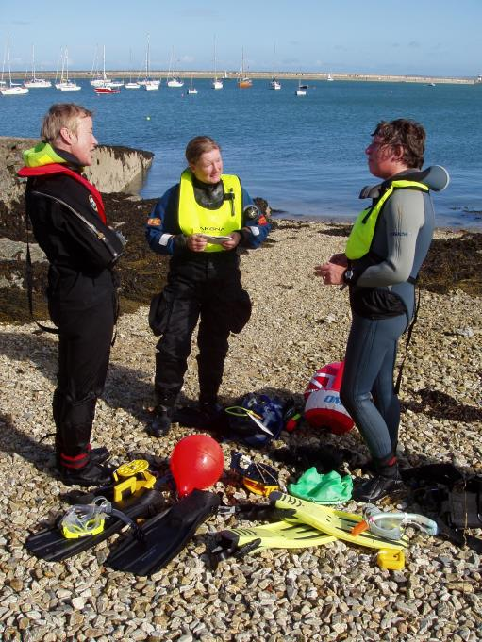
Post-Snorkel Activities
Shelter
  Changing, getting warm/out of sun
  Food/drink
  Hydration
  Debrief - REAP
  Review – what did you do and see?
  Encourage –highlights or training completed
  Assess – any issues or do differently
  Preview – What next?
  Feedback to the SDM

Slide 13
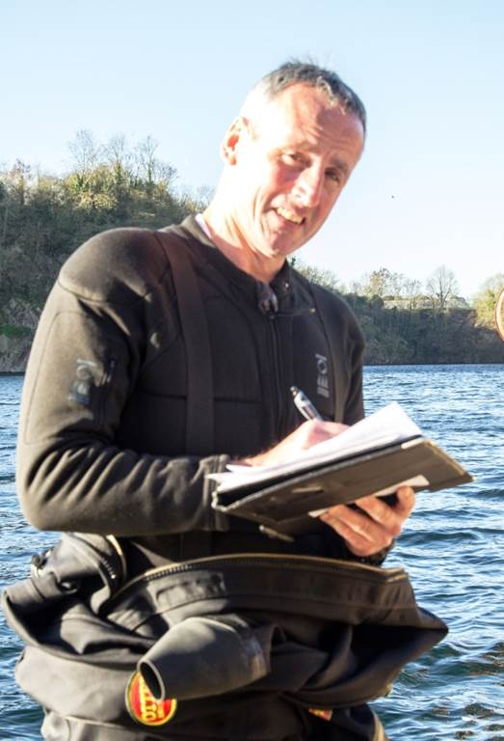
Self-Evaluation
How Did it Go?
  Visualise the day
  Are you happy with how everything went?
  Changes
  Assess your own management
  What would you do differently next time?

Slide 14
Self-Evaluation (2)
  REAP
  Review – what did you do and see?
  Encourage – bring out the highlights or training completed
  Assess – identify any issues and things to do differently
  Preview – What next?

Slide 15
Quiz 2
What conditions should you monitor?
  Divers
    One up – one down
    Cold/heat/exhaustion
  Weather
  Sea State
What are the key elements of REAP?
  Review
  Encourage
  Assess
  Preview

Slide 16
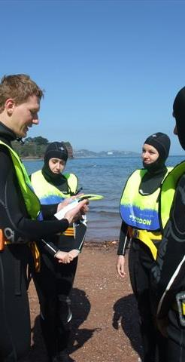
Summary
Leading a group of Snorkel Divers
  Preparation
  Entries
  In-Water
  Additional Equipment
  Monitoring
  Keeping Safe and Fun
  Managing Exits
  Post-dive activities
  Self-evaluation

