Slide 1
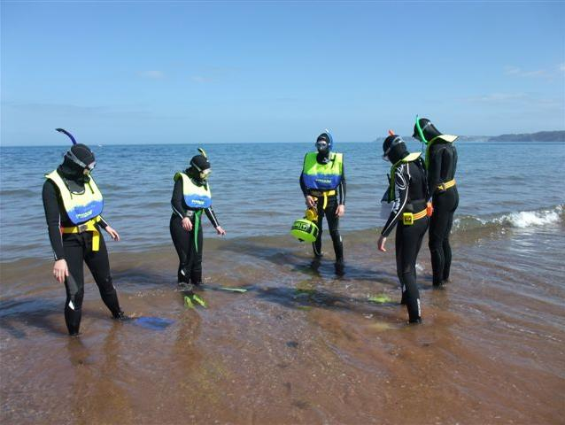

Role of a Snorkel
Dive Manager
Module SMT1
Snorkel Dive Manager

Slide 2
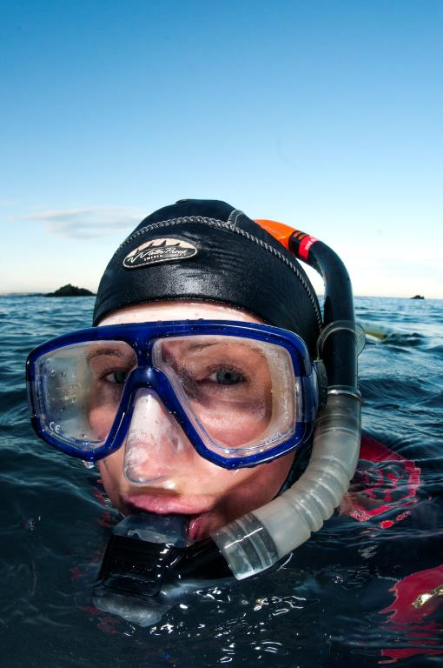
Module content
Understanding the role of the Snorkel Dive Manager
  Planning
  Communications
  Equipment Requirement
  Brief
  Surface Cover
  Risk Assessment
  Planning for emergencies

Slide 3
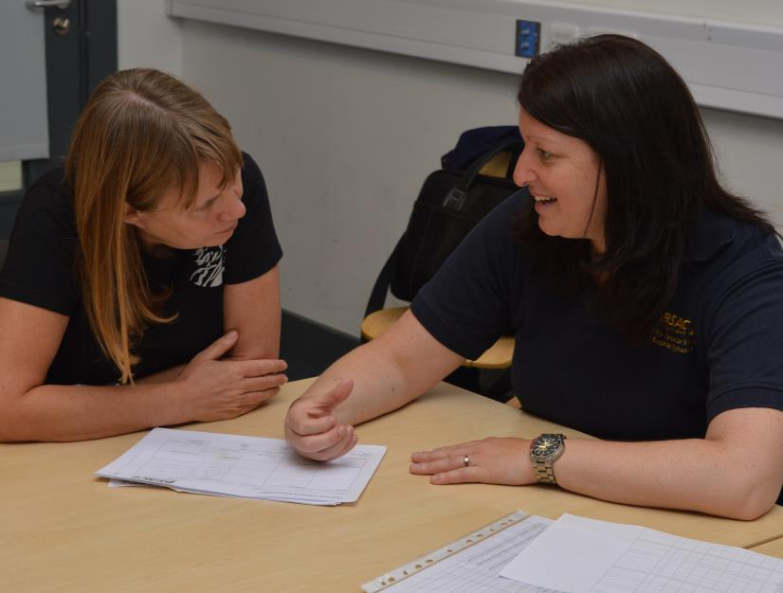
Planning
Why?
Who?
Where?
When?
What?

Slide 4
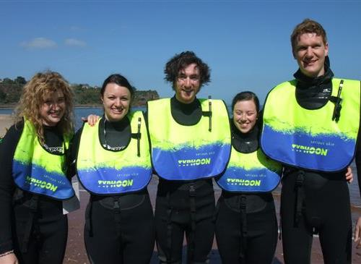
Planning – Who?
Snorkel Diver Levels
  What Qualifications
  Site matched to experience
  More adventurous set minimum qualification and experience
Safety Training
Scuba Diver Crossover
Buddy Pairs
  Inexperience with experienced?
  Divers looking to extend experience?
  Training?

Slide 5
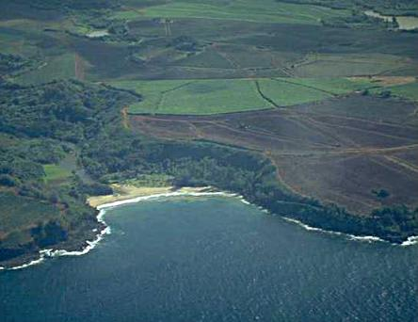
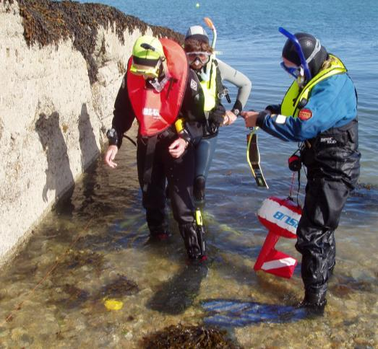
Planning – Where? - Sites
Features
  Reefs
  Wrecks
  Rivers
  Quarries and lakes
Use of OS Maps/Charts
Identifying new sites
Entry/exit depth

Slide 6
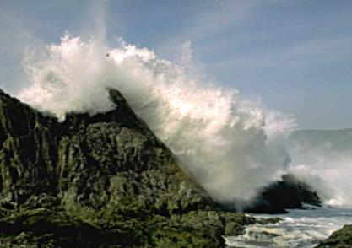
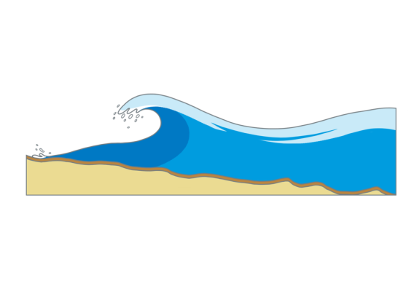



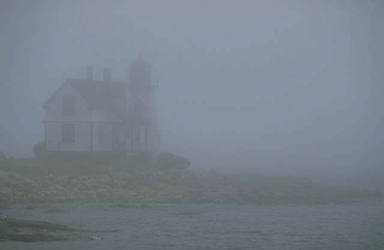
Planning – When? - Weather
Effects of Wind
  Generates waves and sea swell
    Height depends on direction and time
    Height depends on wind strength
  Wind and Waves can affect visibility
    Sites closer to coast more affected
    Breaking waves cause more turbulence
Rain/Fog
  Both can reduce surface visibility
  Compromising safety by risk of separation

Slide 7
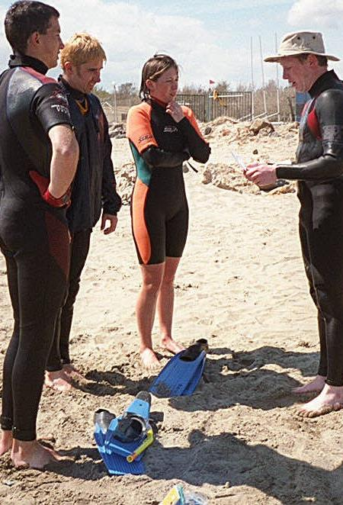
Planning – When? - Weather
Temperature
  Hot Weather can cause overheating
    Risk hyperthermia
    Maintain fluid intake to limit dehydration
  Cold Weather and wind can create wind chill
  Planning may highlight need for relevant thermal protection

Slide 8
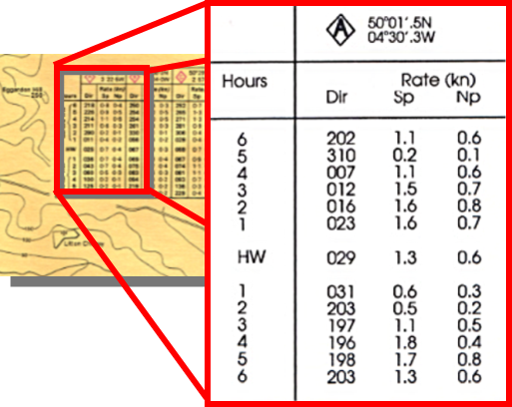
Planning – When - Tides
HW
Finding Flow Rate
  Can be found on a Chart
Time of Least Water movement
  Slack water
Tidal Diamond Table (4 columns)
  Hours before and after HW
  Direction of flow
  Speed (in knots) of flow Spring Tides
  Speed (in knots) of flow Neap Tides
Tidal Range
LW

Slide 9
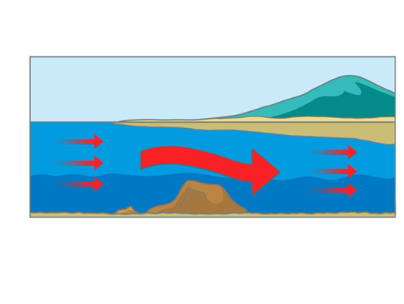
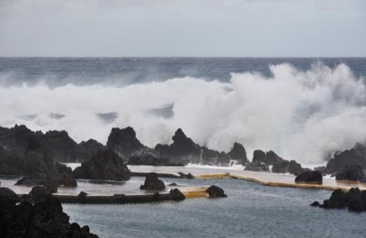
Planning – When - Tides
Planning Drift Snorkels
  Need to understand direction of travel
  Allow boat cover to follow
  Ensure safe direction (avoid hazards)
Entry/exits
  Tide may impact
  At high tide deep water entry from height
  Low tide exit may be difficult

Slide 10
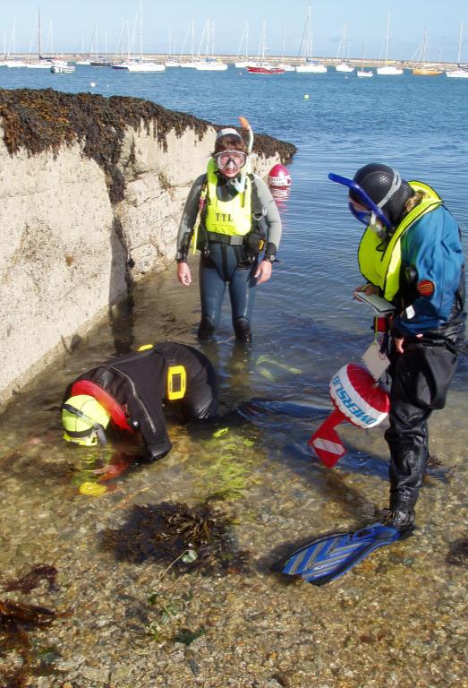
Planning – Weather Forecasts
Important part of planning
  Decide if dive can go ahead
  Known sites aware of relevant impacts
  Alternative sites?
Beaufort wind scale
  ‘Force’
  Beaufort scale Force 1 to 12
    1 calm conditions
    12 Hurricane winds
    Force 4 normally limit of snorkelling activities

Slide 11
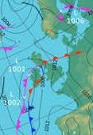
Planning – Weather Forecasts
Shipping/Inshore forecasts
  In UK Radio 4 four times a day
  Local radio may also give forecasts
  TV carries national and regional forecasts
  Web sites and phone Apps available
  Coastguard issue VHF forecasts and can provide updates

Slide 12
Quiz 1
What weather can affect diving?
  Direction and time of wind
  Strength of the wind
  Rain/Fog
What wind force limits diving?
  Force 4 or higher

Slide 13
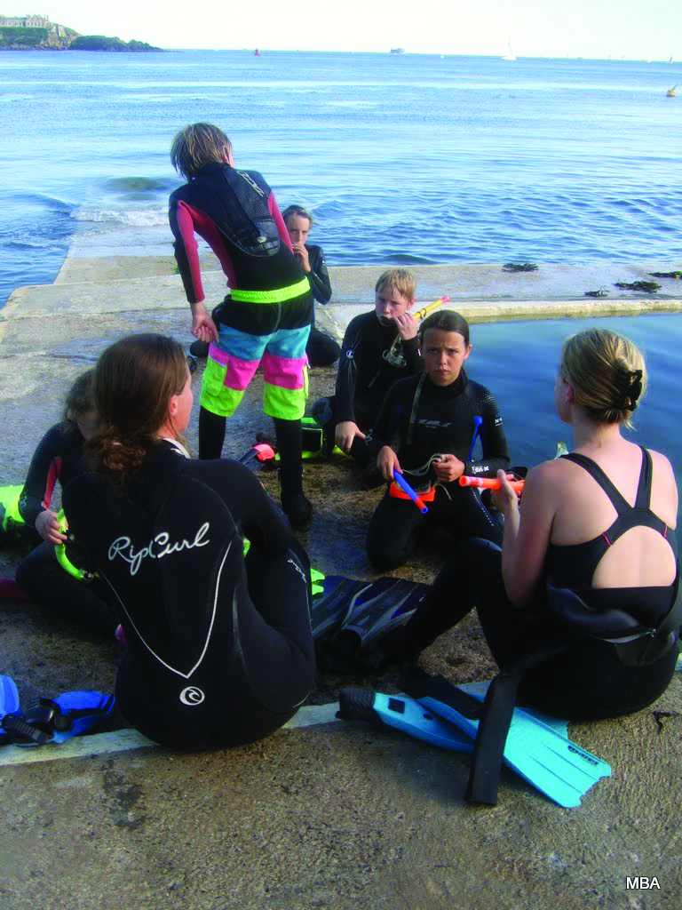
Planning – What? - Other
Costings
  Entry fees
  Boat costs
  Accommodation
  Food/drink
  Travel Costs
Parking/access
  Parking at site or walk?
  Is there a charge?
  Boat access/launching

Slide 14
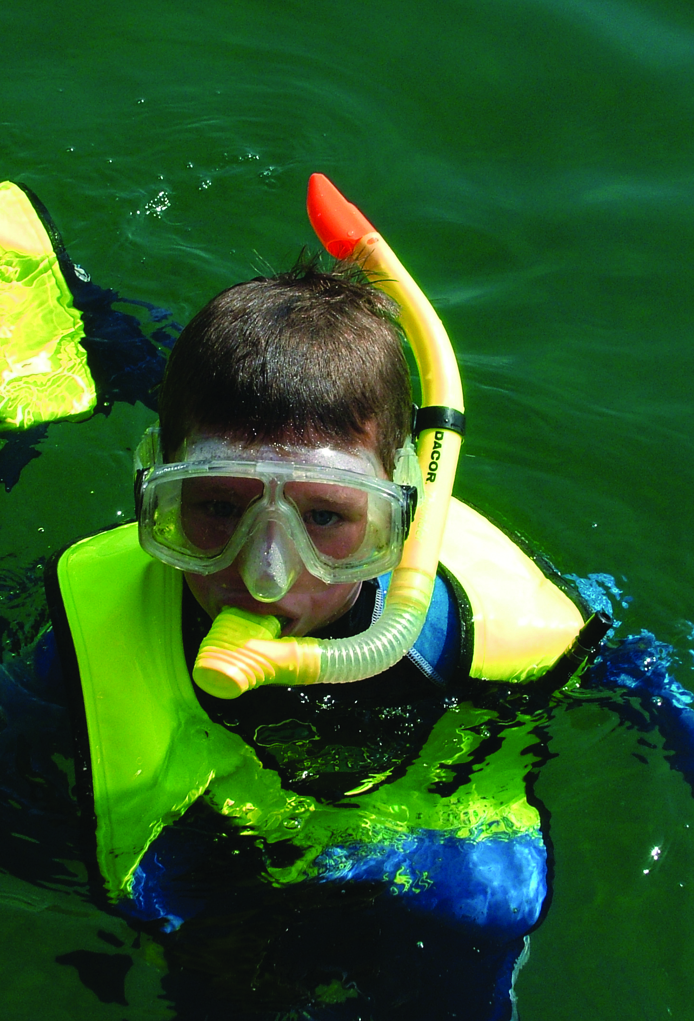
Planning – What? - Other
Changing/toilet facilities
  What facilities available?
  Is there a charge?
  Is food and drink available
Safeguarding
  young people involved?
    Ensure their wellbeing
    Parents attend?
    Adults happy to be responsible?
    BSAC Safeguarding (see SMT2)

Slide 15
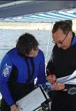
Communications
Once Planning complete
Where
  Is the diving taking place
When
  Date and time
Group Equipment
  What to bring
  What will be provided
Contacts
  Who to contact with questions
  Emergency contact details

Slide 16
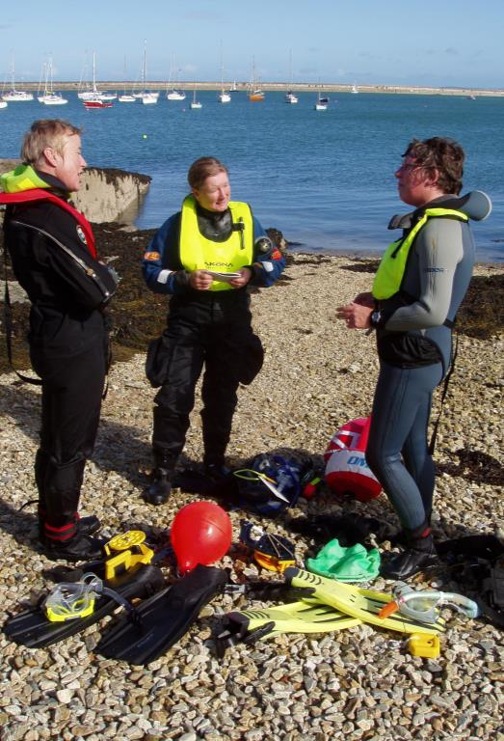
Equipment
Personal
  What to bring (mask, fins, snorkel, wetsuit, food/drink)
Leaders
  SMB, Compass, torch
Group
  First Aid Kit, Oxygen
  Site plan
  Marker buoys
  Dive plan
  Boat?

Slide 17
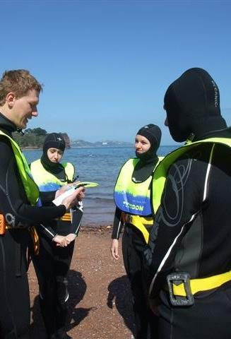
Brief
Leaders Brief
  Planned in advance
  Written down to ensure all covered
SEEDS
  Safety – everyone fit, aware of site?
  Exercise – dive plan, depths, times, access, any training
  Equipment – shotlines, markers, survey
  Discipline – how to behave as a group
  Signals – diver to cover and vice versa

Slide 18
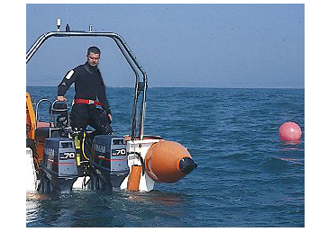
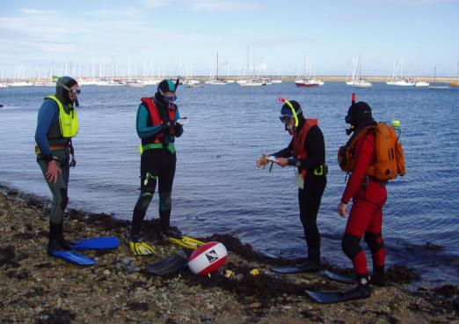
Surface Cover
Boat or shore
  Must have surface cover
  Coordinated by SDM
  May delegate to ASDM whilst in water
  Sufficient to support any issues
Additional Training
  Surface cover should combine to provide necessary skills

Slide 19
Surface Cover
Briefing a non-snorkel diver
  What should they expect to see?
  Where are the group heading?
  How many snorkel divers?
  What will tell that that everything is fine?
  What will tell them that there is a problem?
  What are you expecting them to do if there is a problem?

Slide 20
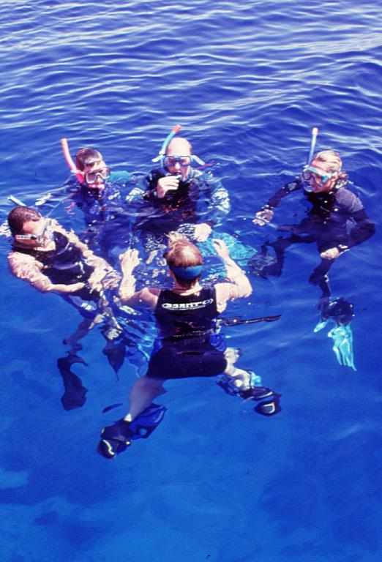
Risk Assessment
What could go wrong?
Covered in planning and SEEDS brief
On-site Risk Assessment
  New risks during day - Modify plan
  Changing weather
  More boat traffic
Discretion to stop activities
  Issues cannot be resolved? stop activity
  Responsibility to ensure everyone safe

Slide 21
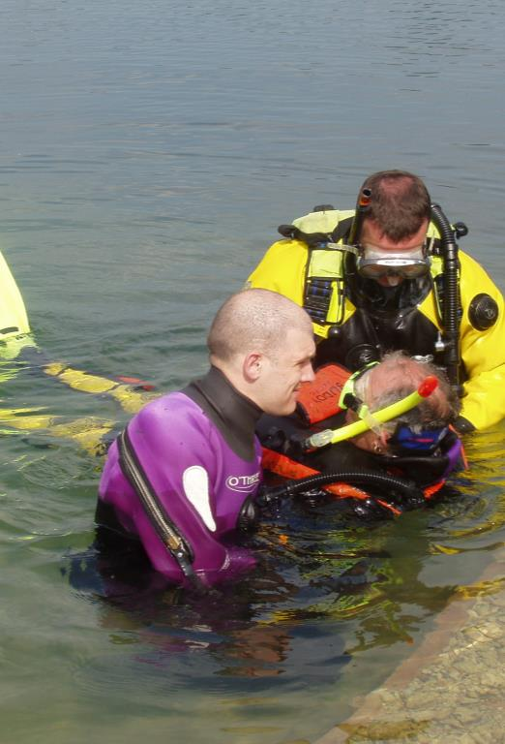
Planning for emergencies
What could go wrong?
  Weight belt slipping
  Refitting mask/snorkel in water
  Dealing with misted masks
  Leaking masks
  Jellyfish stings (avoidance)
  Group spreading out
  Snorkellers colliding with each other

Slide 22
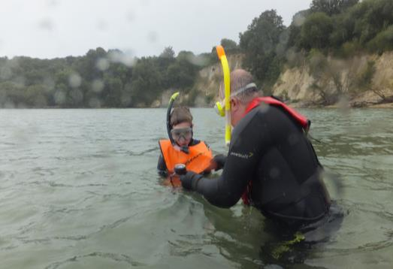
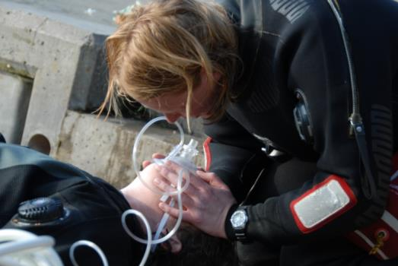
Planning for emergencies
Actions to take
  Can it be dealt with in water?
    Or is assistance required
  Can activity continue?
    Or return to shore/boat
  In-water management of the group
  Potential clearer briefing before next dive
  First Aid support
  Emergency contact details
  Evacuation/transport plan

Slide 23
Quiz 2
What structure should a Brief have?
  SEEDS
What may be in Group Equipment?
  First Aid Kit
  Oxygen
  Site plan
  Marker buoys
  Dive plan
  Boat?

Slide 24
Summary
Understanding the role of the Snorkel Dive Manager
  Planning
  Communications
  Equipment Requirement
  Brief
  Surface Cover
  Risk Assessment
  Planning for emergencies

