Slide 1
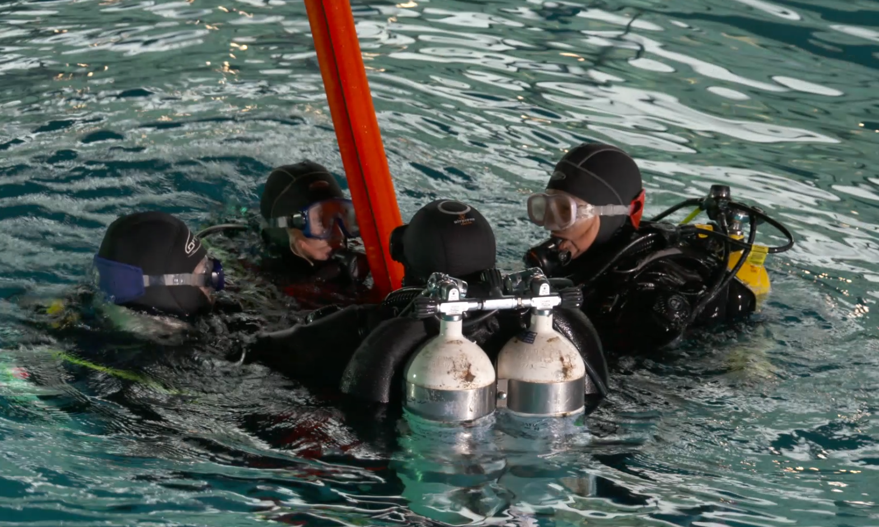
Sea Survival Techniques

Slide 2
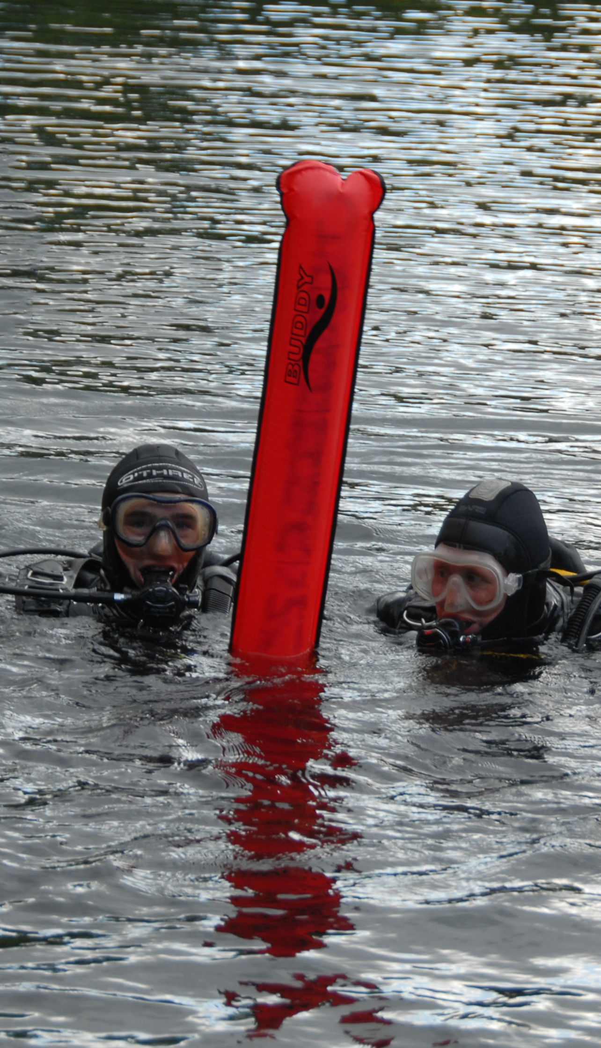
Sea Survival Techniques
Know what to do if you are lost on the surface.
Understand Survival Techniques

Slide 3
VIDEO 6 - Sea Survival Techniques

Slide 4
Discussion
What are the main points that you will take away from this session ?

Slide 5
Summary
Know what to do if you are lost on the surface.
Understand Survival Techniques

