Slide 1
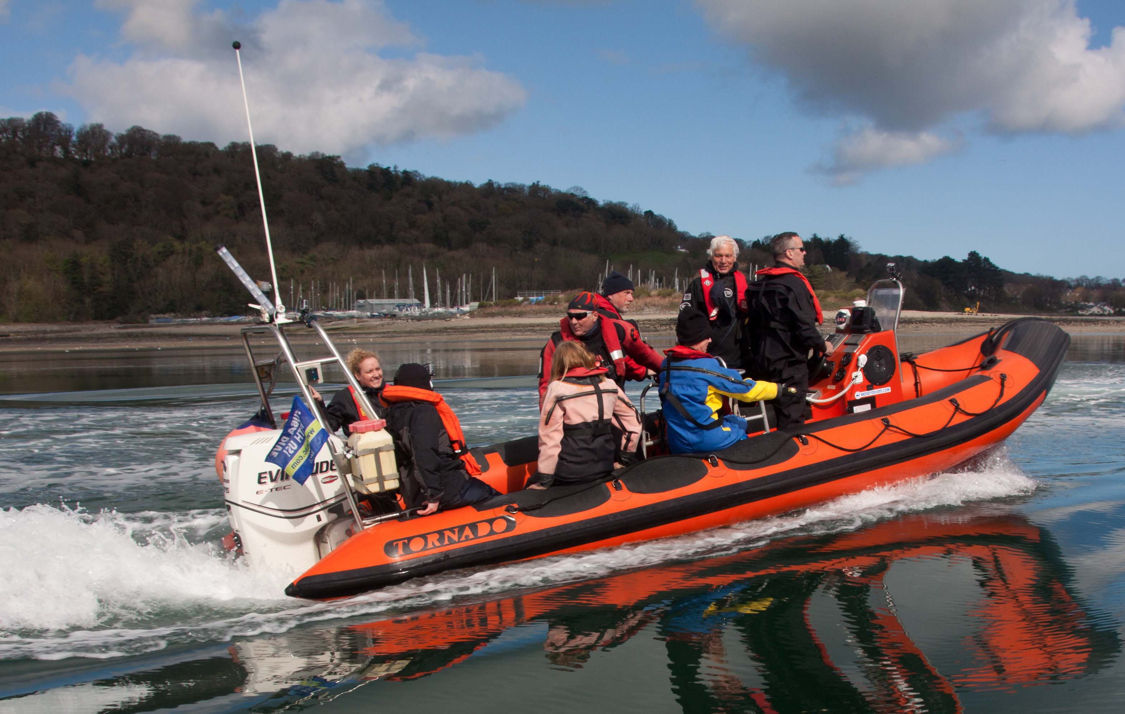
Navigation and safety kit for Boats

Slide 2
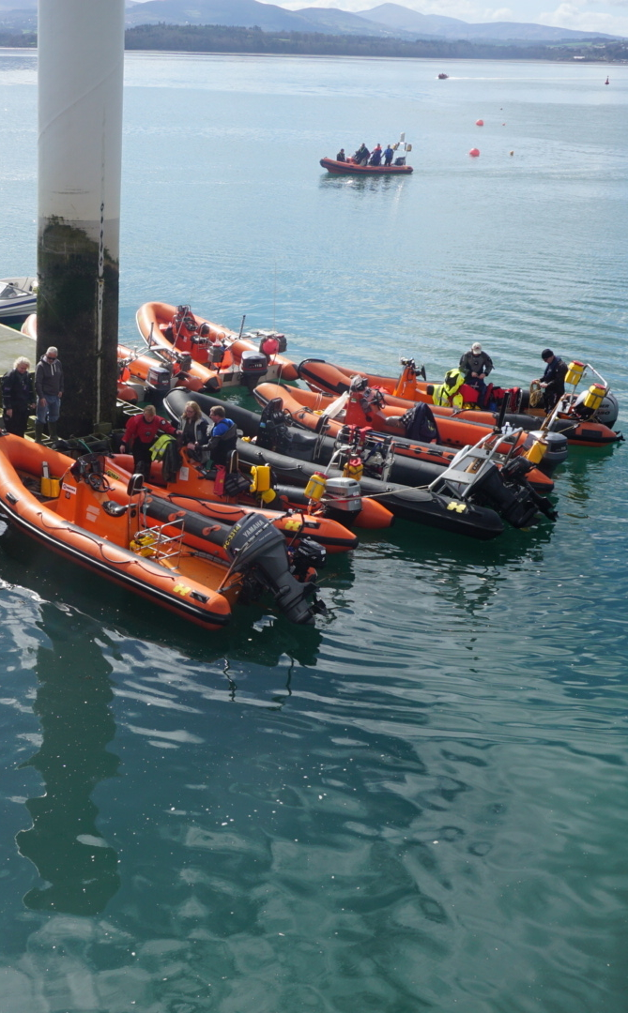
Navigation and Safety Kit for Dive Boats
Identify Navigation Equipment
Be able to locate Safety Equipment
Understand VHF Radio use in an Emergency

Slide 3
VIDEO 3 – Navigation and safety kit for Boats

Slide 4
Discussion Point
As a diver, what do you need to know when you go onto a boat in terms of the boat’s safety equipment ?
What other diver specific safety equipment would you expect to find ?

Slide 5
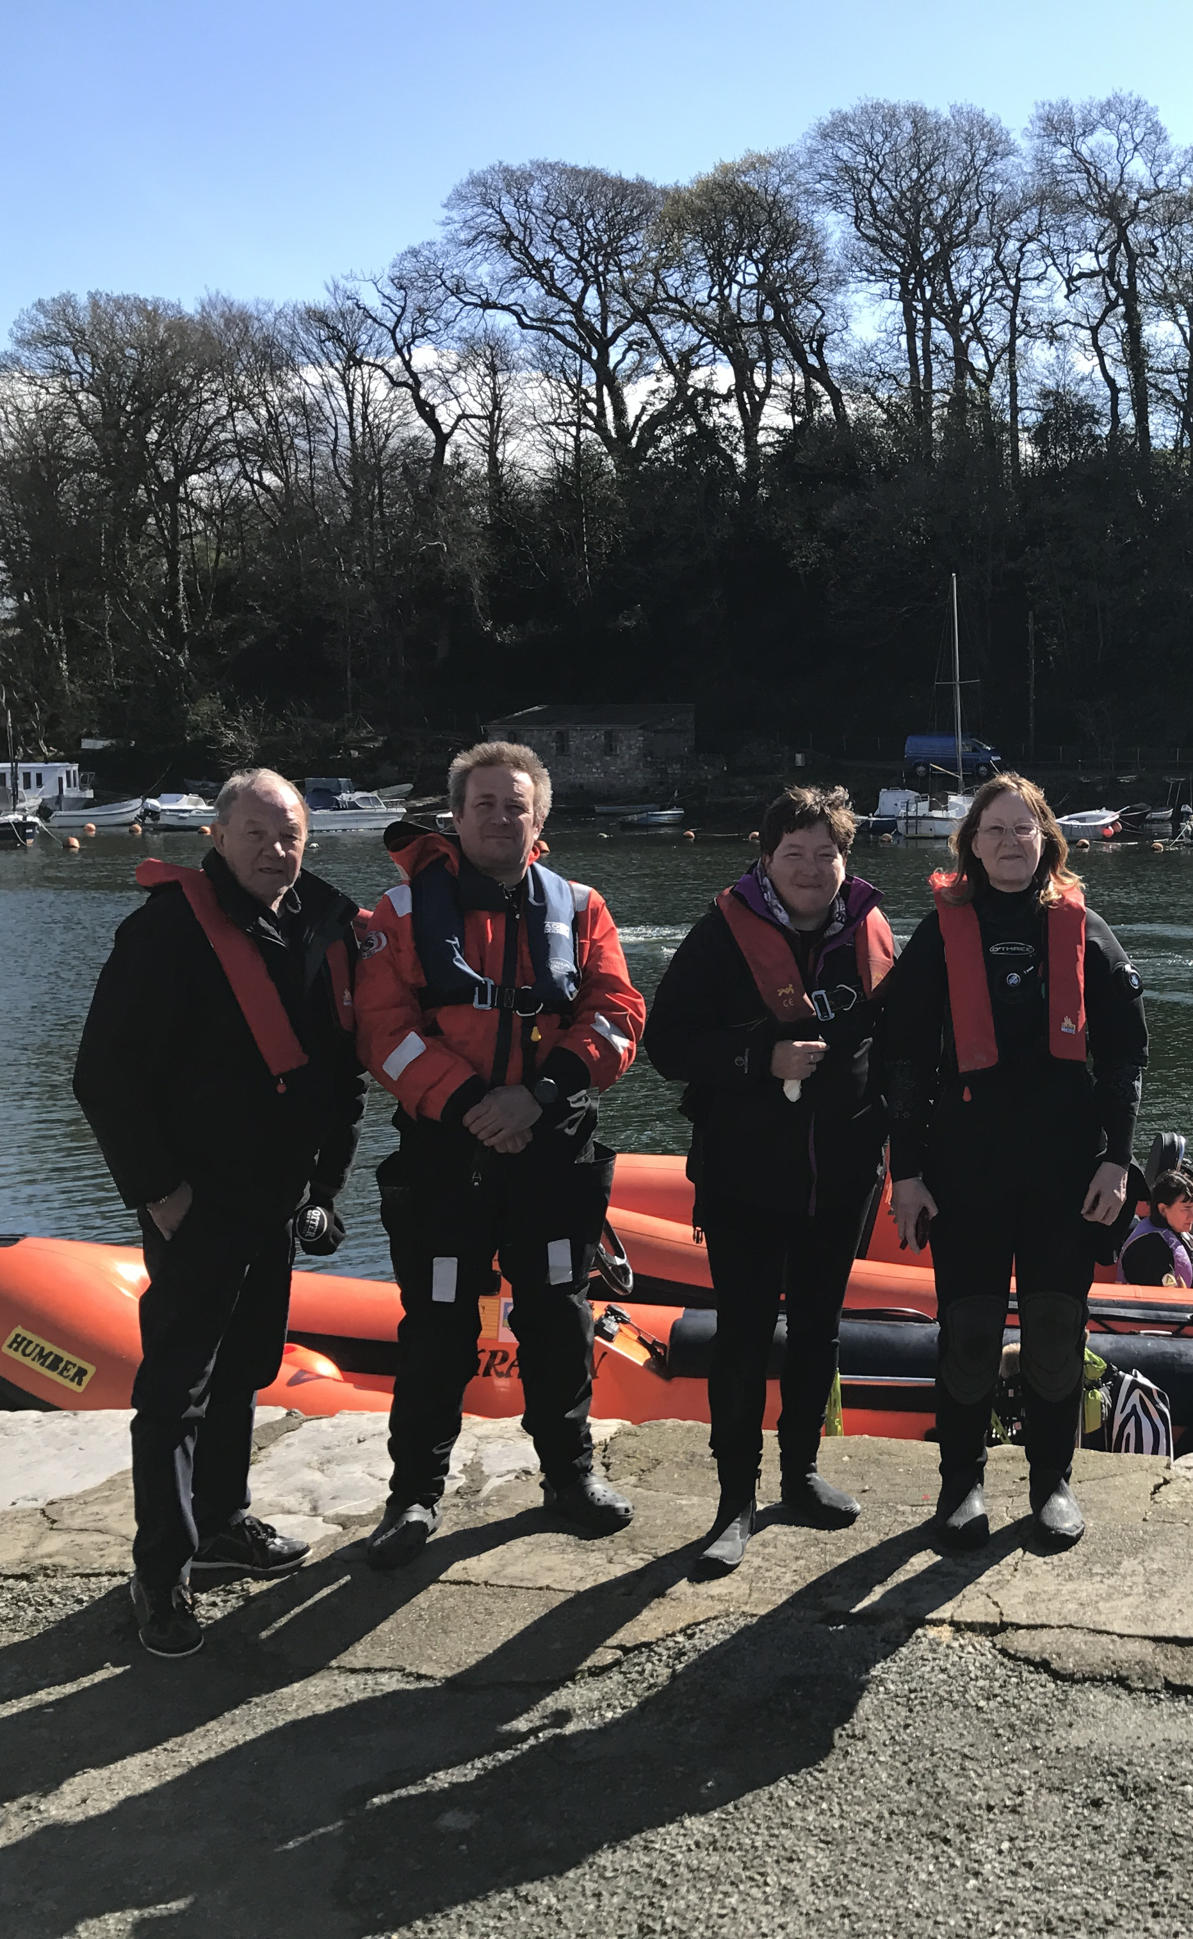
Summary
Identify Navigation Equipment
Be able to locate Safety Equipment
Understand VHF Radio use in an Emergency

