Slide 1
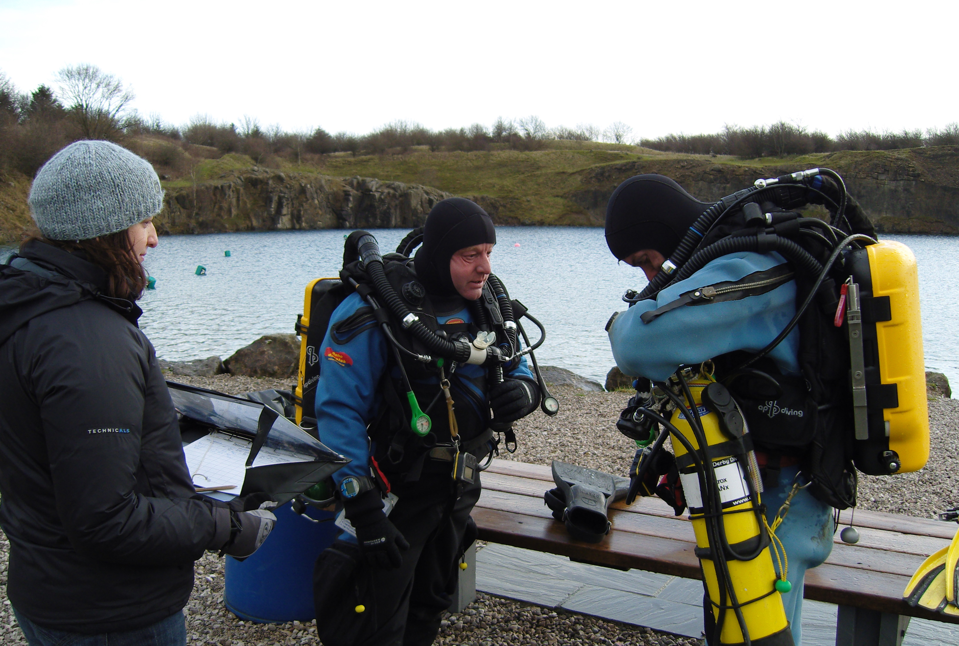
Dive Preparation

Slide 2
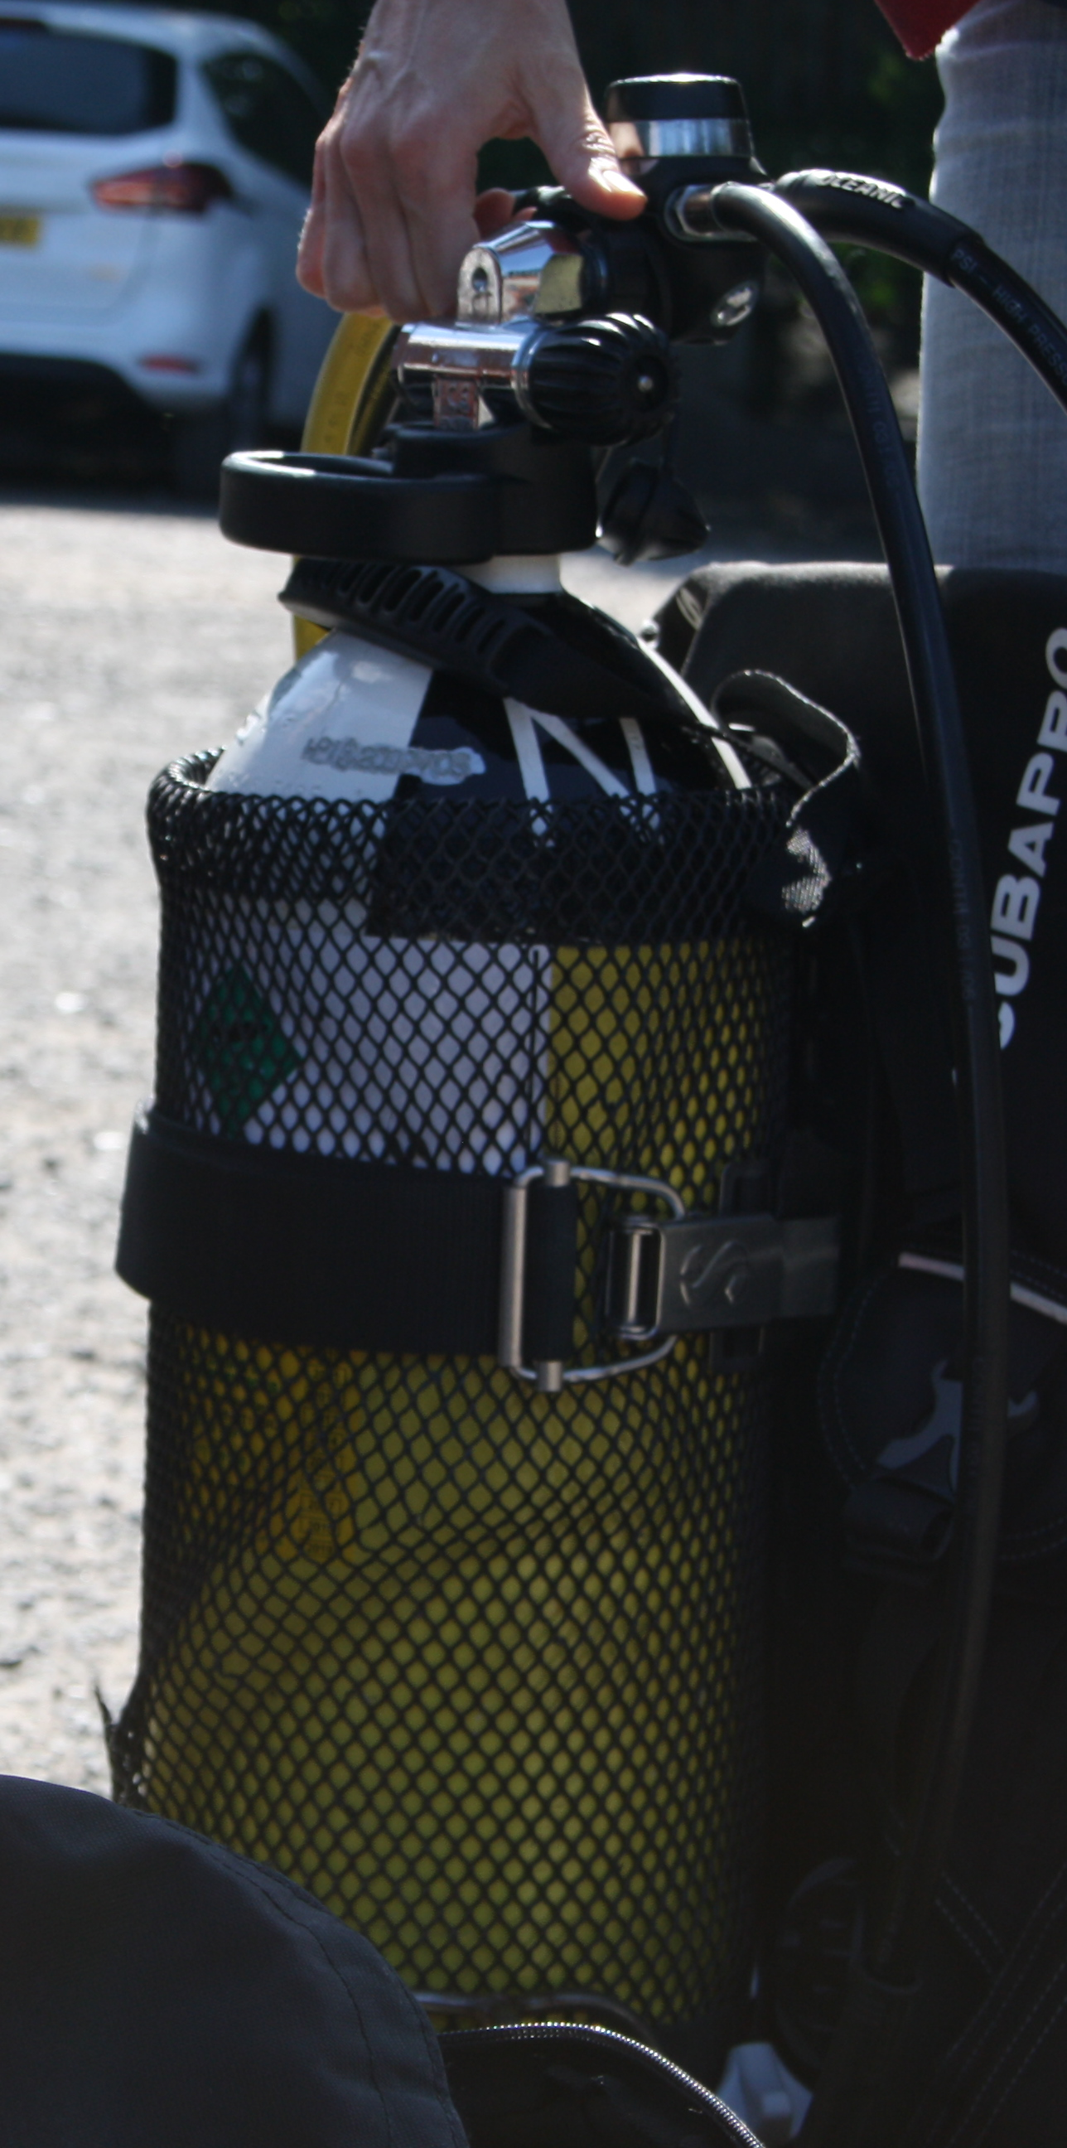
Dive Preparation
Personal Fitness
Checking Scuba Equipment
Manufacturer / Industry Testing Guidelines
Buddy Check

Slide 3
VIDEO 2 – Dive Preparation

Slide 4
Discussion Point
What are the main factors to consider both personally and regarding your equipment before going diving ?

Slide 5
Summary
Personal Fitness
Checking Scuba Equipment
Manufacturer / Industry Testing Guidelines
Buddy Check

