Slide 1
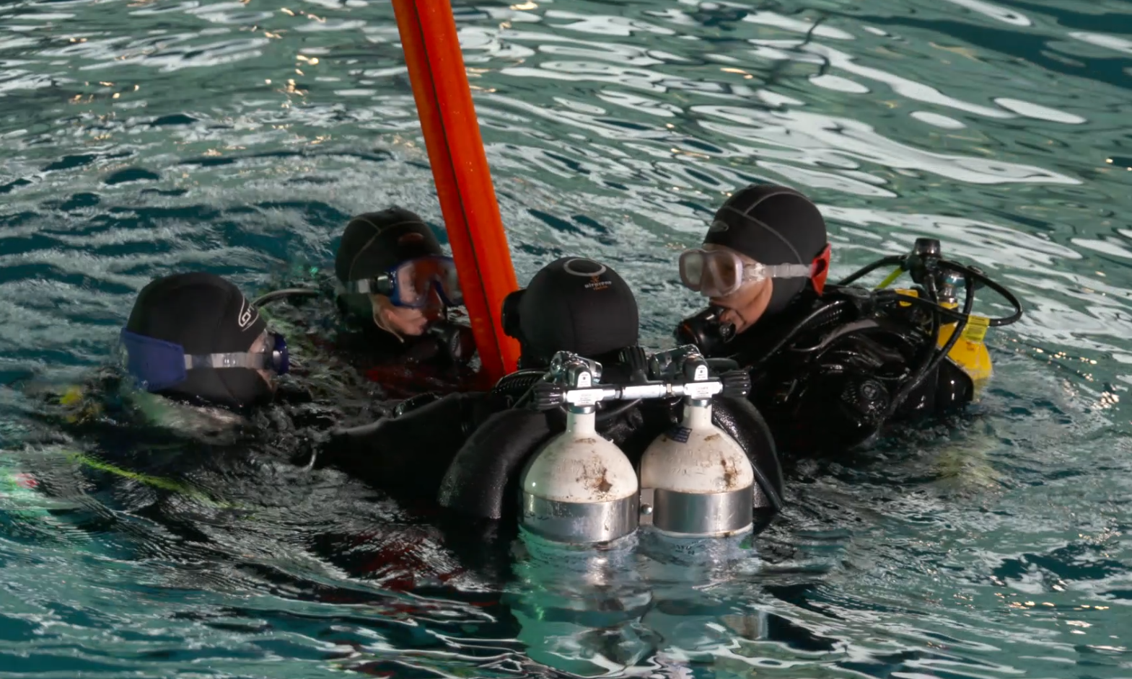
RNLI Diver Sea Survival Workshop

Slide 2
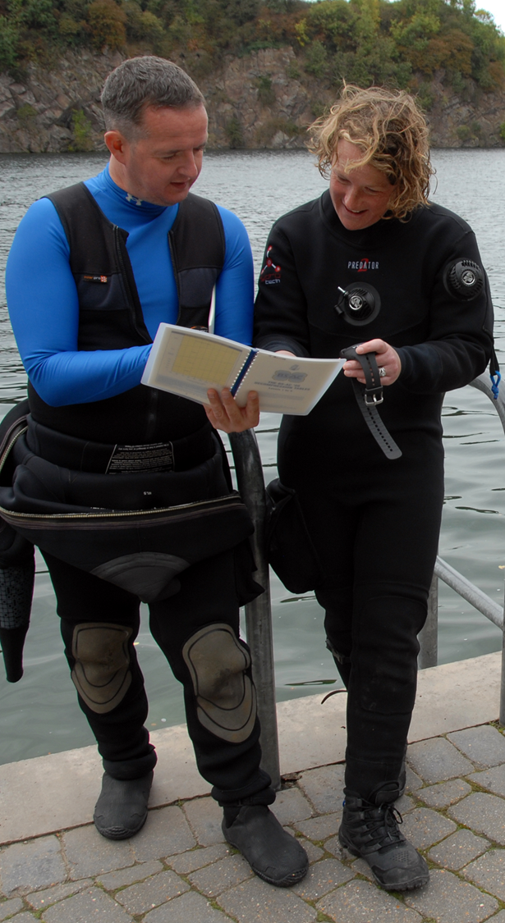
Dive Planning Workshop
The Dive Manager
Charts
Weather
Dive Planning

Slide 3

The role of the Dive Manager
Appointed by the Diving Officer
Planning
Risk Assessment
Delegation

Slide 4
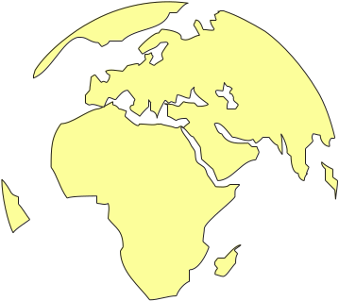
Charts
Grid Reference System
Parallels of Latitude
Meridians of Longitude
Parallels of Latitude
Meridians of Longitude
Chart No. 45

Slide 5
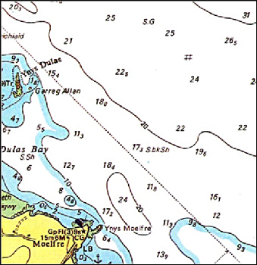
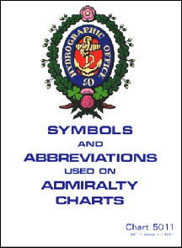
Charts - for Planning
Chart 5011 - identifies all features on a chart
  Coastline features
  Depth contour lines
  Seabed information
  Hazards
  Tidal flow information - currents

Slide 6
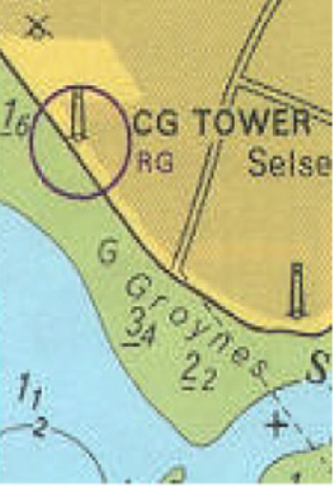
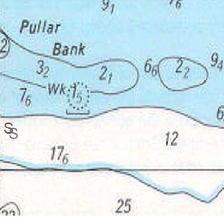
Charts - Features
  Dry land - yellow
  Prominent features
  Areas that cover/uncover with the tide - green
  Sea areas mainly white but shallow areas solid blue or edged in blue
  Depth contour lines
  Depth soundings
  Type of seabed
  Obstructions

Slide 7
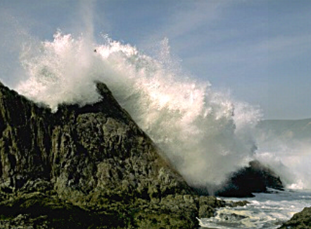

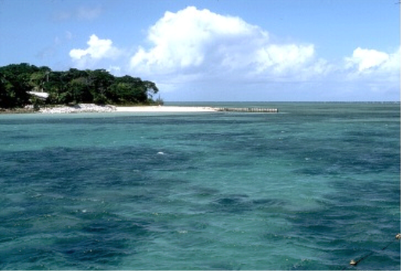
Weather Planning
Effects of wind
  Generates waves and sea swell
    Depends on its direction
    Depends on its strength
  Can affect underwater visibility
Rain and Fog
  Reduces surface visibility
Temperature
  Hot - hyperthermia
  Cold - hypothermia

Slide 8
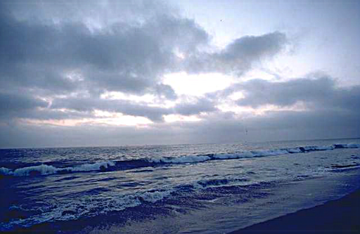
Weather Forecasts
Beaufort Wind Scale
  Over Force 4 - affects diving comfort and safety on unprotected sites
Shipping/Inshore forecasts
  UK - BBC Radio 4 (200 kHz)
  Local radio stations
  TV
  Web sites
  Coastguard

Slide 9
Group Exercise
  Plan a dive
  Using the Chart Supplied, plan a dive to the specified site.
  Identify any potential risks and how you might mitigate them.
  Prepare a brief for the dive team and identify any extra equipment you might need.

Slide 10
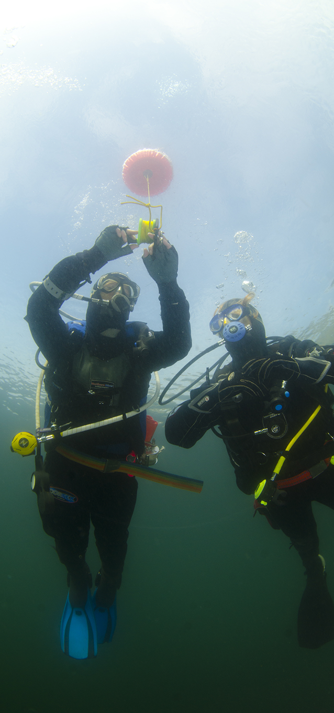
Summary
Role of the Dive Manager
Charts
  Planning
  Features
Weather
  Planning
  Forecasts
Dive Planning

