Slide 1
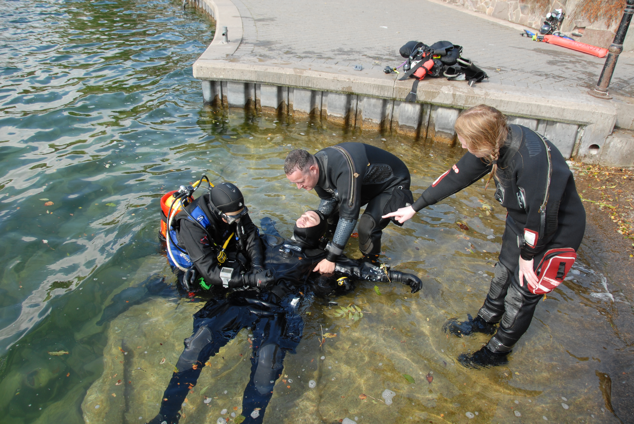

Practical Rescue Management
Introduction

Slide 2
Practical Rescue Management
Introductions
Course aims
Domestic arrangements
Locations
Timings

Slide 3
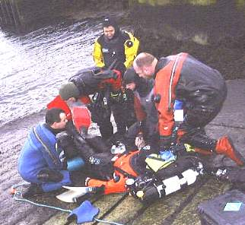
Course Outline
Rescue Management Part 1
Rescue Management Scenarios
Helicopter Operations
Rescue Management Part 2
Putting It All Into Perspective

