Slide 1
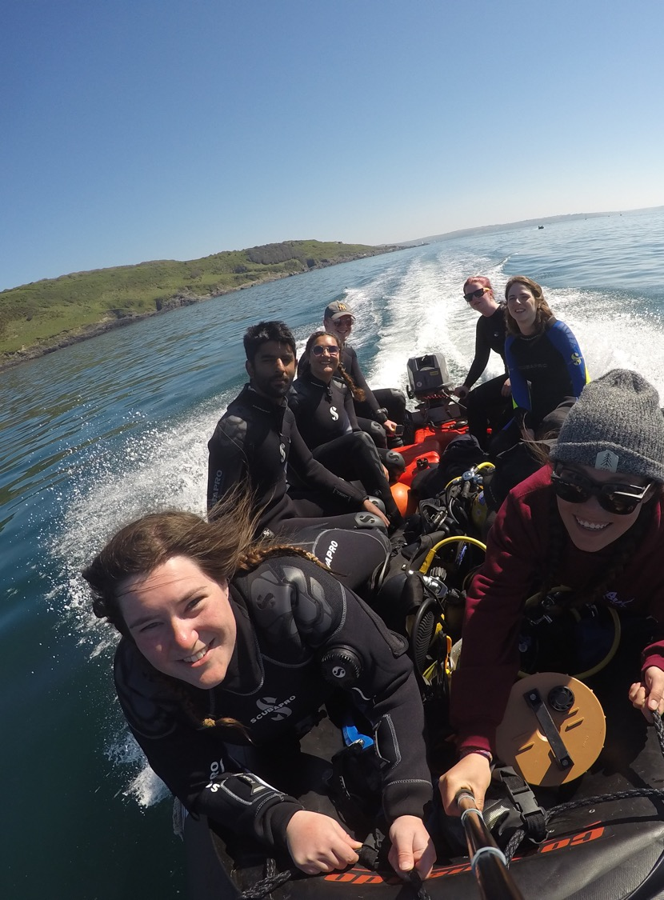
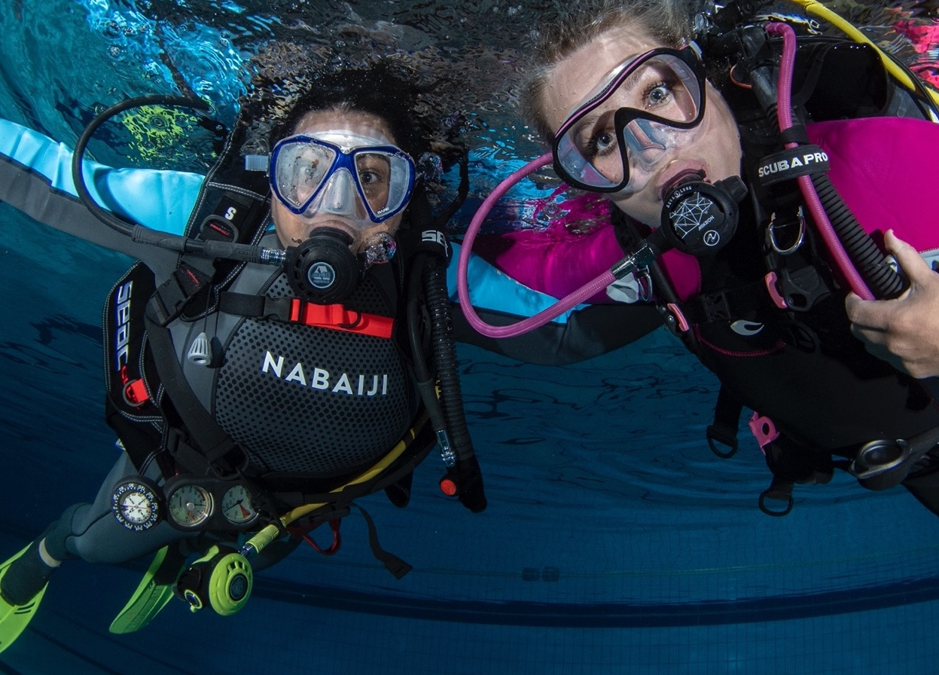

Welcome to [clubname]
Your gateway to adventure!

Slide 2

Our club
Top tip
XXXXXXXXXXXXXXX
xxxxxx
It’s really all about making friends, developing new skills and enjoying great diving. Our club:
  Has been around since [year]!
  Meets at [venue], every [day] from [time]–[time]pm
  Usually meets [after the pool session in the clubhouse]
  [All new members get a ‘buddy’. Your ‘go to’ person for questions!]
  Is committed to the safety and well-being
  of our members.
Copyright © BSAC 2024

Slide 3
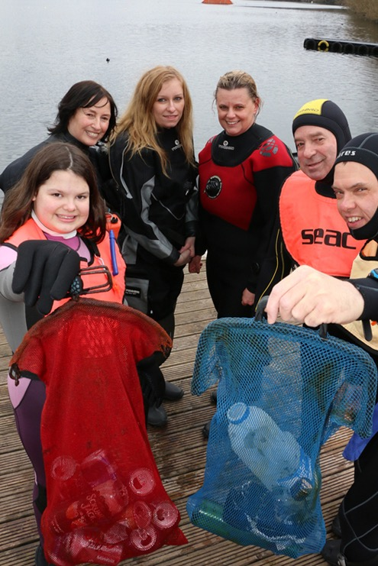
Club activities
Welcome to [clubname]
The club organises a wide range of activities for members to get involved in:
  Dive trips to exciting UK locations
  Overseas club holidays
  Marine conservation initiatives
  Social events and gatherings
  [xxxxxxxxxxxxxxx]
Top tip
all of our events and trips are listed online at
xxxxxx
Copyright © BSAC 2024

Slide 4
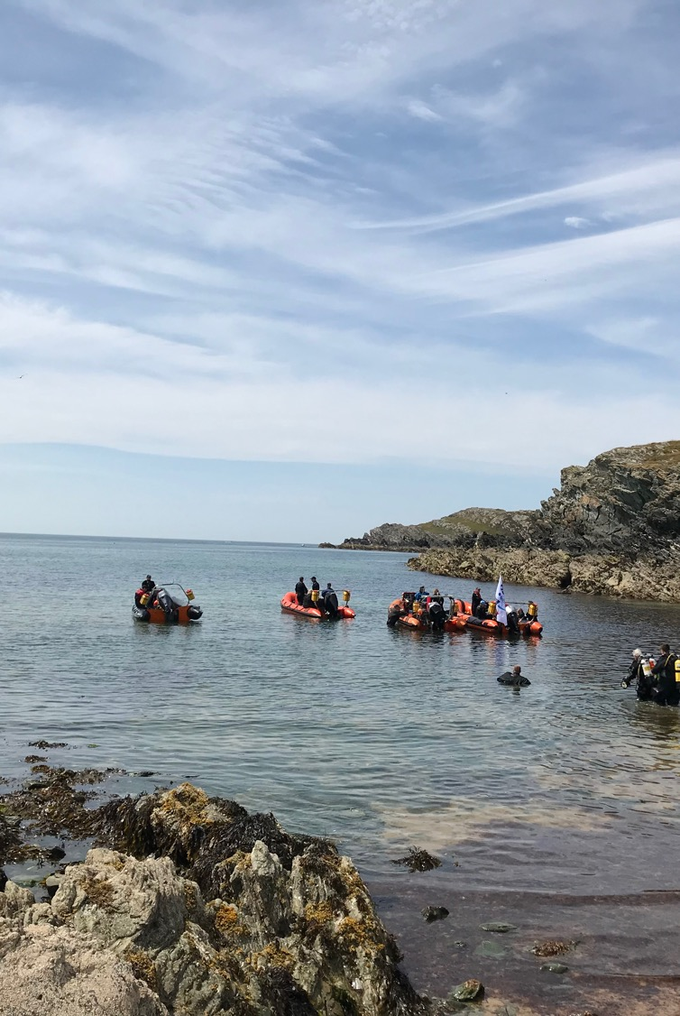
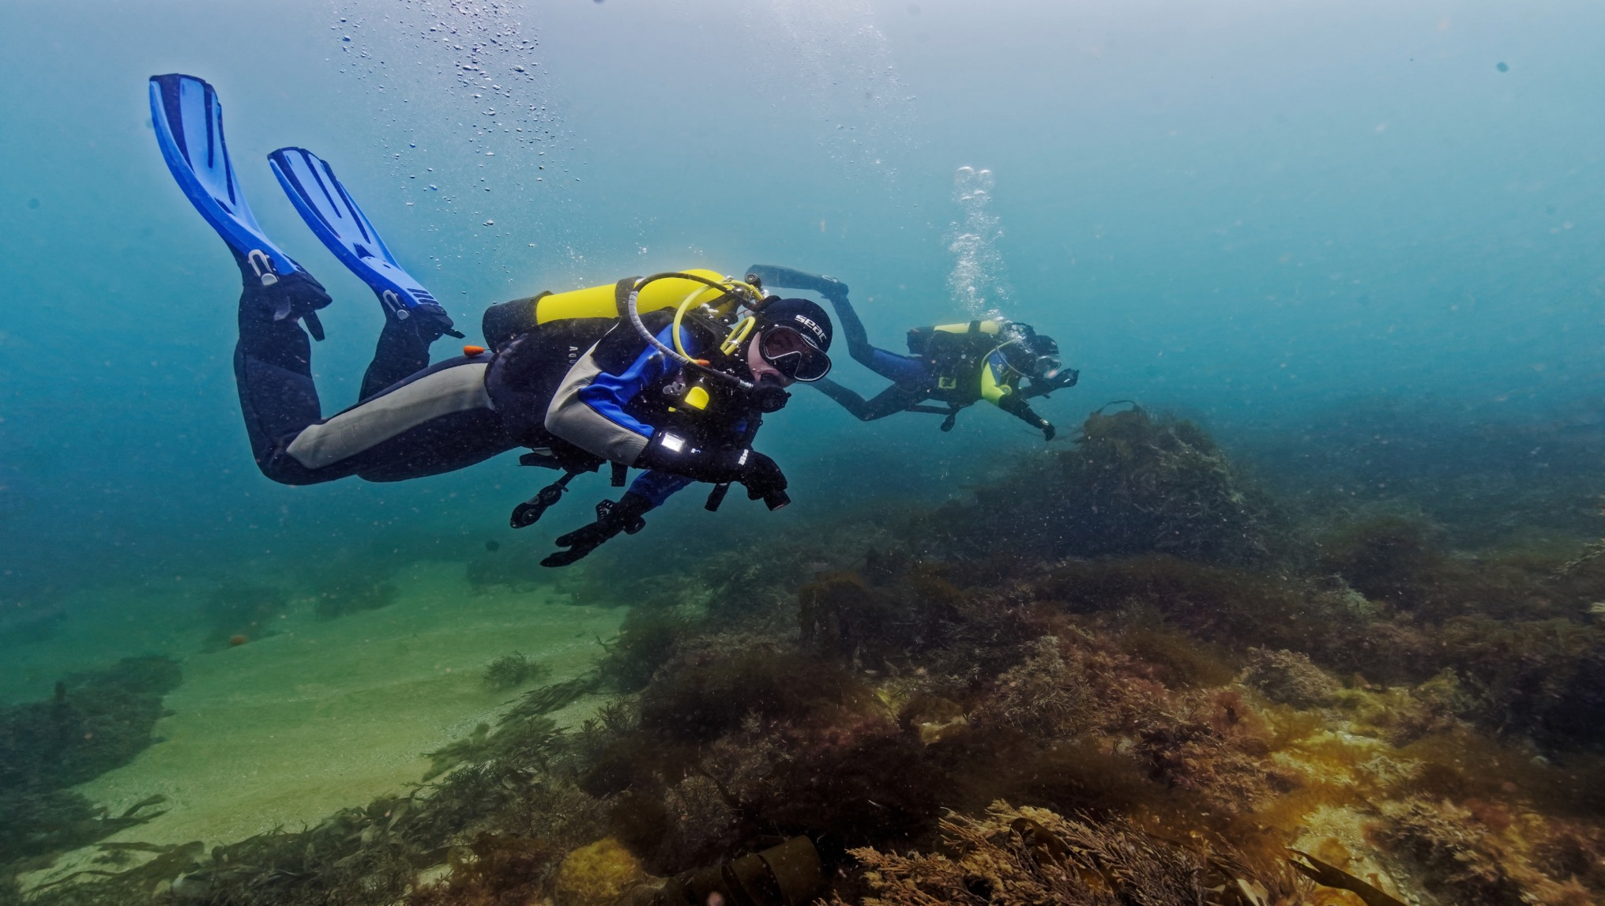
What is BSAC?
Founded in 1953, BSAC is the UK National Governing Body for scuba diving and snorkelling and a trusted authority in the world of diving.

Slide 5
Our club is a ‘branch’ of BSAC
We’re part of something bigger…
  A supportive community of clubs, training centres and members
  Internationally-recognised diving and snorkelling qualifications
  Commitment to safety, safeguarding and welfare of members
  Not-for-profit organisation run by divers and snorkellers, with small head office in Cheshire
Top tip
Follow the link in your new member email to register for your MyBSAC account on bsac.com.
Copyright © BSAC 2024

Slide 6
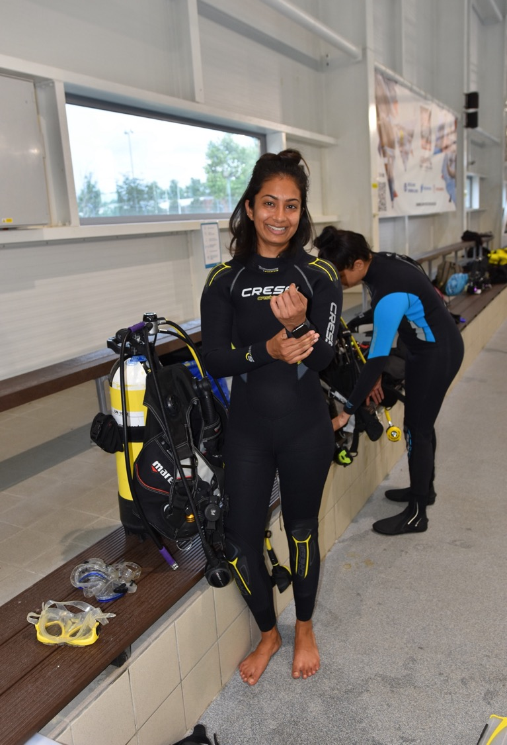

Slide 7
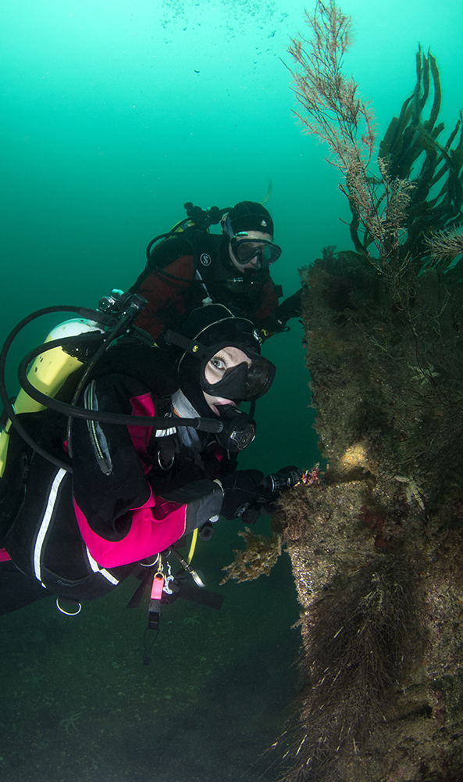
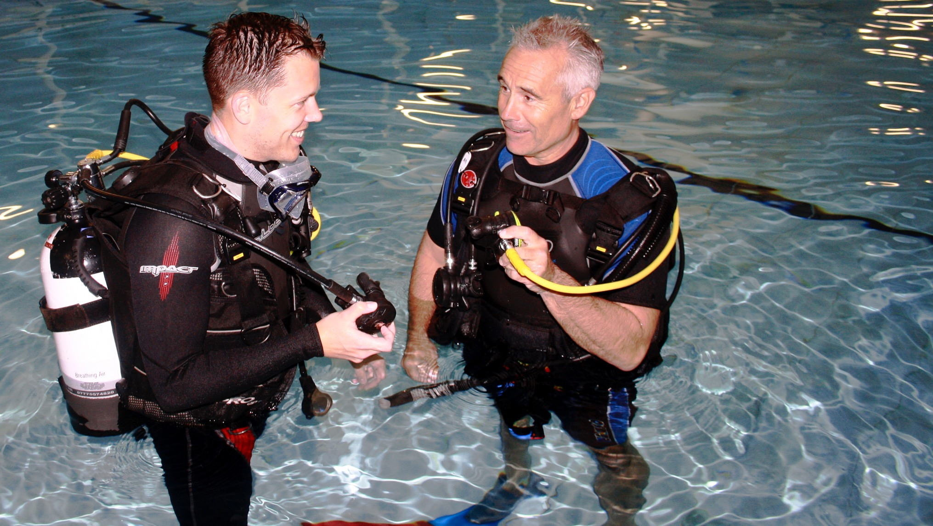
About your BSAC
Ocean Diver course

Slide 8
Your Ocean Diver course
Welcome to [clubname]
As with all BSAC training, the Ocean Diver course is designed to progressively build your skills and confidence, as safely as possible
  Our aim is to train you to dive in open water in controlled conditions, to a maximum depth of 20m, under the supervision of a Dive Manager.
  The course has a mix of 6 classroom, 5 pool/sheltered-water and 4 open-water modules
  Your commitment is important! 😊
  An important element of the course is self-study
  Please make a note of the URN with your training materials!
Top tip
There are online quizzes and videos to support your training, at bsac.com/ODsupport
Copyright © BSAC 2024

Slide 9
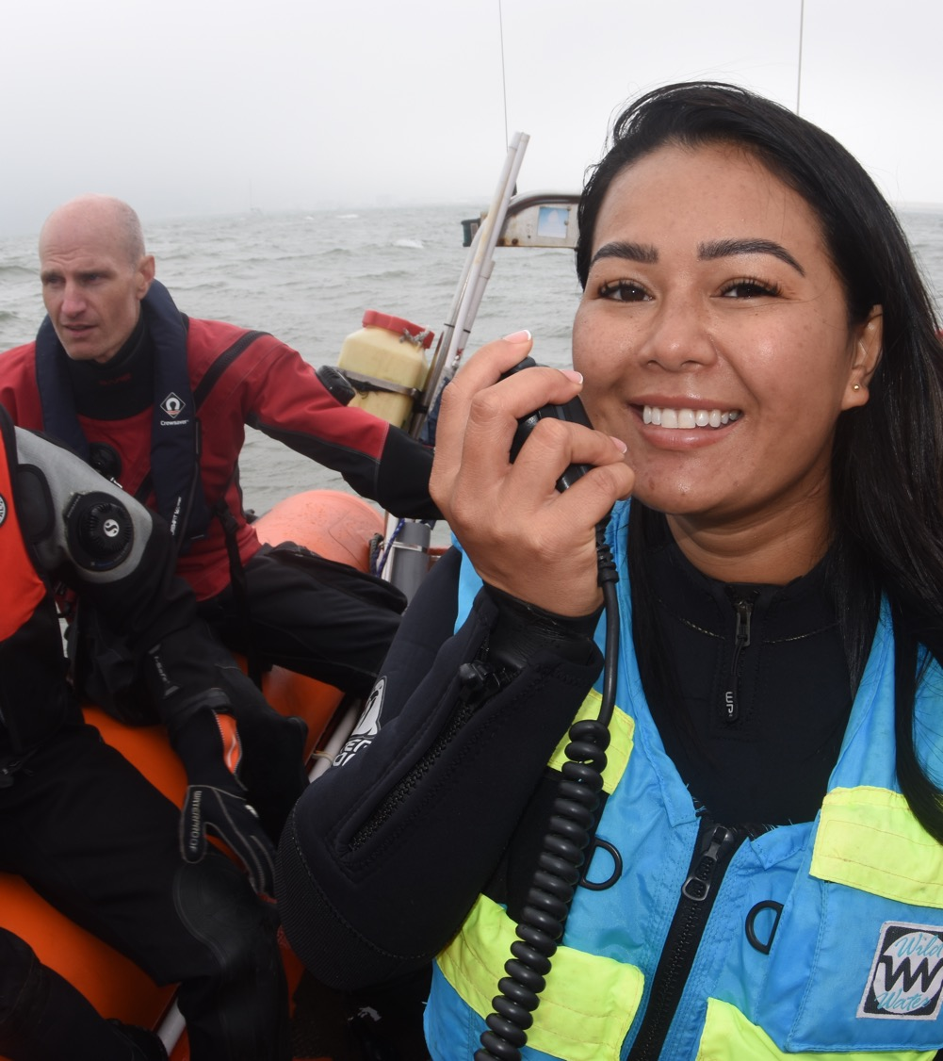
Progressing your training
Once you have qualified as an Ocean Diver, you could further your training to expand knowledge and enjoyment of the underwater world.
  Continue your diver training with the Sports Diver course
  As an Ocean Diver, you could attend a specialist Skill Development Course (SDC) such as First Aid for Divers or Boat Handling.
Copyright © BSAC 2024

Slide 10
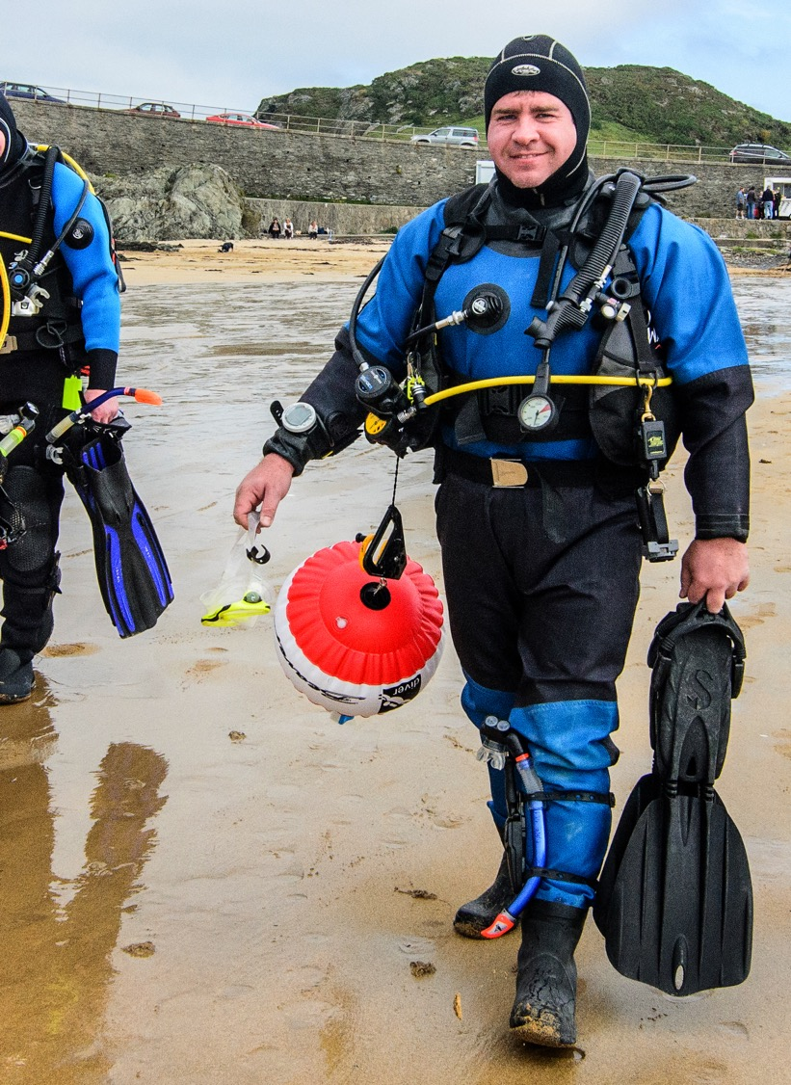
Progressing your training
  Courses offered at our club, that you could do, include:
    Sports Diver
    First Aid for Divers
    Boat Handling
    There are more, please ask!
  You could also book onto a regionally-organised BSAC training event. 100s are organised every year around the UK. Book at: bsac.com/events
Top tip
Explore all of BSAC’s training
opportunities at bsac.com/training
Copyright © BSAC 2024

Slide 11

How we keep in touch
In person…
  Your instructor [name]
  your main contact during training
  Your club buddy [name]
  Club nights and socials – get stuck in from the start!
Your instructor:
[insert name]
Top tip
Our next social event is xxxxxx on xxxx. Please come along!!
Your buddy:
[insert name]
Copyright © BSAC 2024

Slide 12



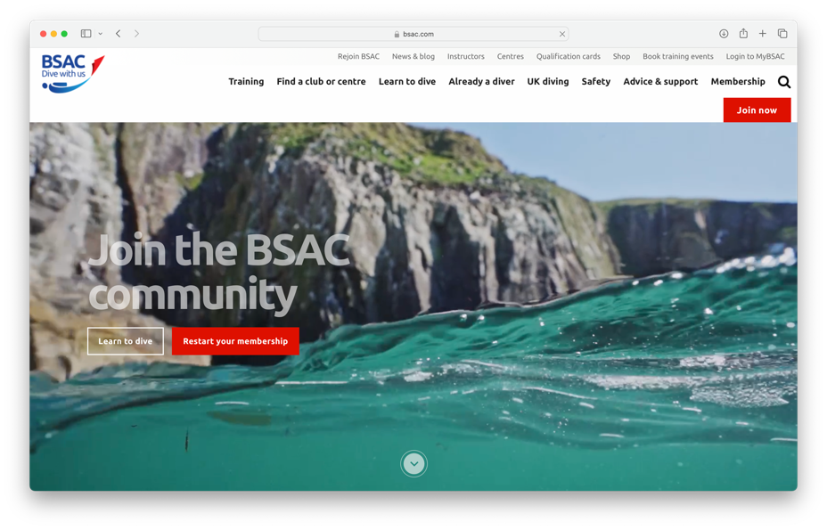


How we keep in touch
Then online we have…
  Website – general club info and events listings
  Email – these are sent ad hoc normally, when there is news to share
  WhatsApp – for bigger trips we tend to set these up when needed
  Facebook Page, Twitter and YouTube – Please join in the chat, contribute pics/videos etc

Slide 13
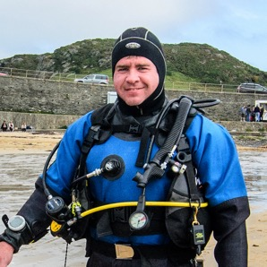
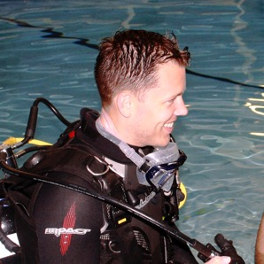
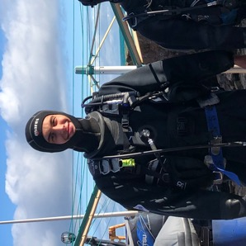
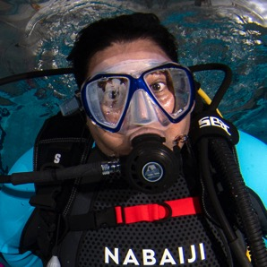
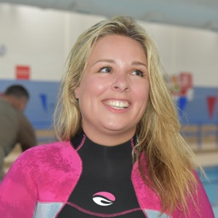
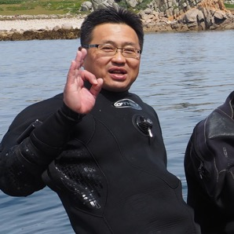
Meet our key contacts
Top tip
You will find most these people around on club night!
These people are on the club committee.
Please contact them with any questions you may have.
Diving
Officer:
xnamex
Equipment
Officer:
xnamex
Welfare
Officer:
xnamex
Chair:
xnamex
Training
Officer:
xnamex
Membership
Secretary:
xnamex

Slide 14
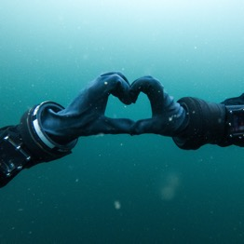
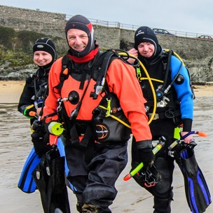



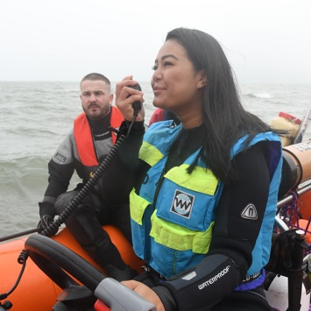
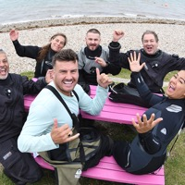
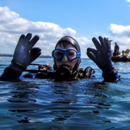
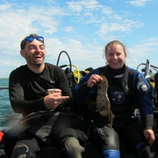
Our club
There are lots of perks to being a member of xxclubnamexx:
Liability insurance cover
Access to training – both in the club, around the UK and beyond!
SCUBA magazine
Use of club equipment and facilities
xxxxxxxx
Participation in club trips and events
Membership discounts on dive travel, kit and outdoors brands
Access to expert advice from the experienced BSAC team at head office

Slide 15
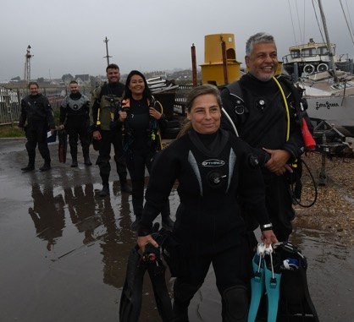
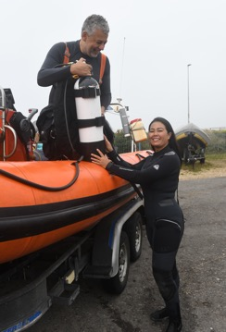
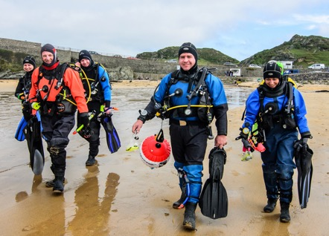
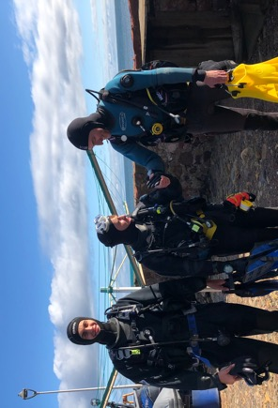
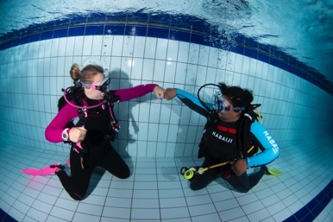
A few words from our members
“Insert short quote here… Insert short quote here… Insert short quote here… Insert short quote here… Insert short quote here…”
“Insert best quote here… Insert best quote here… Insert best quote here… Insert best quote here… Insert best quote here… Insert best quote here…”
“Insert short quote here… Insert short quote here… Insert short quote here… Insert short quote here… Insert short quote here…”

Slide 16
Any questions?

Slide 17
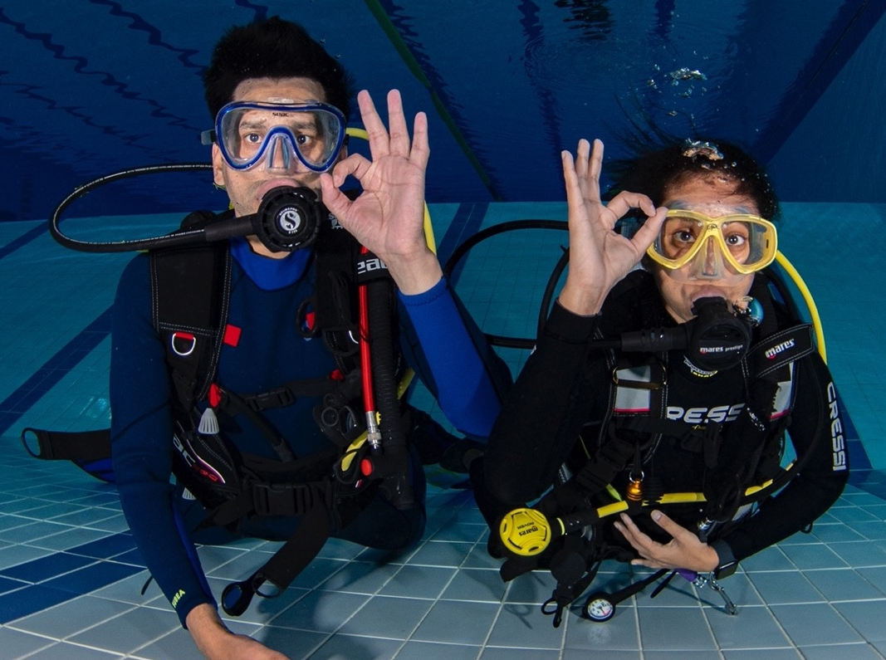

Keep in touch
info@bsac.com | bsac.com | @BSACdivers | 0151 350 6201 [replace with club details]

