Slide 1
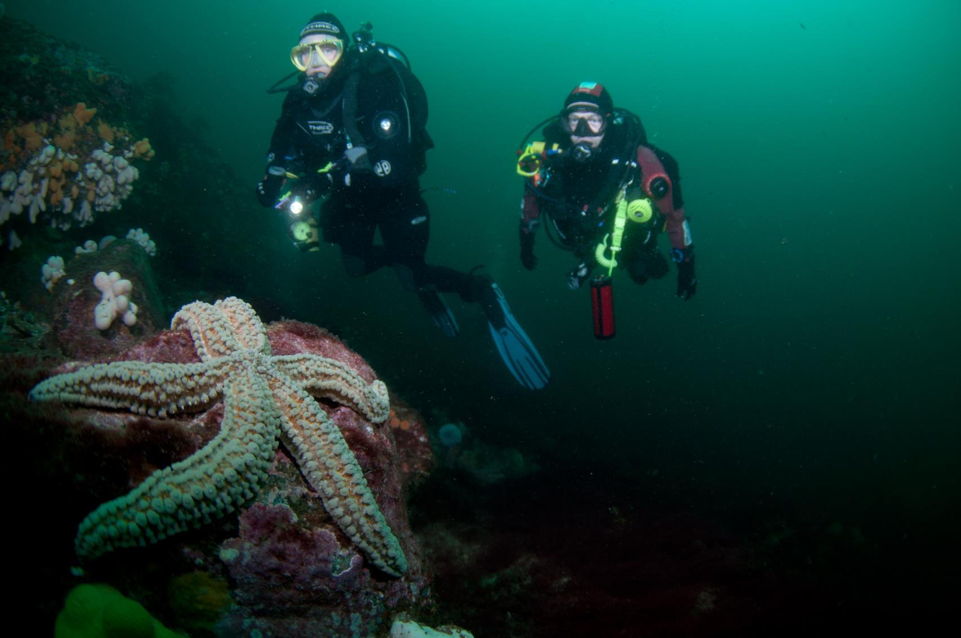

Marine Life Appreciation
Marine biology and ecology basics

Slide 2
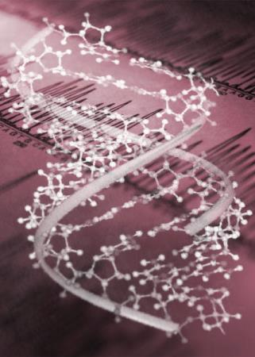
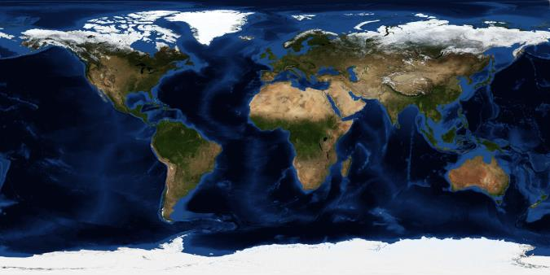
Marine science
Key processes
  Feeding
    Photosynthesis
    Metabolism
    Food webs
  Reproduction
    Sexual
    Asexual
    Life cycles
Environment
  Environmental variables
  Seasonal cycles
  Habitats
Adaptation

Slide 3

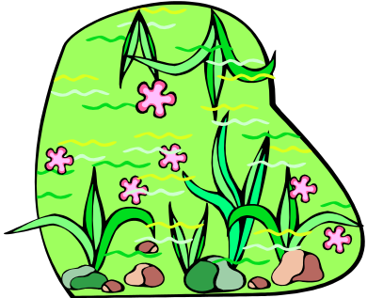
Photosynthesis
Using the sun’s light to create food
Solar
Energy
Plant cells
  Carbon dioxide + Water = Food + Oxygen
  Needs nutrients
Plant
Cells
Water +
Carbon Dioxide
Food +
Oxygen

Slide 4
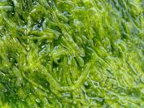
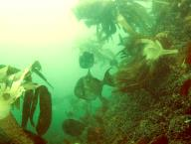
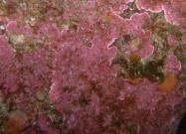
Photosynthesis and light
Water absorbs light restricting plants in how deep they can exist
  Light penetration variable by day, season and location
  From less than a few metres to >100m
Quality of light varies with depth
  Red light absorbed first, green and blue penetrates furthest
  Algae have different pigments (including chlorophyll) which absorb different wavelengths of light
  Best pigments differ with depth so colour of seaweeds changes with depth
5m
10m
15m
20m
25m
30m

Slide 5
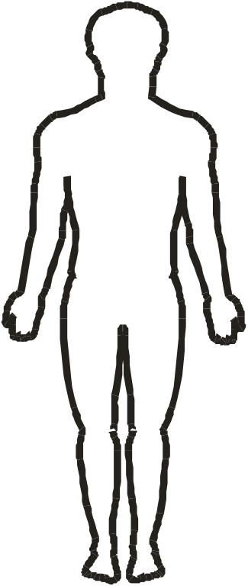

Metabolism
Metabolism - The process of life
Body cells
  Food + Oxygen = Energy
  Waste products removal
Energy transfer from sun
Energy
Energy
Body
Cells
=
Food +
Oxygen
Water +
Carbon Dioxide
Solar
Energy
Plant
Cells

Slide 6






Feeding
Producers
  Photosynthesis
  Metabolism at night
Consumers
  Metabolism
Food chain
  Pyramids
  Linked populations
Cod
Herring
Zooplankton
Phytoplankton

Slide 7
Food webs
A representation of feeding links
  Plants and phytoplankton form initial step
  Zooplankton main first predators
  Intermediate predators
    Small adults and juveniles
  Top predators
    Large fish birds mammals and HUMANS
Everything is connected!
Nothing is wasted
  Detrital food web
Seals
Cod
Herring
Worms
Sandeels
Phytoplankton
Puffins
Sun
Zooplankton
Grazing food web

Slide 8
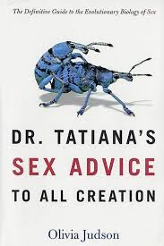
Reproduction
Sexual
  Internal fertilisation
  External fertilisation
Asexual
  Budding, spores, fragmentation, eggs
Frequency
Life cycles
  Simple
  Complex
Longevity

Slide 9
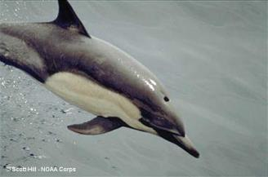
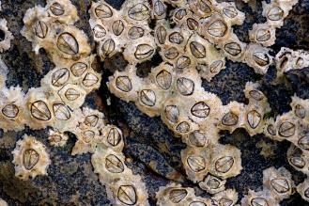


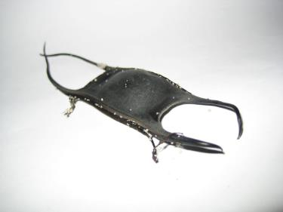
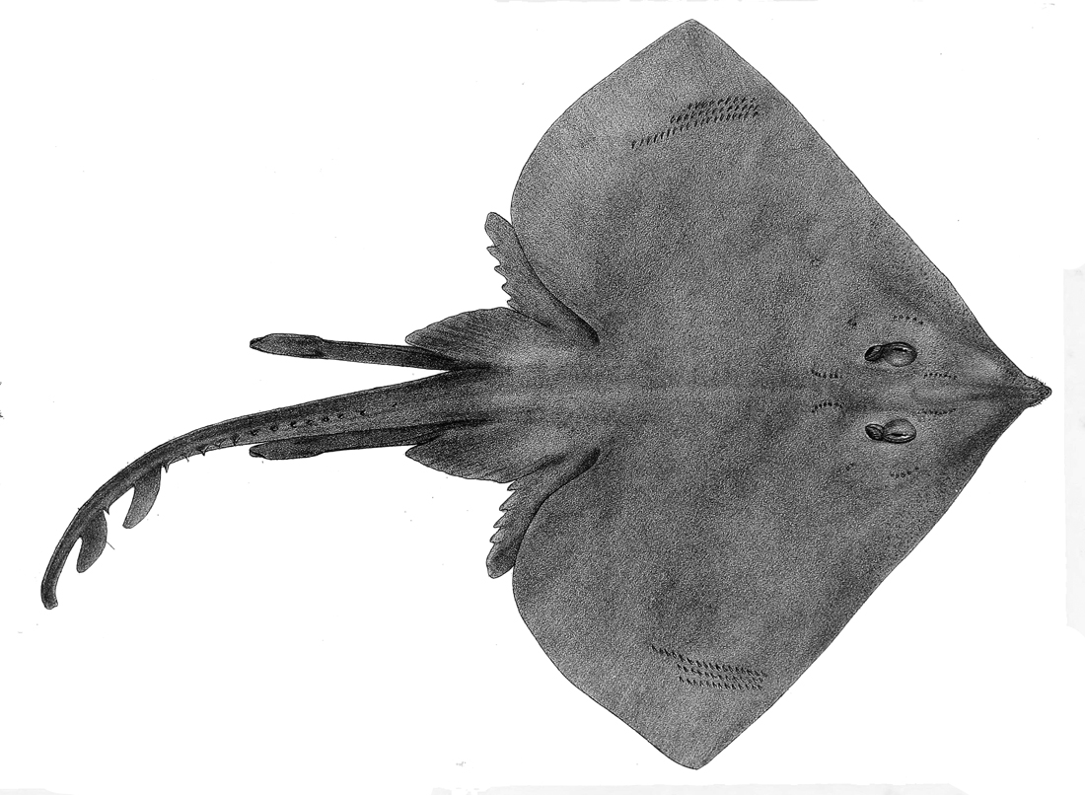
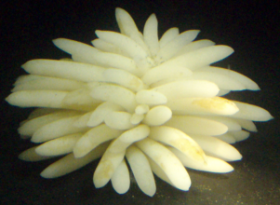
Internal fertilisation
Sexual reproduction
  Sperm & egg
  Live young
  Protected eggs
  Barnacles et al
Michael Maggs Wikimedia Commons
Xtylee - Wikimedia Commons
Wikimedia: Captmondo

Slide 10
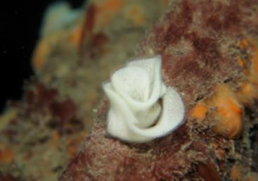
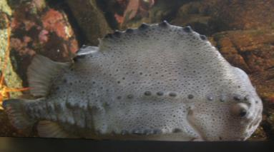
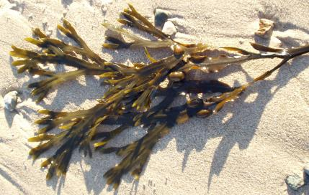
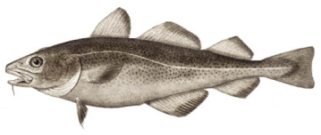
External fertilisation
Sexual reproduction
Spawning
  Broadcast
  Localised
  Parenting
J D Greenbaum
© 2006 Steven G. Johnson

Slide 11
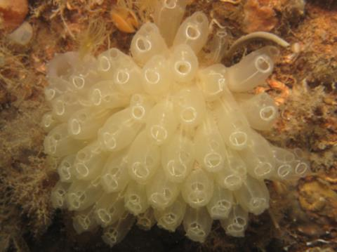
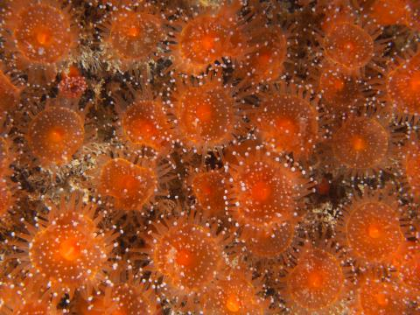
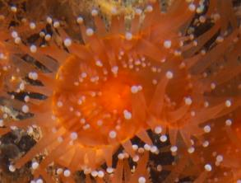
Asexual reproduction
Reproduction without a partner
  budding – growing new colony members at the edges
  fission – splitting in two, producing clones
J D Greenbaum
J D Greenbaum

Slide 12
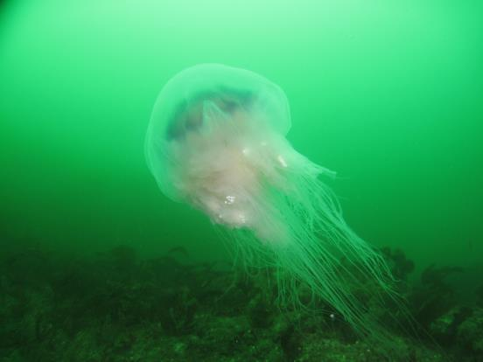
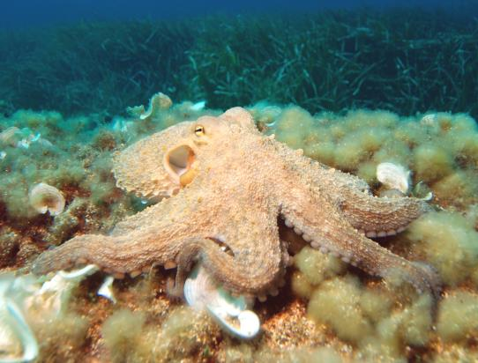
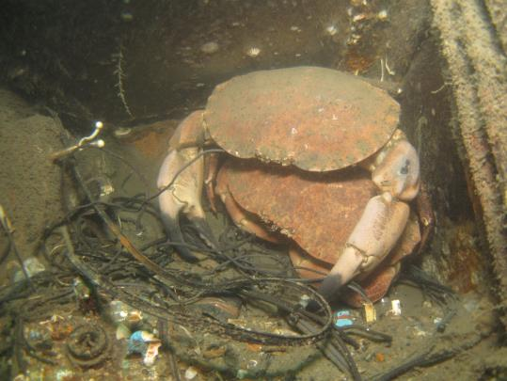
Frequency
Very wide range
  Daily
  Seasonal/episodic
  Once in a lifetime
J D Greenbaum
albert kok Wikimedia Commons
J D Greenbaum

Slide 13
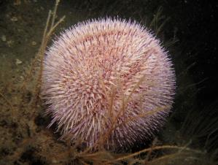
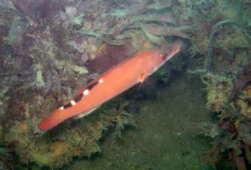
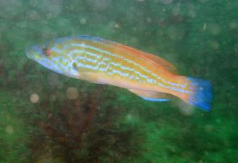
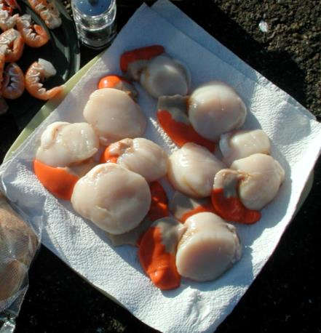
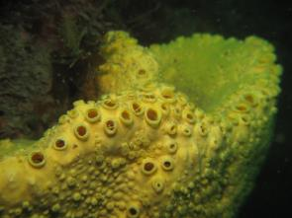
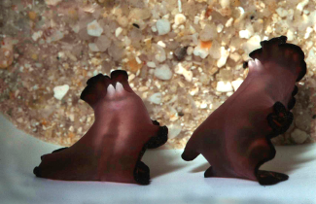
Gender
  Single sex
  Hermaphrodites
  Sex changers
  Dual sex
J D Greenbaum
Aharrygill Wikimedia Commons
Aharrygill Wikimedia Commons
Nico Michiels Wikimedia Commons
J D Greenbaum
Christopher Bulle

Slide 14
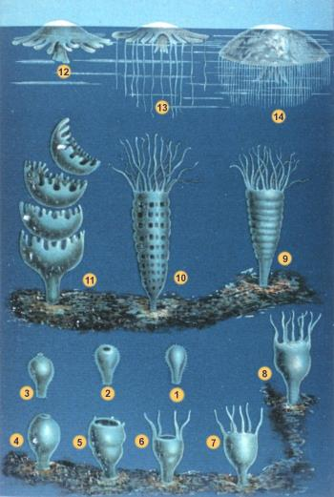
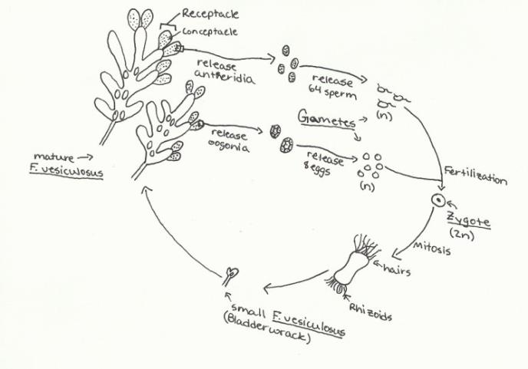
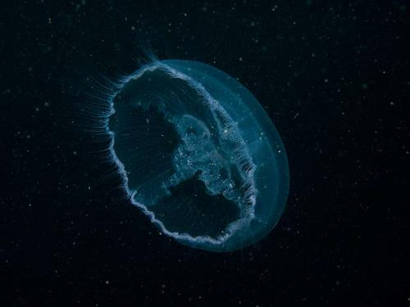
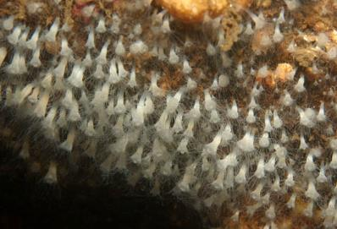
Life cycle complexity
Simple
  Adult è juvenile
  Example: bladder wrack
Complex
  Adult è one or more intermediate stages è juvenile
  Example: jellyfish
Stemonitis
© 2011 Ben Harris
NOAA Photo Library
©Bernard Picton

Slide 15
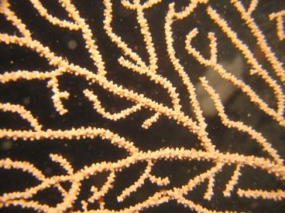
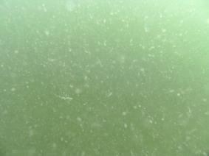
Longevity
Sea fan
Dead men’s finger
Scallop
J D Greenbaum
Cushion star
Dahlia anemone
Periwinkle
Scampi
Skate
Star ascidian
Kelp
Tubularia
Plumose anemone
Maerl
Brittle star
Lobster
Plankton bloom*
Sponge
Dolphin
Phytoplankton
Coral reef*
.01
.1
1
10
100
1000
Lifespan in years
* assembly, not individuals

Slide 16
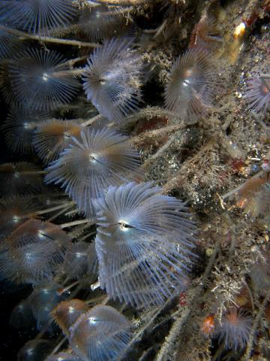
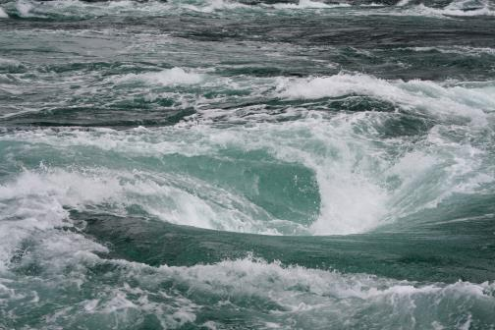
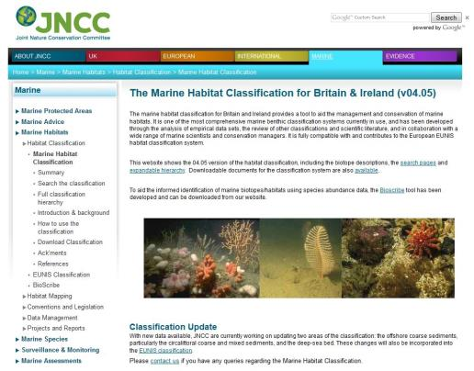
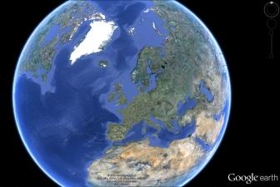
Environmental variables
Variables
  Light
  Nutrients
  Currents & waves
  Salinity
  Dissolved gases
  Temperature
Geography
  Latitude
  Seasonal variations
Habitats
  Places to live
Hellbuny/Wikimedia Commons
J D Greenbaum

Slide 17
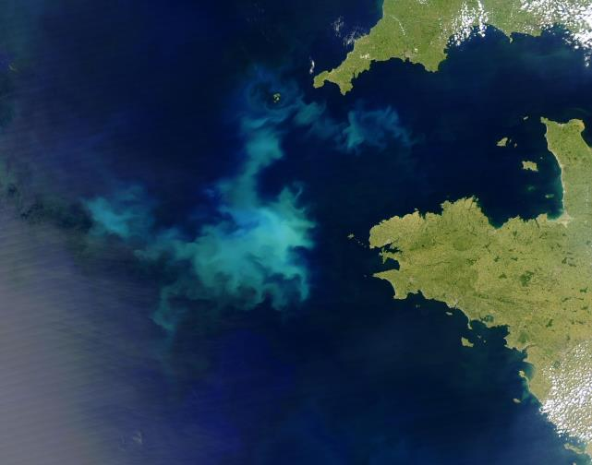
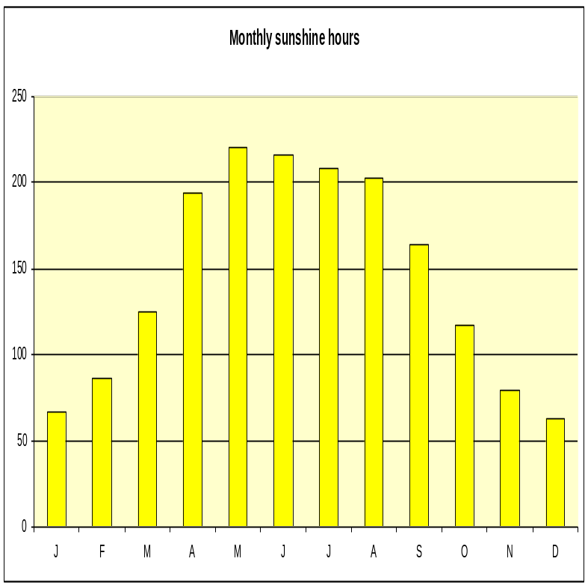
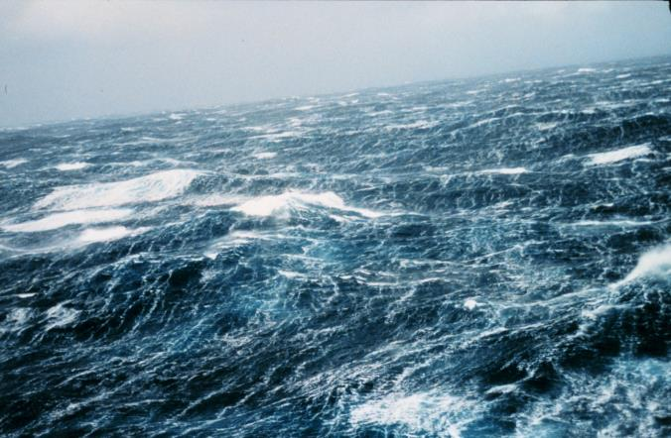
Seasonal cycles
Spring
  Increasing temperature
  Increasing light
  Lots of phytoplankton!
Summer
  Plankton bloom diminishes
  Dead plants and animals sink to seabed
  Nutrients removed from surface
Autumn-Winter
  Stormy weather mixes water
  Nutrients brought back from seabed to surface
NASA
NOAA

Slide 18
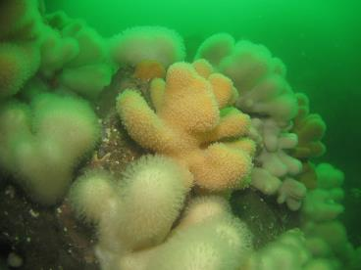
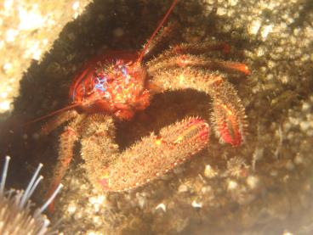
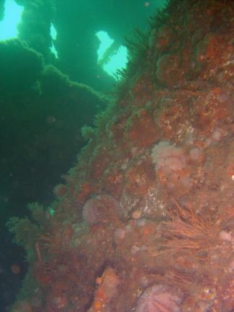
Habitats – hard ground
Boulder & bedrock
Organisms live on or between the surfaces
Organisms are typically easy to see
Most common dive sites
Man-made – wrecks, bridges, walls, shotlines
J D Greenbaum
J D Greenbaum
J D Greenbaum

Slide 19
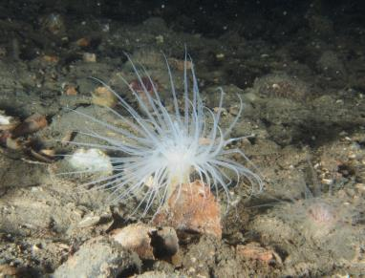
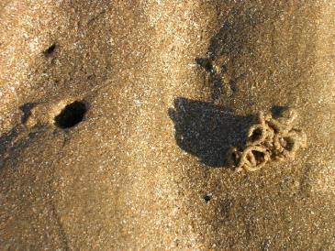
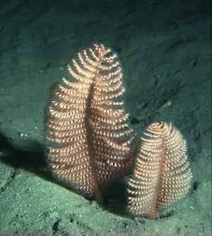
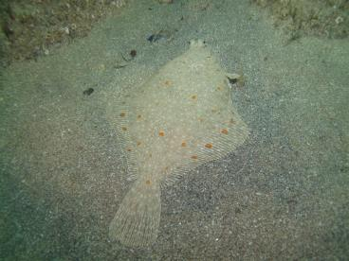
Habitats – soft ground
Mobile & unstable
Organisms typically burrowers
Sand or shale, coarse sediments
Muddy, fine sediments
Often flat & apparently featureless
Often very rich habitats, but animals hidden in 3D
Keith Williamson
J D Greenbaum
J D Greenbaum
©Bernard Picton

Slide 20





Habitats – high and low energy
High energy sites
  High wave exposure or very strong tidal currents
  Surfaces often covered in animals
Low energy sites
  Sheltered from waves
  Weak tides
  Rocks may be ‘mucky’
Other habitat types
  Open water
  Biogenic
  Seaweed and plant communities
R A Scarsbrook
J D Greenbaum
J D Greenbaum
Rosanna Milligan
C Sweeting

Slide 21









Adaptation
Adaptation process
  Evolution: survival of the fittest
Adaptation
  Features that aid survival
Example: marine animals depend on eating other plants and animals
  hunters
  scavengers
  filter feeders
  Grazers
Reproduction and feeding styles are also adaptations
©Bernard Picton
J D Greenbaum
Andy.Cowley/ Wikimedia Commons
©Bernard Picton
J D Greenbaum
©Bernard Picton
©Bernard Picton
Andy.Cowley/ Wikimedia Commons

Slide 22












Adaptation - feeding
Size doesn’t matter
Linking with other animals
  Win-win
  Home for life
  Animal on plant
  Plant on animal
©Bernard Picton
©Bernard Picton
©Bernard Picton
Havspappan/Flickr
With algae
Havspappan/Flickr
©Bernard Picton
©Bernard Picton
Havspappan/Flickr
Havspappan/Flickr
Naked sponge
With algae
©Bernard Picton
©Bernard Picton
©Bernard Picton

Slide 23










Adaptation - predators
To help catch prey some animals have:
  Binocular vision
  Excellent sensitivity to their environment
  Good camouflage
  Extendable stomachs
  Venom
©Bernard Picton
Mgiganteus/Wikimedia Commons
©Bernard Picton
©Bernard Picton
J D Greenbaum
©Bernard Picton
Mgiganteus/Wikimedia Commons
©Bernard Picton
©Bernard Picton
J D Greenbaum
©Bernard Picton

Slide 24
















Adaptation - prey
To avoid being eaten some animals:
  Have all round vision
  Have sharp spines
  React very fast
  Stay in large groups
  Blend into their surroundings
  Have warning / danger colours
  Have built in protection
  Have escape or startle responses
PD/Wikipedia
J D Greenbaum
©Bernard Picton
©Bernard Picton
J D Greenbaum
©Bernard Picton
©Bernard Picton
PD/Wikipedia
©Bernard Picton
J D Greenbaum
©Bernard Picton
©Bernard Picton
©Bernard Picton
©Bernard Picton
©Bernard Picton
J D Greenbaum

Slide 25











More adaptation examples
Streamlining
  Help moving efficiently or stop being swept away
  Swimming fast
  Resist wave action or dehydration
  Go with the flow
Breathing
  Direct oxygen absorption
  Oxygen extraction via gills
  Breath hold diving
Tango22 /Wikimedia Commons
©Bernard Picton
J D Greenbaum
©Bernard Picton
Gills
FAO
Tango22 /Wikimedia Commons
FAO
©Bernard Picton

Slide 26
Summary
Everything has to feed and reproduce in order to survive
Life in the sea gets its energy from the sun
  Producers
  Consumers
  Food chain/web
Many different ways to reproduce
  Sexual more costly, more genetic variation
  Asexual easier, produces clones
  Mix and match
Geography, geology, climate lead to many types of habitat
Species adapt or die out

