Slide 1


Webinar Tutorial
READING UNIVERSITY
www.rubsac.org.uk |

Slide 2

Welcome!

Slide 3
Contents
Different software options
Physical and virtual workspace
Setting the stage
Etiquette
Teamwork
Complimentary tools

Slide 4






Video Conferencing Platforms…

Slide 5




Rooms and Lobbies
Meeting Room
Lobby
*admit*
  Max capacity
  Longevity
  Password protection

Slide 6
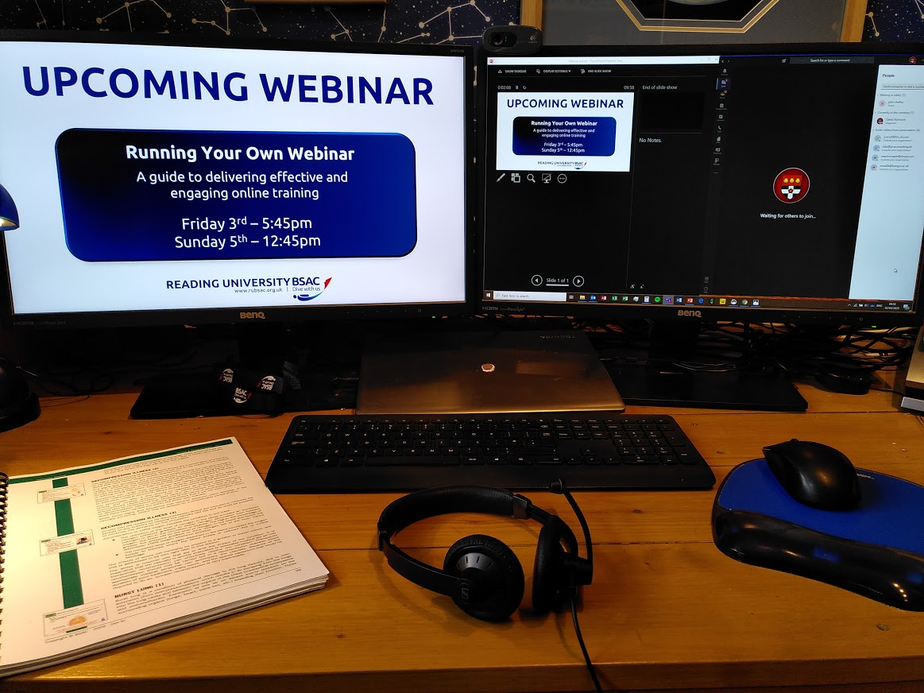
Physical Workspace
Background noise
Acoustics?
Microphone
Headphone
Feedback!

Slide 7
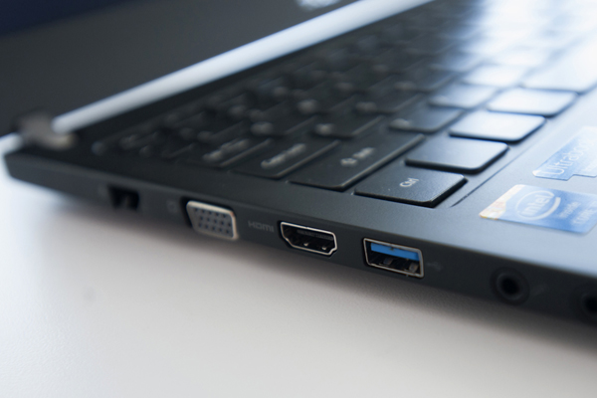
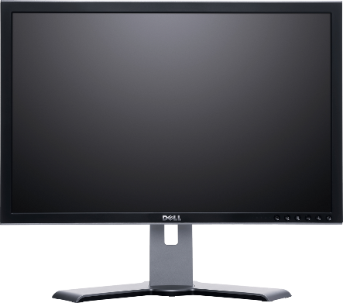

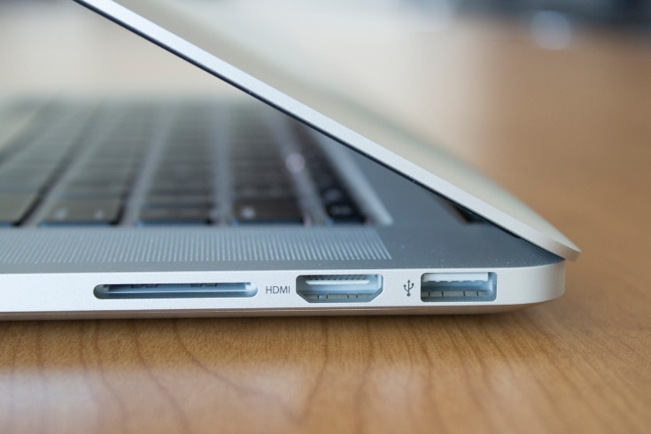

Multiple Monitors

Slide 8

Typical Screen Layout
Screen 1
  ‘Live’ Screen
    Powerpoint show
    Polling results
    Videos
Screen 2
  ‘Driving’ Screen
    Webinar software
    Powerpoint controls
    Polling controls
Screen 1
  ‘Live’ Screen
    Powerpoint show
    Polling results
    Videos

Slide 9
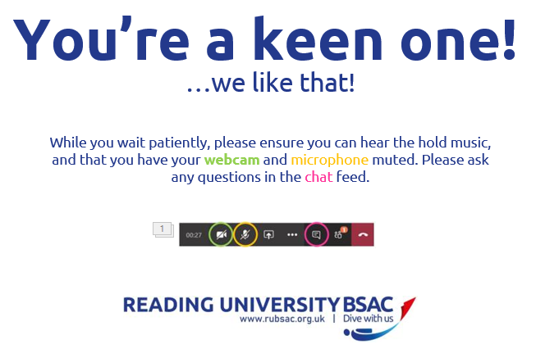
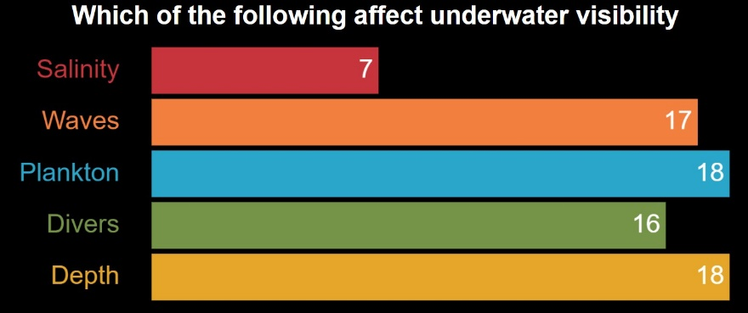

Screen Switching
Screen 1
  Driving Screen
  Webinar software
  Powerpoint controls
  Polling controls

Slide 10

Tricks/Tips: Setting the stage
Splash screens
  Useful information
  Turn off microphone
  Turn off video
Hold music?
  Share audio (be careful!)

Slide 11

Tricks/Tips: Teamwork
BAMBOOZLED!
?

Slide 12



Tricks/Tips: Teamwork

Slide 13
Tricks/Tips: Teamwork
Preparation
  Allocate time for dry run
  Brief the team
  Share handouts
  Means of communication outside of the room
  Emergency channel
  Glass of water
  Disaster recovery??
Responding to Questions
  Don’t be afraid to say ‘I don’t know’…
  …and delegate to ‘BSAC Gnomes’

Slide 14

Complimentary Tools: Collecting Data
BEWARE!! GDPR (Data Protection)
  Keep private
    Don’t share
    Use BCC in emails, or use mailchimp etc
  Keep secure
    Password protected device/files
  Use for its intended purpose
  Destroy properly
  Destroy at end of lifespan
    (ie don’t keep forever)

Slide 15
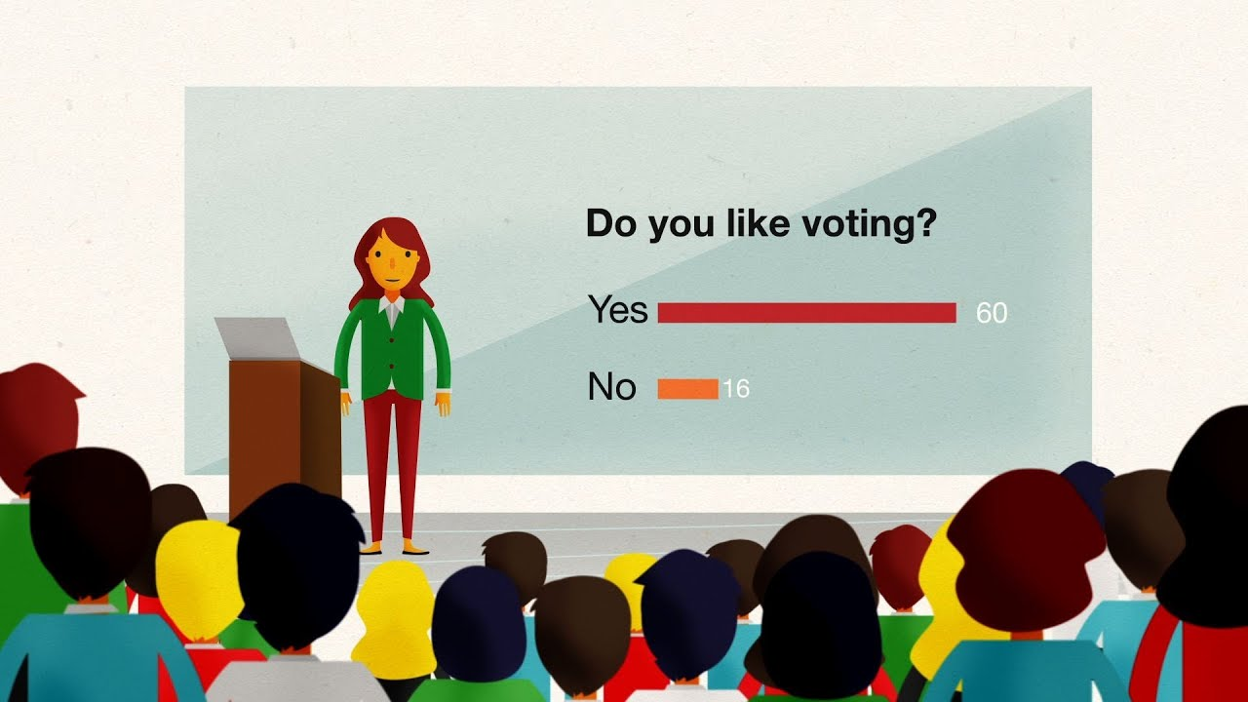

Complimentary Tools: Polling/Quizzes

Slide 16
Any Questions?

