Slide 1
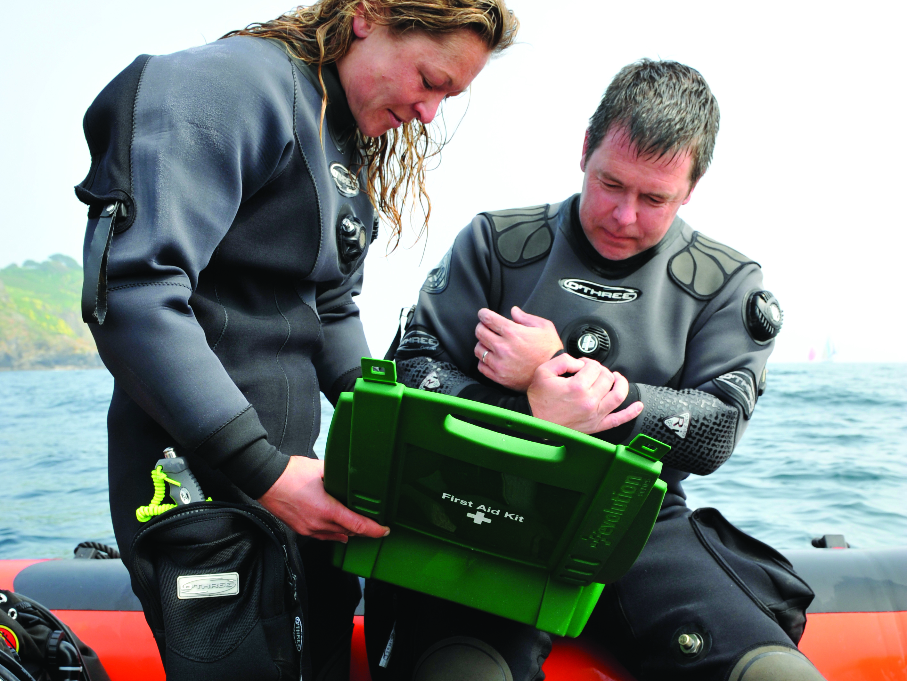

First Aid for Divers
Wounds and Bleeding

Slide 2
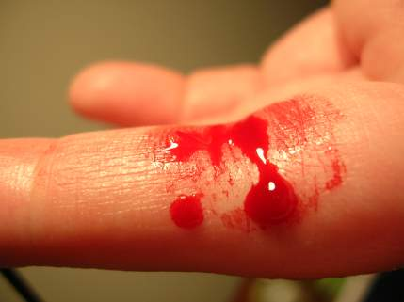
Contents
Types of wound
Bleeding and clotting
Treatment

Slide 3
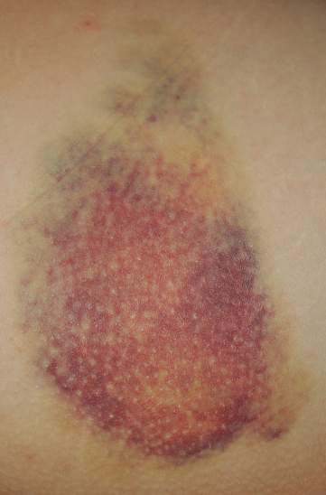
Wounds
Any damage to the skin or underlying tissues
Open wound
  skin is breached
  blood lost from the body
  allows infection into the body
Closed wound
  underlying tissues damaged beneath intact skin
  blood lost from circulation but NOT from the body

Slide 4
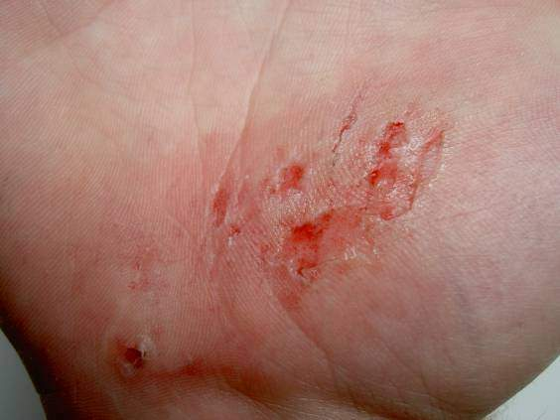
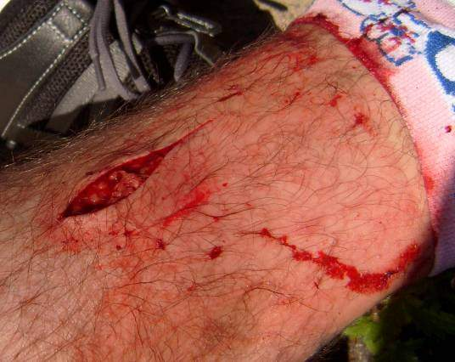
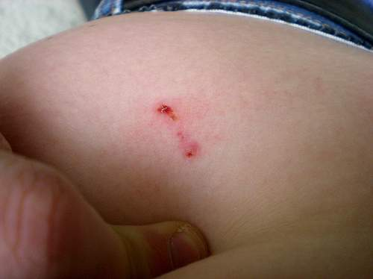
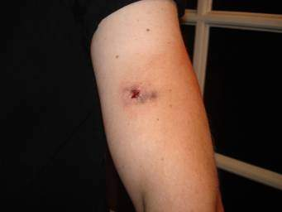
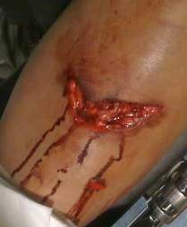
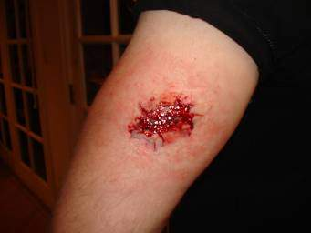
Types of wound
Open
  incision
  laceration
  abrasion
  puncture
  ‘gunshot’
Closed
  contusion
  internal bleeding

Slide 5
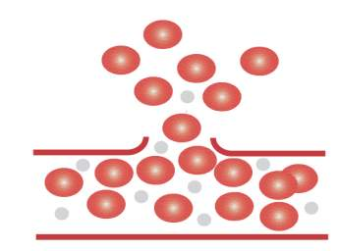
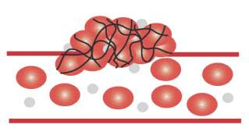
Bleeding and clotting
Ruptured blood vessels
  blood cells escape
  wounded tissue releases chemicals
Platelets
  stick to edges of wound
  release further chemicals
  blood vessels contract
  fibrin threads form
Blood clot
  fibrin threads form mesh over wound, trapping blood cells
  clot hardens, sealing hole
Keep casualty still to help clotting
Red blood cells
Platelets
Damaged blood vessel
Blood clot
Fibrin threads

Slide 6
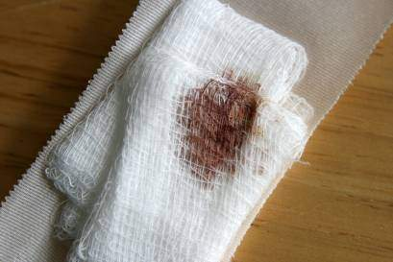
Treatment principles
Minimise blood loss
Help body cope with blood loss
Prevent infection
Treat for shock

Slide 7
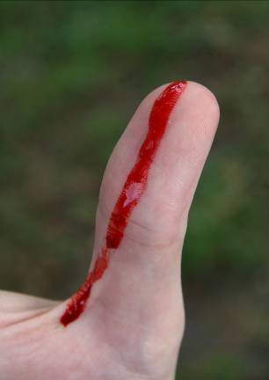
Minor open wounds
Treatment
  clean wound
  dry wound
  apply sterile dressing
  apply firm bandage

Slide 8
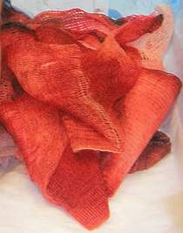
Severe bleeding
Treatment
  apply pressure
  raise and support injury
  apply sterile dressing
  if more required apply further dressings on top
  bandage firmly
  DO NOT use tourniquets
  immobilise affected area to help blood clotting
Severed body part
  bag it
  keep cool and dry
  send with casualty

Slide 9
Internal bleeding signs and symptoms
Pain / tenderness
Bruising
Blood in spittle / urine
Shock without obvious blood loss
  weakness, dizziness
  pallor, sweating
  rapid pulse and breathing
  breathlessness, unconsciousness

Slide 10
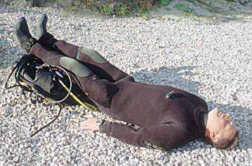
Internal bleeding treatment
Lie down (legs raised)
Arrange evacuation
Record
  breathing
  pulse
  response levels
  treatment
Recovery position if casualty loses consciousness

Slide 11
Summary
Open wounds
Closed wounds
Clotting
Hygiene
Pressure
No tourniqets or pressure points

