Slide 1
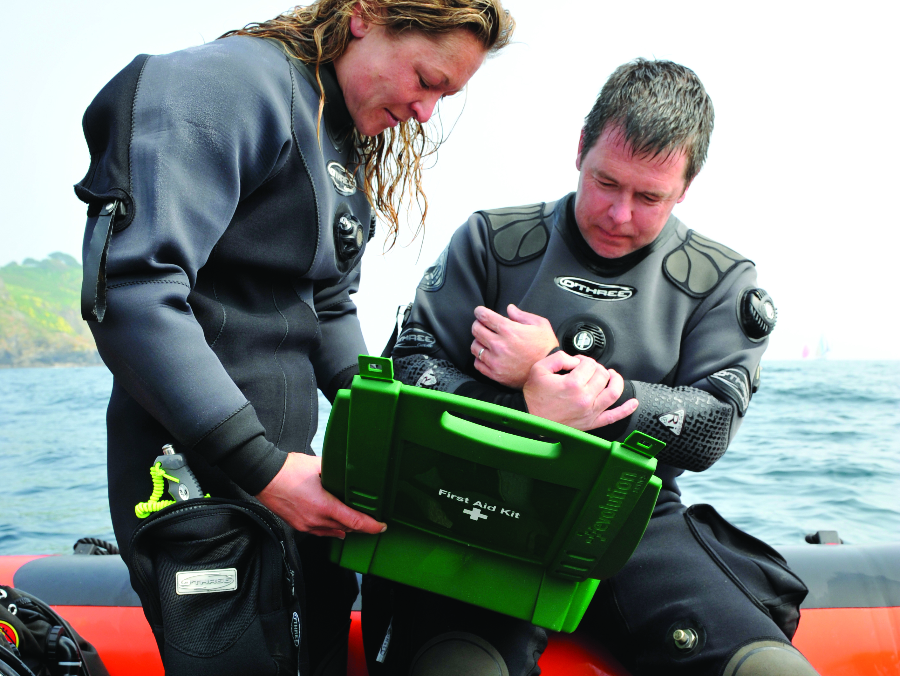

First Aid for Divers
Summoning Assistance

Slide 2

Summoning assistance
At sea
  coastguard for all types of emergency
On land
  DCI – BHA / RN Diver Helplines
  lost diver – police
  injuries – ambulance
  write down incident details
    incident history
    signs and symptoms
    first aid given
  give to ambulance crew
  send with casualty

Slide 3
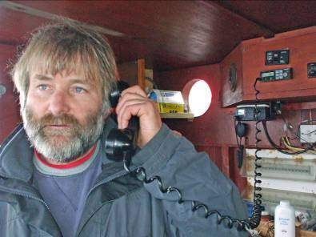
Emergency services at sea
Contact coastguard on VHF DSC and / or channel 16
  Mayday = life in imminent danger
  Pan Pan = assistance urgently required
Give full details
  vessel’s name / call sign
  position and intentions
  nature of emergency
  assistance required
Report back to rescue manager essential

Slide 4


Emergency services on land
Police / Ambulance / Coastguard
  Telephone: 999 or 112
BHA/RN Diver Help Line
  England, Wales & N. Ireland: 07831 151523
  Scotland: 0345 408 6008
Give full details
  nature of incident
  location
  personnel involved
Report back to rescue manager essential

