Slide 1
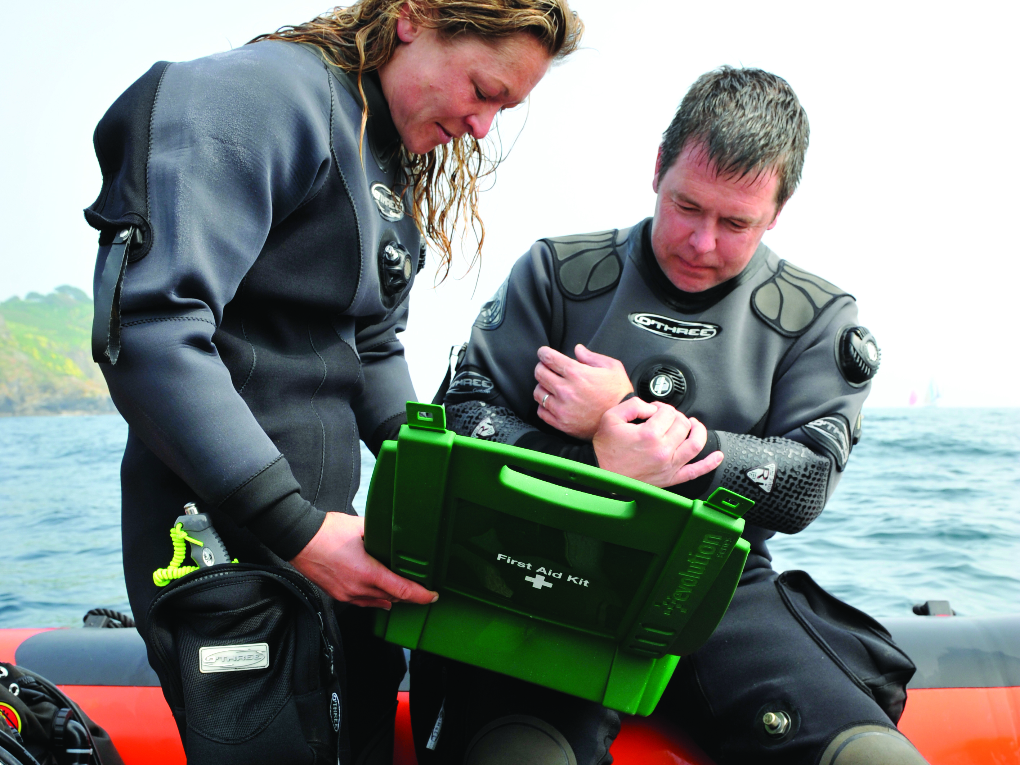

First Aid for Divers
Shock

Slide 2
Shock
Inadequate circulation
  tissue damage due to inadequate oxygenation and waste removal
  life-threatening
Consider in all major injuries
Causes
  reduced blood volume (bleeding, burns, bruising, prolonged seasickness)
  massive dilation of blood vessels (fainting, hyperthermia)
  inadequate cardiac output (heart attack, pulmonary barotrauma)
  allergic reaction to drugs, food or stings
  removal from the water after prolonged immersion

Slide 3
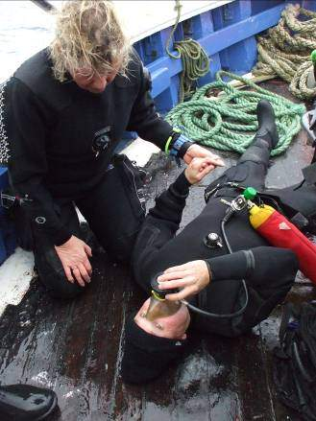
Dealing with shock
Signs & symptoms
  weakness, dizziness
  pallor, sweating
  rapid pulse and breathing
  breathlessness, unconsciousness
Treatment
  contact the emergency services
  treat prime cause
  reassure, keep casualty quiet
  lay casualty down, legs raised (but not for DCI or burst lung)
  keep warm and comfortable
  administer oxygen
  monitor condition
  give nil by mouth (except for DCI)

Slide 4
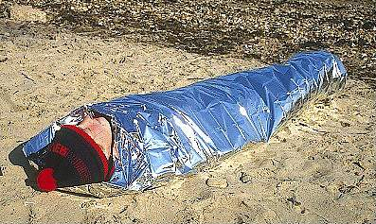
Immersion shock
First aid
  keep casualty in horizontal attitude at all times
  discourage any movement or activity by the casualty
  other actions as for shock

Slide 5
Summary
Caused by inadequate circulation
Life-threatening condition
Expect in all major injury cases
Treat prime cause
Legs raised, O₂, TLC, no fluids, evacuate
Special cases
  immersion shock
  DCI

