Slide 1
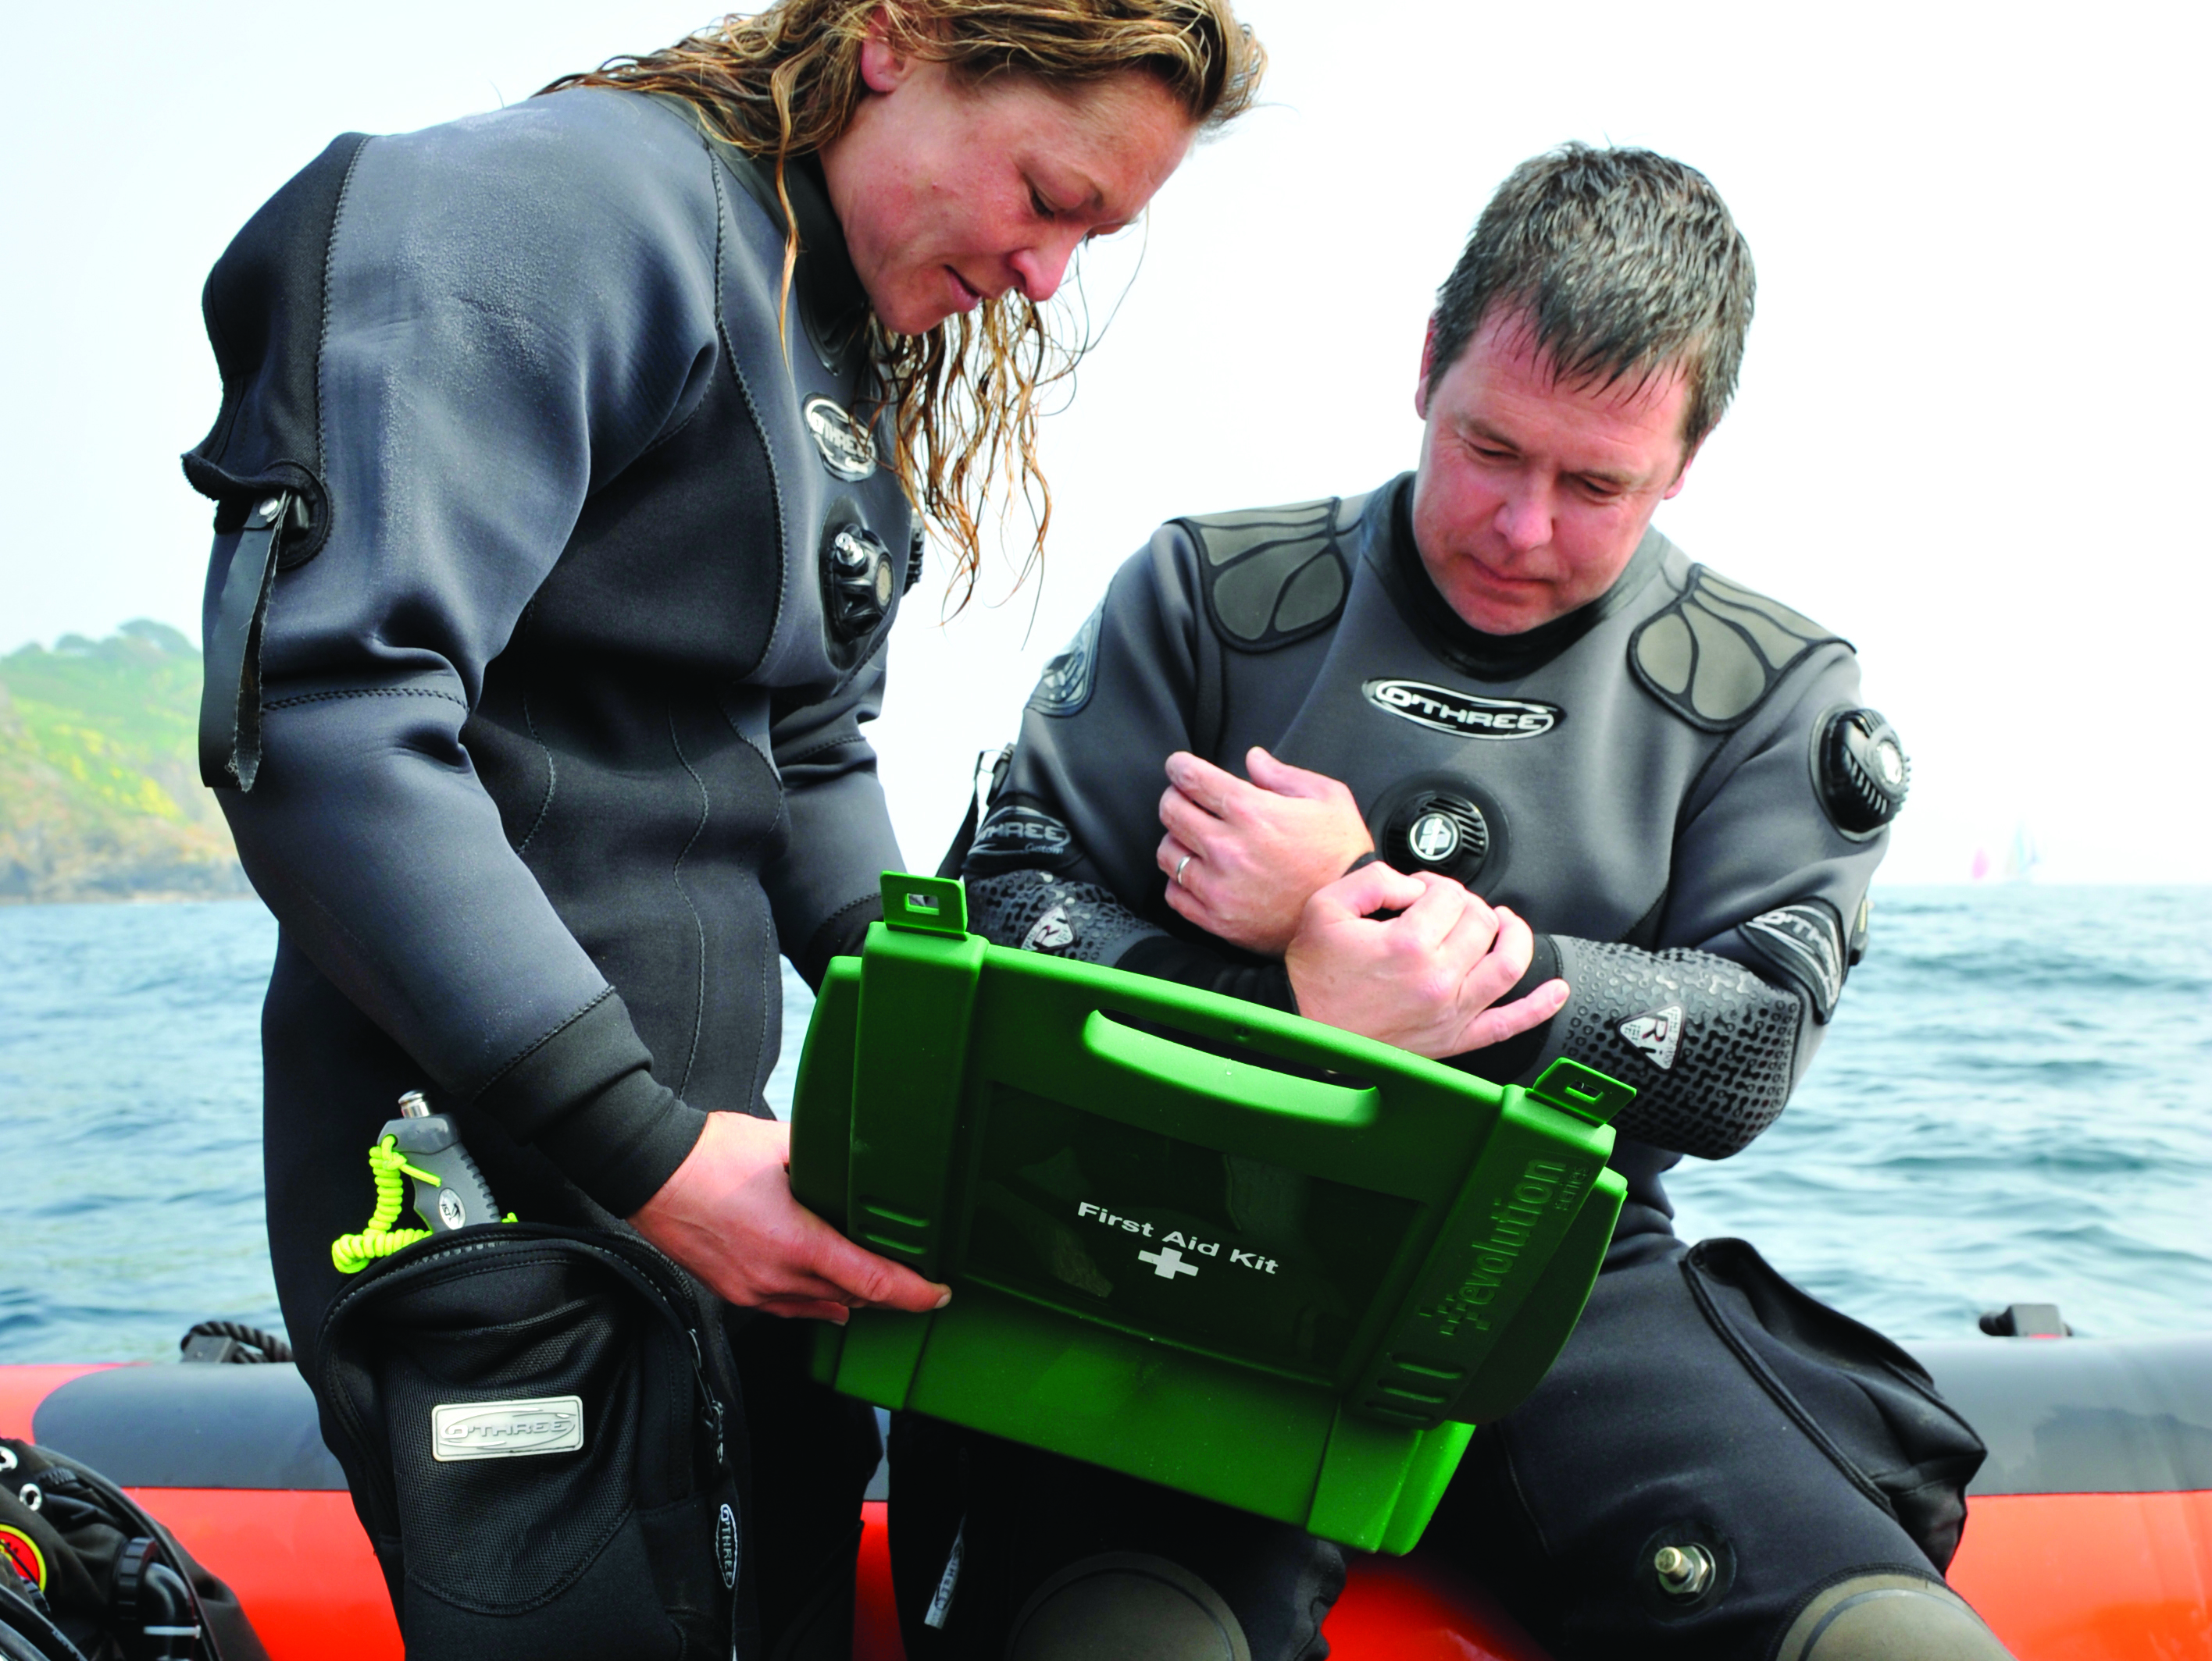

First Aid for Divers
Other Conditions

Slide 2
Contents
Barotrauma
  mask squeeze
  ear problems
  sinus problems
  teeth
Life-threatening conditions
  severe head injury
  stroke
  heart attack
  blast injury
Others
  stings from sea creatures
  seasickness
  hypothermia
  hyperthermia and exhaustion

Slide 3
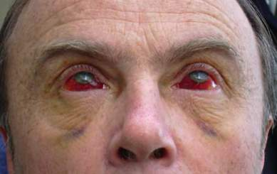
Mask squeeze
Inadequate equalisation on descent
  bruised / swollen facial tissues
  bruised / haemorrhaged eyes
  self healing
Treatment
  reassurance
  medical attention if painful
  refrain from diving until clear

Slide 4
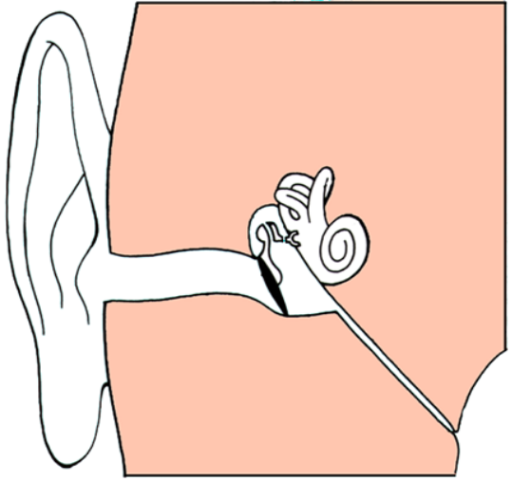
Ear problems
Structure
Causes
  inadequate ear clearing on descent
  tight hood on descent
  blocked eustachian tube on ascent
Signs and symptoms
  pain
  dizziness / vertigo
  hearing disturbances
  deafness
  bleeding from ear
Treatment
  cover ear and allow drainage
  refrain from diving
  medical attention for deafness, or if unresolved
Inner Ear
Ear Drum
Eustachian Tube

Slide 5
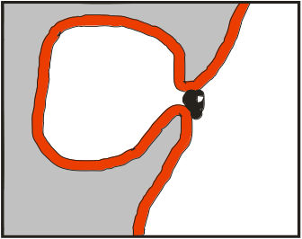
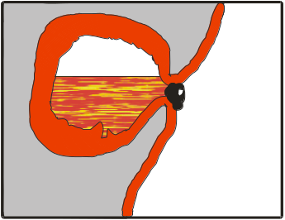
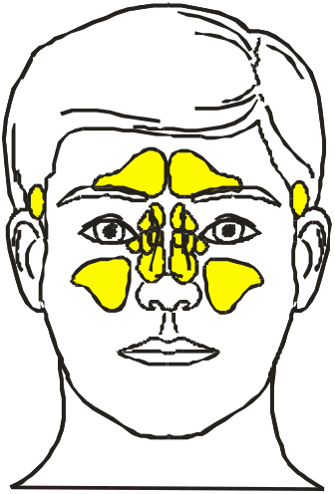
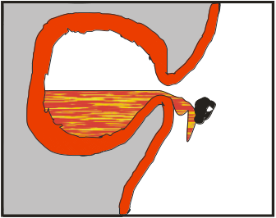
Sinus problems
Structure
Causes
  diving with a cold
Signs and symptoms
  blood in the mask
  sinus pain
Treatment
  painkillers
  medical attention if severe
Before Dive
Air
Mucous membrane
Block
During Dive
Air
Membrane swelling
Blood
Membrane rupture
Air
Bleeding into nasal passage

Slide 6
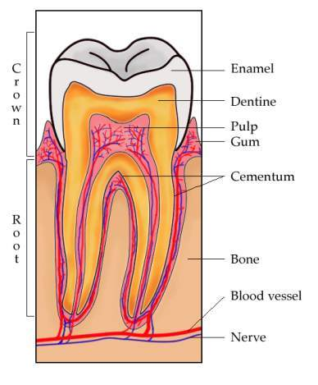
Teeth
Cause
  air pockets trapped behind fillings
  cavities with narrow openings
Signs & symptoms
  pain during ascent / descent
  dislodged fillings / split tooth
  bleeding from gums
Treatment
  painkillers
  pad to prevent further damage
  refer to dentist

Slide 7
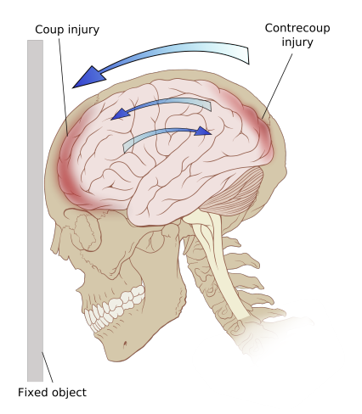
Severe head injury
Signs and symptoms – blow to head plus:
  headache worsens, or lasts over 6 hours
  extreme or persistent sleepiness
  two or more bouts of vomiting
  unconsciousness, however brief
  unequal pupil size
  straw coloured or blood stained fluid from nose or ears
  severe dizziness or loss of balance
  confusion or strange behaviour
  problems with memory
  unable to use part of body eg, arm or leg
  difficulty seeing or double vision
  slurred speech
  unusual breathing patterns
  ringing or deafness in one or both ears
  seizure or fit

Slide 8
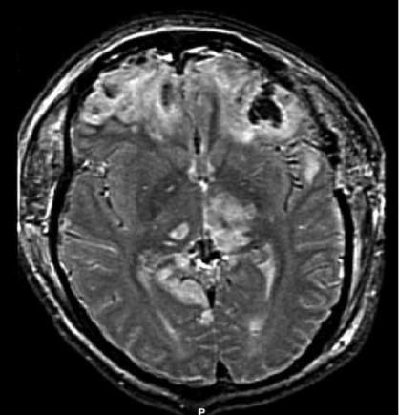
Severe head injury
Treatment
  immediate medical attention
  give oxygen (divers only)
  treat other injuries
  do not dive or drive

Slide 9
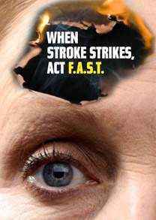
Stroke
Disruption of blood supply to brain
  Face
  Arms
  Speech
  Time
Other signs and symptoms
  dizziness
  communication problems
  problems with balance and coordination
  difficulty swallowing
  severe headaches
  numbness / weakness / paralysis of one side of body
  loss of consciousness (in severe cases)
Immediate medical attention

Slide 10

Heart attack
Disruption of blood supply to heart
  chest pain
  shortness of breath
  clammy, sweaty, and grey complexion
  dizziness
  nausea and vomiting
  restlessness
  coughing
  general feeling of being unwell
Treatment
  300mg aspirin
  immediate medical attention
  lay down, TLC
  give oxygen (divers only)
  BLS if necessary
  AED if necessary and available

Slide 11
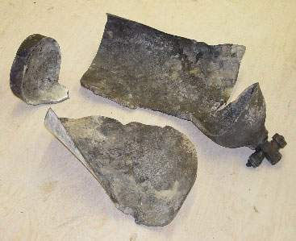
Blast injury
Causes
  exploding cylinder
  burst flailing hose
  explosives
Injuries due to
  overpressure
    bruising
    tissue separation
    soft tissue damage
    limb damage / amputation
  shrapnel
    high energy particles
    multiple wounds
    ‘gunshot’ wounds

Slide 12
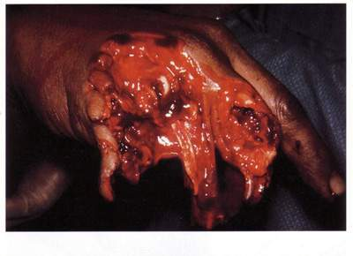
Blast injury
Treatment
  ABC
  counter bleeding
  treat fractures
  make casualty comfortable
  treat for shock
  arrange urgent evacuation

Slide 13
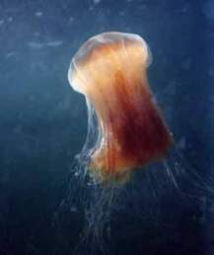
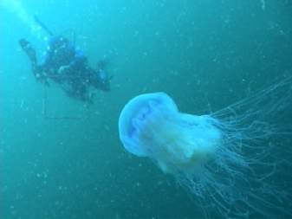
Stings from sea creatures
Hazards
  UK rarely serious
Signs & symptoms
  contact with animal
  pain
  rash and / or swelling
  shock
Treatment
  remove jellyfish stings
    do not touch
    do not use fresh water
  treat symptoms
  get medical help if serious

Slide 14
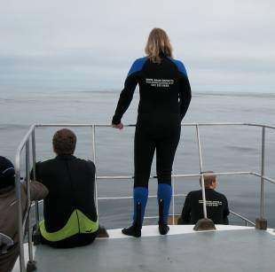

Seasickness
Cause
  motion affects balance mechanism
  people differ in susceptibility
Prevention / minimisation
  healthy eating and drinking
  watch horizon, minimise motion
  comfortable clothing
  proprietary remedies
Signs & symptoms
  nausea, vomiting, pallor, headache
  inability to perform tasks
Treatment
  lay / sit down, keep warm
  secure to prevent falling (overboard)
  remove to more stable environment

Slide 15
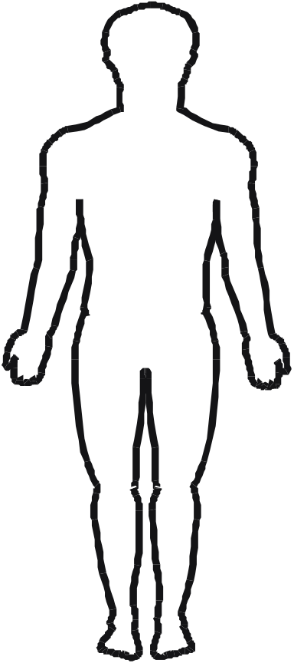
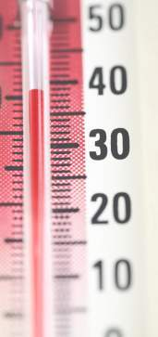
Hypothermia
Body temperature <35°C
Causes
  inadequate thermal protection
  water conducts heat 25 times faster than air
  wind chill/evaporation
Signs and symptoms
  35-37°C cold, lethargic, pale skin
  33-35°C slurred speech
  32°C intense shivering, low comprehension, irrational
  30°C shivering stops, lack of coordination, slow pulse and breathing
  27°C unconscious
  24°C death
<35ºC

Slide 16
Hypothermia
Treatment
  insulate, lay down, keep quiet
  hands and arms not touching trunk
  warm sheltered environment
  replace or cover wet clothing
  hot sweet drinks
  recovery position if unconscious, BLS if necessary
  evacuate to medical attention
Do not
  give alcohol
  rub or massage limbs
  allow casualty to exercise
In extremis
  gentle heat to trunk only
  rewarm at original cooling rate
<35ºC

Slide 17
Hyperthermia
Causes
  exercise in heat and / or excessive clothing
  loss of salt through sweating and / or D and V
Signs and symptoms
  casualty exhausted and restless
  headache, dizziness, nausea
  cramps in lower limbs
  pale, clammy skin, normal or falling temperature
  fast shallow breaths, weak rapid pulse
Treatment
  lay down in cool place
  water or rehydration drink
  recovery position if unconscious
  evacuate to medical facility
>37ºC

Slide 18
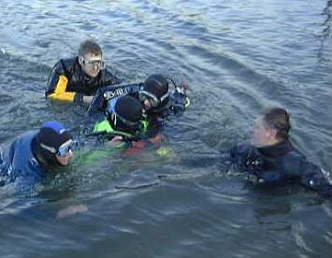
Exhaustion
Causes
  overexertion
  aggravated by heat, cold, depth, illness
Signs and symptoms
  deep laboured breathing
  headache and confusion
  unable to respond to mental and physical demands
Treatment
  stop activity
  lay down and keep quiet
Exhaustion = common sign of DCI

Slide 19
Summary
Mask squeeze
Ear problems
Sinus problems
Teeth
Severe head injury
Stroke
Heart attack
Blast injury
Stings from sea creatures
Seasickness
Hypothermia
Hyperthermia
Exhaustion

