Slide 1
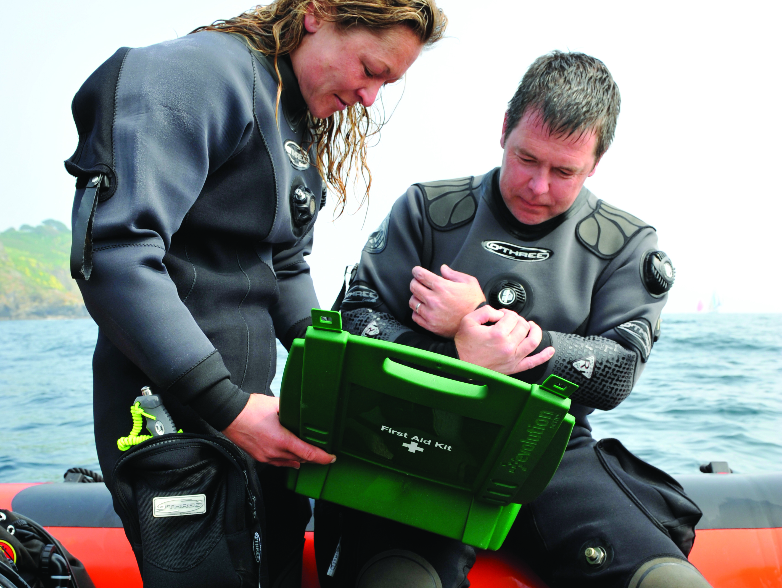

First Aid for Divers
Introduction

Slide 2
First Aid for Divers
Introductions
Course aims
  first aid for common injuries and illnesses
  specific to club diving situations
  other BSAC rescue skills training
Use of oxygen
Domestic arrangements
Locations
Timings

Slide 3
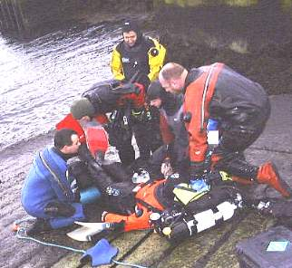
Course outline
Principles and priorities of first aid
Casualty examination – practical
Summoning assistance
First aid kits
Shock
Wounds and bleeding
Bandaging – practical
Burns
Miscellaneous injuries and conditions
Injuries to muscles, bones and joints
Dressings, splinting and moving casualties – practical
Open Forum, debrief and disperse

