Slide 1
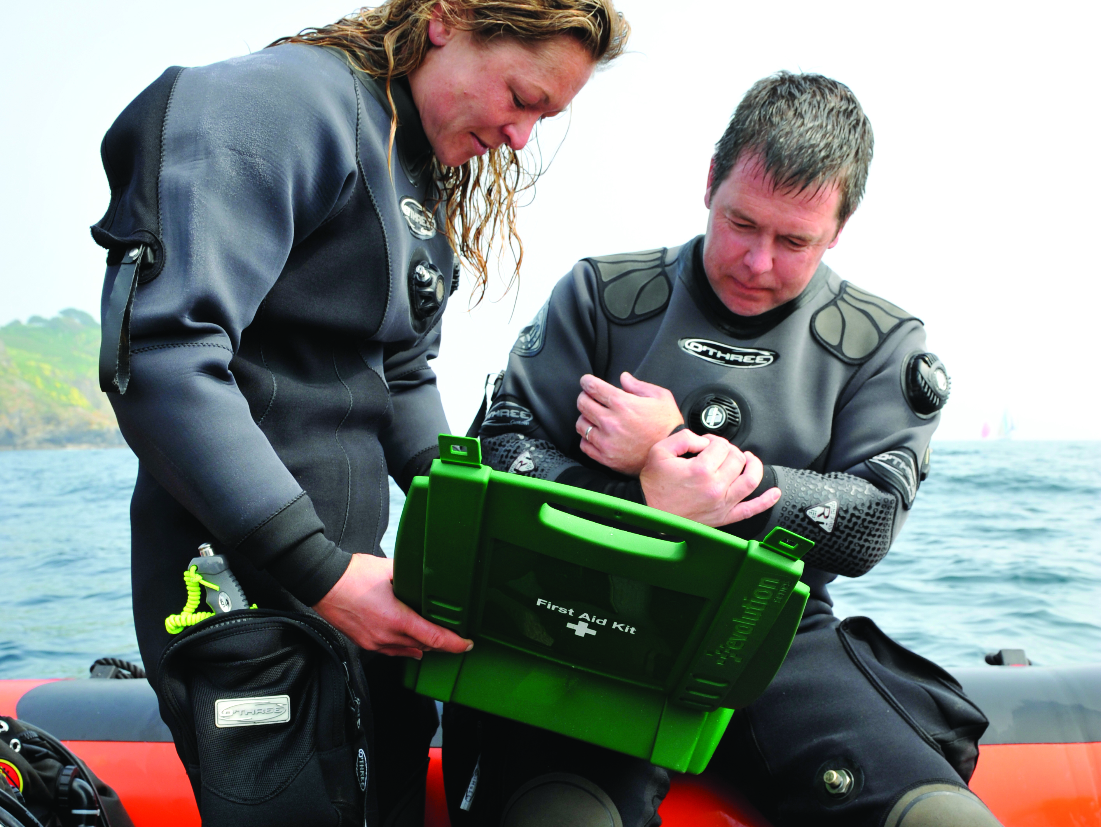

First Aid for Divers
Burns

Slide 2
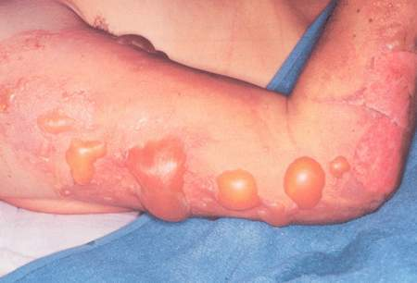
Contents
Classification
Signs and symptoms
Treatment

Slide 3
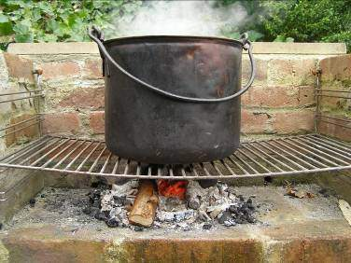
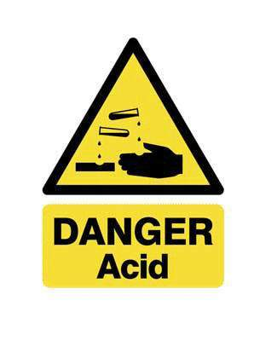
Types and causes
Dry burns
  flame
  hot surface
  friction
  electricity
  radiation
Scalds
  hot liquid
Chemical

Slide 4
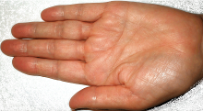
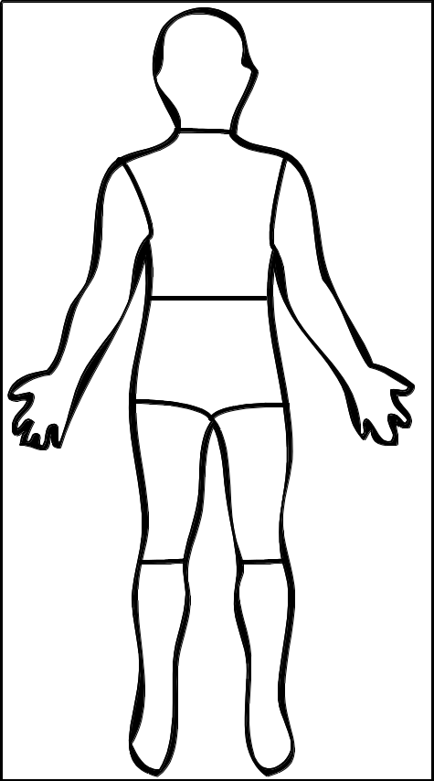
Area
Bigger area = more severe
Palm of casualty’s hand = 1%
Wallace’s rule of 9’s
  head
  arm
  chest
  upper back
  abdomen
  lower back
  thigh
  lower leg
9%
9%x2
9%
9%
9%x2
9%
9%
9%
9%

Slide 5
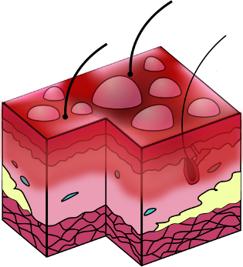
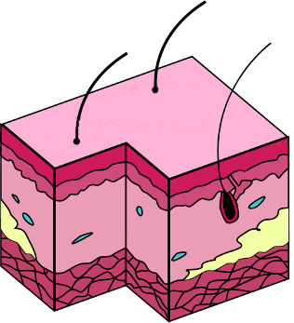
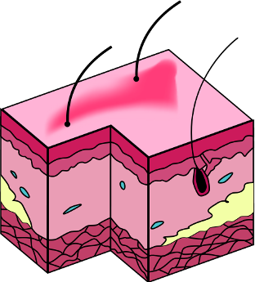
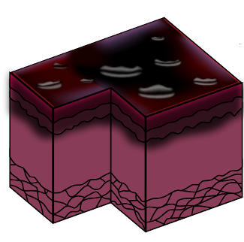
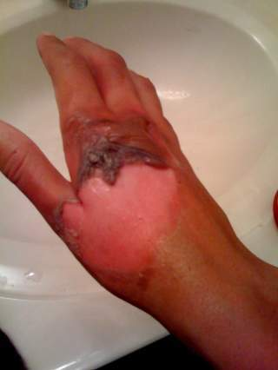
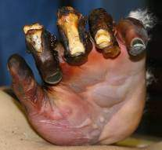
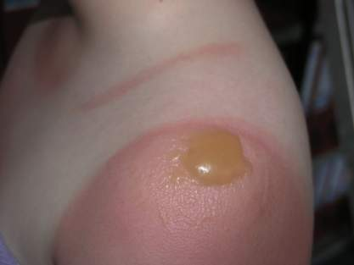
Burn depth, signs and symptoms
Skin structure
  epidermis - waterproof
  dermis - blood vessels, nerves, muscles
  subcutaneous tissue
Burn classification
  superficial
    Red / swollen / painful
  partial thickness
    red/swollen / painful
    exposed to infection
    blisters
  full thickness
    Pale / waxy / possibly charred
    serious

Slide 6
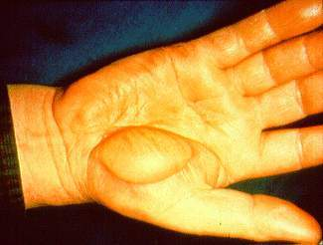
Electrical burns
Possible features
  superficial surface injury
  extensive damage to lower layers
  cardiac arrest
  electric shock risk for first aider

Slide 7
Treatment – superficial burns
Reassure casualty
Cool affected area
  gently flowing cold water
  up to 20 minutes
Remove constrictions
Cover
DO NOT
  break blisters
  apply lotions, ointments etc
  use adhesive dressings

Slide 8
Partial / full thickness
Lay casualty down
Cool affected area
Remove constrictions, wet clothing
Cover burned limbs
Treat for shock (and give O₂)
  conscious – give sips of water
  unconscious – recovery position
Evacuate to medical attention
DO NOT
  break blisters
  apply lotions, ointments etc
  use adhesive dressings
  remove dry clothing

Slide 9
Chemical burns
Flood with water
  20 minutes minimum
  keep water away from healthy tissue
Remove contaminated clothing
  gently
  avoid self / area contamination
  protection
Continue as for partial and full thickness burns
Evacuate to medical attention

Slide 10
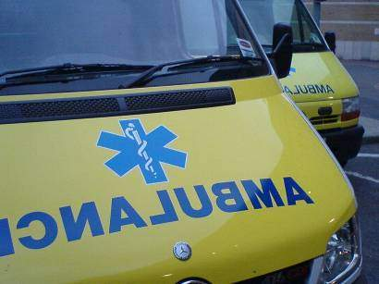
Hospital treatment if burn is.......
Full thickness
To face, hands, feet, genitals
Right around a limb
Partial thickness > 1%
Superficial > 5%
Mixed pattern of thickness
Chemical

Slide 11
Summary
Classification
Signs & symptoms
First aid
Needing hospital treatment

