Slide 1
BSAC Dive Leader Training
Oxygen & Diving Incidents

Slide 2
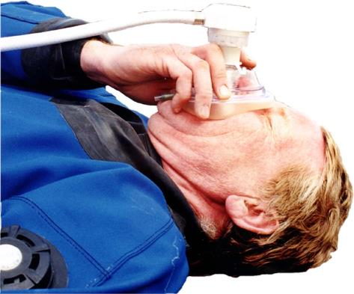
Lesson Outline
What is oxygen?
Conditions:
  Decompression illness
  Burst lung
  Near drowning
  Shock
  Carbon monoxide poisoning
Signs and symptoms
On-site first aid
Benefits of oxygen

Slide 3

Oxygen
Characteristics
  A colourless, odourless, tasteless gas
  Comprises approximately 21% of the atmosphere (by volume)
  An essential component of metabolism
  Carried in the blood stream
    Primary means - combined with the haemoglobin
    Secondary means - dissolved in the blood plasma
  Plasma’s capacity to transport additional oxygen utilised in oxygen administration
Will not burn but supports the combustion of other materials

Slide 4
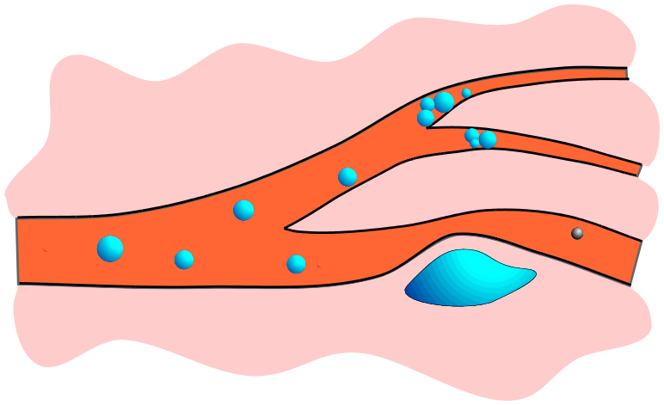
Decompression Illness (1)
Causes
  Inadequate elimination of nitrogen from the body during ascent
  Physical damage to the alveoli due to overpressure introduces bubbles of air (emboli) into the blood
Bubbles blocking blood flow
Bubbles in tissues compress blood vessels
Patent foramen ovale (PFO) allows bubbles to pass from venous to arterial circulation

Slide 5
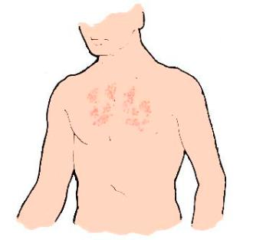
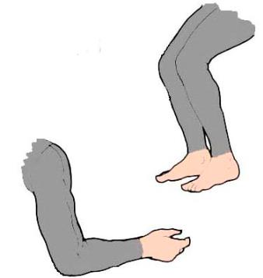
Decompression Illness (2)
Signs and symptoms
  Denial!
  Itches, rashes
  Numbness, tingling, joint pains
  Vision disturbances
  Dizziness, nausea, headaches, confusion
  Weakness, paralysis, loss of bladder/bowel control
  Shortness of breath
  Shock, unconsciousness
  Any abnormality after a dive
Signs and symptoms appear from seconds to many hours after surfacing

Slide 6
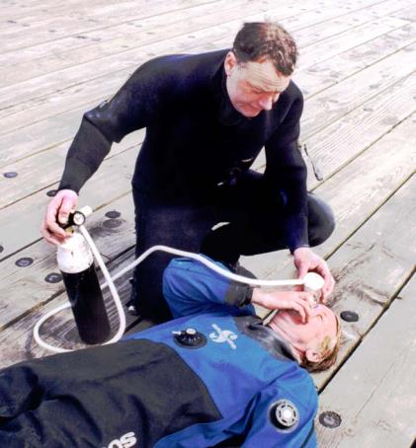
Decompression Illness (3)
On-site first aid
  Lie casualty down flat
  Keep casualty quiet
  Administer 100% oxygen
    Increased nitrogen pressure gradient assists in nitrogen elimination from bubbles in blood and tissue
    The higher the percentage of oxygen the more effective – whenever possible administer 100%
    Improved oxygen supply to tissues where blood flow is reduced due to bubble blockage
  Treat for shock
  Evacuate to a recompression facility as soon as possible

Slide 7
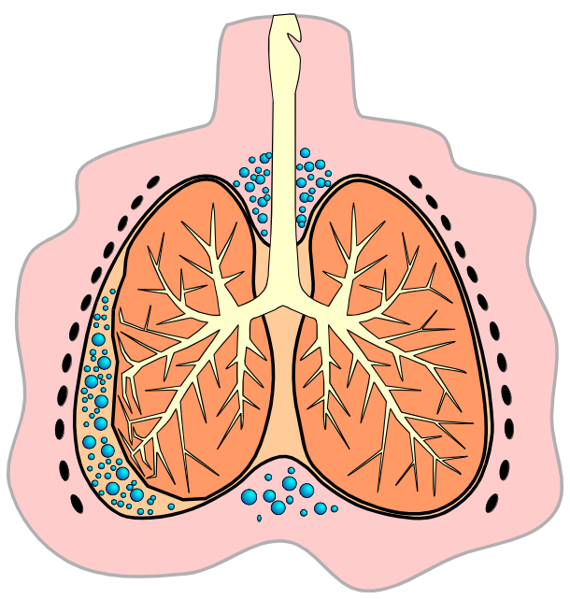
Burst Lung (1)
Cause
  Physical damage to lung tissue from over-extension due to over-pressurisation
Types
Bubbles between organs and tissues (emphysema)
Collapsed lung
(pneumothorax)
Both types can occur in isolation but are usually accompanied by air embolism

Slide 8
Burst Lung (2)
Signs and symptoms include
  Chest discomfort/pain, bloody froth
  Shortness of breath
  Changes to vocal tone, crepitation
  Shock
  Unconsciousness, death
Signs and symptoms of burst lung are frequently accompanied by those for decompression illness

Slide 9
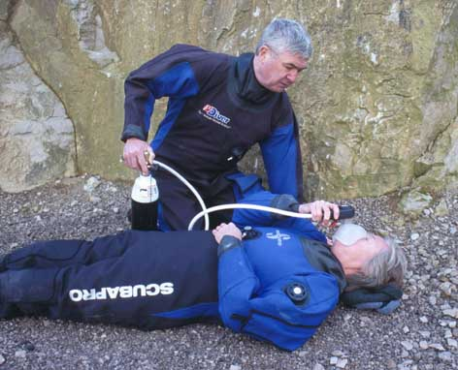
Burst Lung (3)
On-site first aid
  Lie casualty down
  Keep casualty quiet
  Administer 100% oxygen
    Assists in re-absorption of the nitrogen content of air in pneumothorax or emphysema
    Offsets reduced effective lung surface area for gas transfer due to collapsed lung
  Treat for shock
  Evacuate to a recompression facility as soon as possible

Slide 10
Near Drowning (1)
Cause
  Respiratory interruption due to fluid inhalation
Signs and symptoms
  Circumstances
  No breathing
  Cyanosis – ashen grey / blue appearance
  Weak or absent pulse

Slide 11
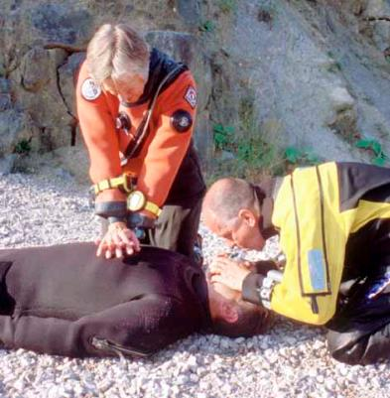
Near Drowning (2)
On-site first aid
  Rescue Breathing
    Oxygen-enriched if possible
    Concentration of oxygen reaching the casualty’s lungs during rescue breathing is increased
  Chest compressions if required
  Recovery position
  Evacuate to medical attention
    Even if apparently fully recovered
    Complications of secondary drowning

Slide 12
Shock (1)
Definition
  Inadequate circulation leading to tissue damage due to inadequate oxygenation and waste removal
Present to a greater or lesser degree in all injuries
Mechanisms
  Reduced blood volume (bleeding, burns, oedema)
  Massive dilation of blood vessels (e.g. fainting)
  Inadequate cardiac output (e.g. heart attack)
  Allergic reaction to drugs, food or stings

Slide 13
Shock (2)
Signs and symptoms
  Weakness, dizziness
  Pallor, sweating
  Rapid pulse rate
  Rapid breathing, feeling breathless
  Unconsciousness

Slide 14
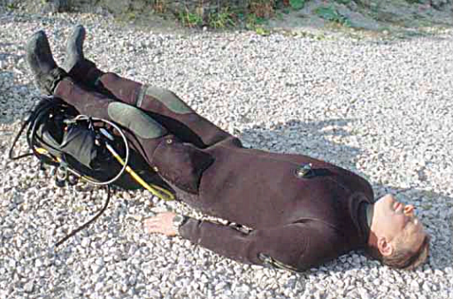
Shock (3)
On-site first aid
  Treat prime cause
  Reassure casualty (TLC)
  Keep casualty quiet
  Lay casualty down with legs raised (not in the case of DCI or burst lung)
  Keep warm and comfortable
  Administer oxygen
    Increased oxygen dissolved in the blood offsets effects of inadequate circulation
  Monitor condition
  Nothing by mouth (except for DCI)
  Evacuate to medical attention

Slide 15
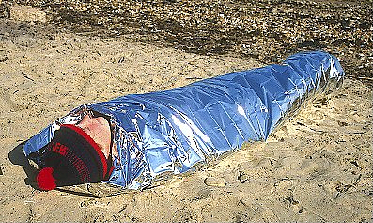
Shock (4)
Immersion shock
  Extreme form of blood vessel dilation due to prolonged immersion
  Muscles relax due to water supporting body weight
  If removed from water upright, blood can pool in lower limbs – potentially fatal
  Keep casualty horizontal at all times
  Discourage any movement or activity by the casualty

Slide 16
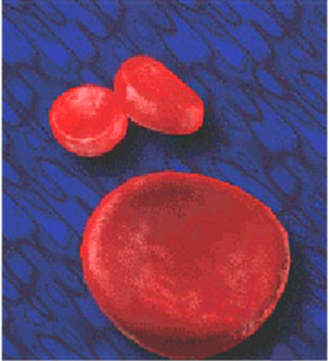
Carbon Monoxide Poisoning (1)
Cause
  Breathing gas contaminated with carbon monoxide
Effect
  Carbon monoxide combines about 200 times more readily with haemoglobin than does oxygen
  Interferes with the blood's ability to transport oxygen
  May act as a cellular poison
CO
CO
CO

Slide 17

Carbon Monoxide Poisoning (2)
Signs and symptoms
  Headache
  Pale or greyish appearance
  Weakness
  Dizziness, nausea
  Tunnel vision
  Vomiting
  Rapid pulse
  Rapid breathing
  Coma
  Convulsions

Slide 18
Carbon Monoxide Poisoning (3)
On-site first aid
  Remove casualty from contaminated breathing supply
  Lie casualty down with legs raised
  Administer 100% oxygen, or oxygen enriched rescue breathing, as appropriate
    More oxygen is transported in solution in the plasma
    Some assistance in breaking down carboxyhaemoglobin
    Helps restore normal cellular function

Slide 19

Summary
Administration of oxygen is beneficial to the major diving disorders
100% oxygen will provide the maximum benefit
Administer oxygen as early as possible
Oxygen is a supplement to other first aid procedures to increase their effectiveness
Casualty must always be evacuated to appropriate medical aid:
  As soon as possible
  Irrespective of any apparent resolution of their condition

