Slide 1
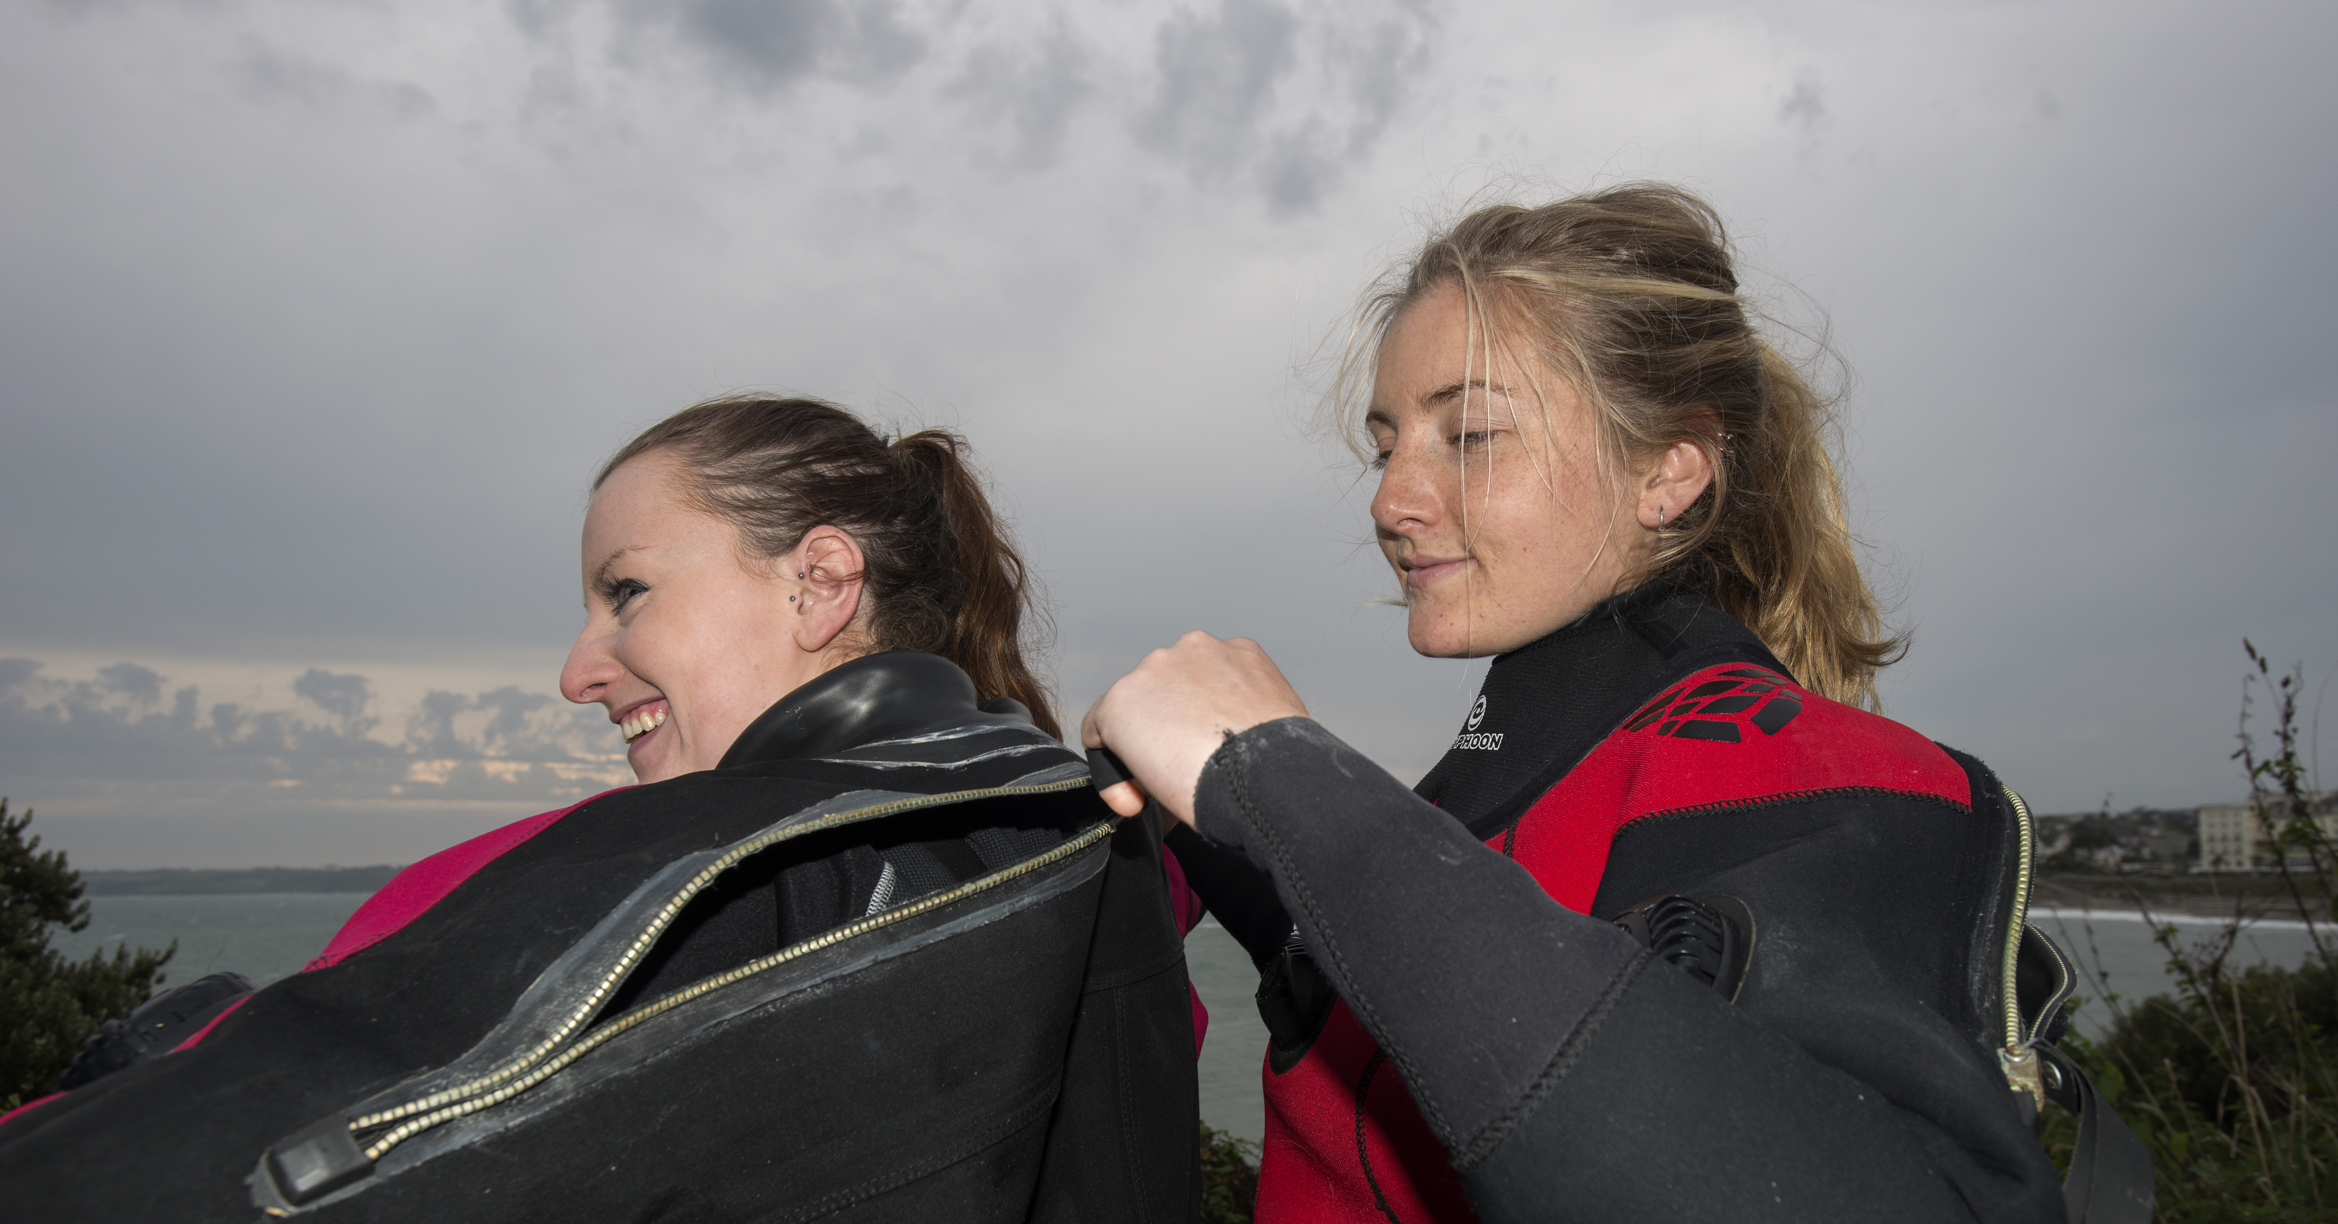

Drysuit Course

Slide 2
Course Aim and Programme
To teach members the correct and safe techniques for drysuit diving
  Theory lesson 1: Drysuits and Equipment
  Theory lesson 2: Drysuit Diving Techniques
  Practical lesson: Sheltered Water
    Using a drysuit
  Practical lesson: Open Water
    Drysuit dive experience

Slide 3
Drysuit Course
Drysuits and Equipment

Slide 4
Section 1: Drysuits and Equipment
  Introduction: lesson objectives
  Review of physics: effects on a drysuit diver
  Types of drysuits
  Undergarments
  Suit controls
  Use of Buoyancy Compensator with drysuit, for:
    Emergency buoyancy
    Escape from depth
    Escape from inversion
    Emergency breathing
  Selection, care and maintenance
  Summary

Slide 5
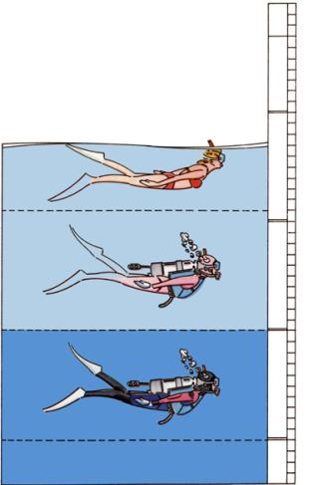
Why use a drysuit in the UK
Heat Loss In Water
  25 x faster than air
40⁰ C
Normal body
temperature
37⁰ C
30⁰ C
No suit
required
  Cold water increases rate of heat loss
  Insulation consideration for divers in UK
Wetsuit / Drysuit
required
20⁰ C
Drysuit
required
  Drysuits used extensively in the UK
10⁰ C
0⁰ C

Slide 6
Introduction: Lesson objectives
At the end of this lesson students will be able to:
  Identify the different types of drysuit
  Identify the features they embody
  Explain why a BC should be used with a drysuit
  Identify the potential problems and their solutions
  Show an understanding of theory knowledge through an end of lesson test

Slide 7
Review of Physics
Session Objectives
  Review pressure / volume changes
  Behaviour under pressure and underwater
  Explain ‘squeeze’ and how to avoid it
  Loss of buoyancy and how to regain it
  Explain ‘air migration’ in a suit and how to control it

Slide 8
Air and Water Pressure
Air
Pressure
1 bar
AIR
1
0m
Depth
0m
Air + Water
Pressure
2 bar
10m
1/2
1/2
10m
Air + Water
Pressure
3 bar
20m
1/3
1/3
20m
Air + Water
Pressure
4 bar
30m
1/4
1/4
30m

Slide 9
Behaviour under pressure
Descending on dive
  Drysuit surrounds body with air providing
    Insulation
    Buoyancy
  On descent water pressure causes compression
    Suit ‘squeeze’ can be caused
    Loss of buoyancy
  Compensate by injecting air into drysuit
    Reduces ‘squeeze’
    Regains buoyancy

Slide 10
Behaviour underwater
Lung volume
Comfort air in suit
Boyles Law
For a fixed mass of gas at constant temperature, the pressure is inversely proportional to the volume
Balloons / Lungs
Air
Pressure
1 bar
AIR
1 bar
Depth
0m
AIR
1
Air + Water
Pressure
2 bar
AIR
2 bar
10m
¹/₂
Air + Water
Pressure
3 bar
AIR
3 bar
20m
¹/₃
Air + Water
Pressure
4 bar
AIR
4 bar
30m
¹/₄

Slide 11
Behaviour underwater
During dive
  ‘Air migration’ – movement of air bubble within drysuit
  Change of attitude must be considered
    Inversion
    Trim
    Inability to dump excess air

Slide 12
Behaviour underwater
Ascending on dive
  On ascent air expands
    Migrates to highest point
    Increases buoyancy
    Increases chance of ‘air migration’
    Seals may ‘pop’ and release air
    Rate of ascent will increase
  Excess air must be released under control
    Use dump valve or control valve
    Regain buoyancy
    Reduce ascent speed

Slide 13
Using SCUBA Equipment Warning
SCUBA delivers Breathing Gas at Ambient Pressure
  Never hold your breath - lungs will expand on ascent = damage
AIR
1 bar
0m
1 bar
  Similarly drysuit air will expand on ascent
  May cause seals to ‘pop’
  So dump excess air in a ‘controlled manner’
AIR
2 bar
AIR
2 bar
10m
2 bar
AIR
3 bar
AIR
3 bar
20m
3 bar

Slide 14
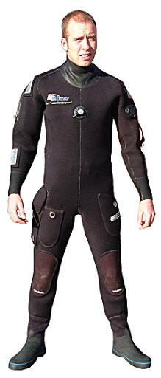
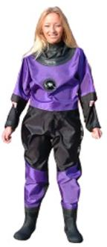
Types of drysuits
Foamed / crushed neoprene drysuit
  Good insulation
  Suit buoyant
  Neoprene seals
Membrane drysuit
  Minimal insulation – need for warm undergarments
  No inherent buoyancy
  Latex seals

Slide 15
Types of drysuits: principles
Neoprene Dry Suit
Membrane Dry Suit
Under Suit
Body
Body
Air
Water
Air
Water

Slide 16
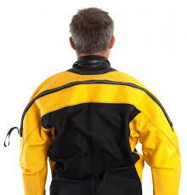
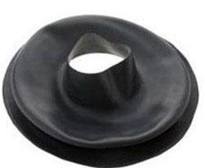
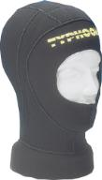
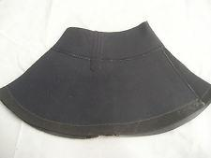
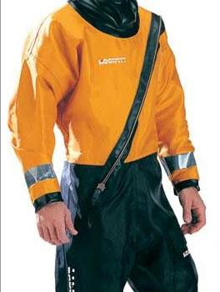
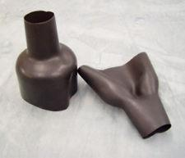
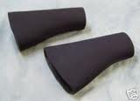
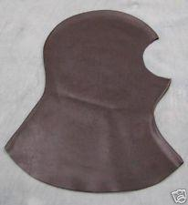
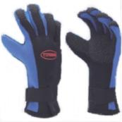
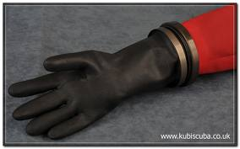
Types of drysuits
Zip entry
  Shoulder
  Front entry
Seals
  Neck and wrists
  Neoprene
  Latex – tapered, trim to size
Hoods
  Separate
  Integrated
Gloves
  Neoprene
  Dry gloves

Slide 17
Types of drysuits
Price range
  Neoprene - £550 – £1000+
  Membrane - £250 – £1000+

Slide 18
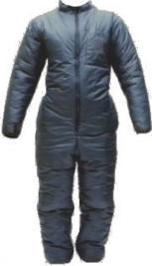
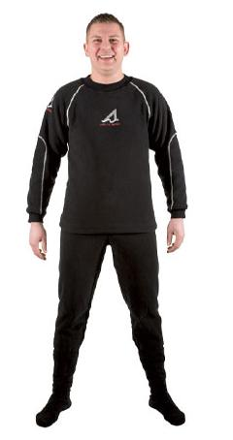
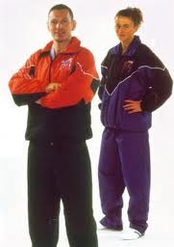
Undergarments
Woolly bears
  Warm, bulky, quick-drying,
  Loose-fitting
  Various materials
Base layers
  Warm, less bulky, quick-drying
  Tighter fit
  Wicks moisture to outside
Track suits
  Various styles
  Suitable for summer use

Slide 19
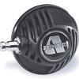
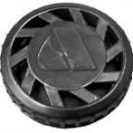
Suit controls
Inflation systems:
  Push button control
  Direct from first stage
  Push / pull fitting for hose connection
Vent systems:
  Cuff dump
    positioned on arm near cuff
    vented by lifting arm
  Automatic / adjustable dump
    positioned on upper arm near shoulder
    venting set automatically
    manual over-ride
Possible interference by BC and other kit
Auto
vent
Inflator

Slide 20
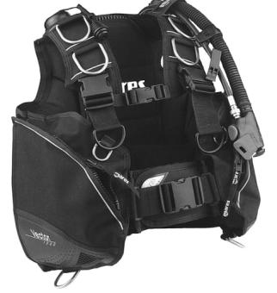
Use of BC with drysuits
Drysuit is NOT a lifejacket
BC must be worn to provide:
  Emergency face-up buoyancy on surface
  Assists in escaping inversion
  Independent source of emergency buoyancy (CBL)
  Emergency buoyancy for free ascents
  Passive, fully kitted diver likely to float face-up but
    Face submerged and awash
Drysuit also independent source of buoyancy
Neoprene suits lose buoyancy with depth
Membrane suits have no neutral buoyancy
If drysuit holed, will lose air and buoyancy.
Regained by:
  Inflating BC
  Dumping weightbelt

Slide 21
Use of BC with drysuits
Escape from inversion at surface
If air migrates to feet:
  Inflate BC to level off and get vertical again
  Buddy could assist
Inversion not usually a problem if suit correct fit for wearer
If inversion does occur it implies:
  Too much air in suit
  Heavy equipment worn too high (cylinders)
Correct buoyancy important for diver stability and comfort

Slide 22
Selection, care and maintenance
Which suit is for you?
  Big bodies need less insulation than smaller ones
Neoprene drysuits:
  Thinner / fewer undergarments
  Warmer if flooded
  Retains some buoyancy when flooded
  Could have reduced flexibility
  Colour usually black!
Membrane drysuits
  Thicker / more undergarments required
  No insulation if flooded
  No buoyancy when flooded
  More flexible movement
  Wide selection of colours

Slide 23
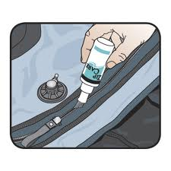
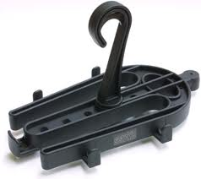
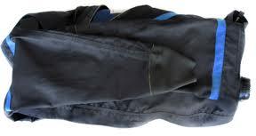
Selection, care and maintenance
Care and maintenance
  Rinse in fresh water
  Allow to dry naturally
  Avoid direct sunlight / excessive heat
  Check and clean zip
  Lubricate with beeswax
  Talc all seals before storing
Store by:
  Hanging from neck on suitable hanger
  Hanging by boots on designed hanger
  Loosely roll

Slide 24
Summary
  Review of physics
  Types of drysuits
  Undergarments
  Suit controls
  Use of Buoyancy Compensator with drysuit, for:
    Emergency buoyancy
    Escape from depth
    Escape from inversion
    Emergency breathing
  Selection, care and maintenance

Slide 25
End of lesson test
  What are the two types of drysuit?
  What is ‘suit squeeze’?
  What are the characteristics of a neoprene suit?
  What are the characteristics of a membrane suit?
  Name two types of undergarment that can be worn
  Name the two controls found on a drysuit
  Is a drysuit suitable as a lifejacket?
  Can a drysuit be used as a source of buoyancy in an emergency?
  What is ‘air migration’?
  What maintenance should be used on a drysuit?

Slide 26
Drysuit Course
Drysuit Diving Techniques

Slide 27
Section 2: Drysuit Diving Techniques
  Introduction: lesson objectives
  Drysuit preparation and dressing
  Correct weighting and buoyancy checks
  Drysuit diving in safety
  Emergency actions
    ‘Blow-up’
    Inversion
    Flooding
  Drysuit diver rescue
  Summary

Slide 28
Introduction: Lesson objectives
At the end of this lesson students will be able to:
  Correctly prepare and dress in a drysuit
  Explain how to dive safely in a drysuit
  Explain actions to be taken in the case of an emergency
  Explain the action to take in rescuing a drysuit diver

Slide 29





Preparation and dressing
Check suit as it is unpacked:
  Check seals not perished
  Check for potential damage
  Talc / lubricate seals
  Lubricate zip
Dress in drysuit undergarments
Put on suit
  Invert top for easy access
  Feet first
  Arms eased through seals
  Head eased through neck seal
  Set neck seal flat and check wrists
  Close zip, with assistance if required
  Squat to squeeze air out

Slide 30
Preparation and dressing
Practical session covering previous sequence
  Preparing suit
  Inverting suit for entry
  Arms and head through seals
  Checking seals are flat
  Closing zip properly
  Expelling air from suit

Slide 31
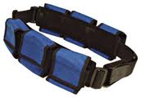
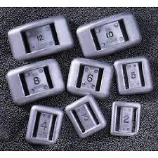

Correct weighting
Initially guess the weight and set up a weightbelt accordingly
Kit up in full diving equipment
Enter water with spare weights within reach, submerge vertically
Attempt buoyancy check:
  Breathe out
  Sink
  Breathe in
  Float up

Slide 32
Correct weighting
  Adjust weight for neutral buoyancy – no air in suit
  Add weight to allow for buoyancy change due to later air consumption – about 2 kg
  Inflate suit slightly to regain neutral buoyancy
    Adds ‘comfort factor’
    Relieves ‘squeeze’
    Gives adequate insulation
    Minimises ‘air migration’
  On descent - add small amount of air to restore neutral buoyancy and comfort
  On ascent - vent air to maintain comfort factor and neutral buoyancy

Slide 33
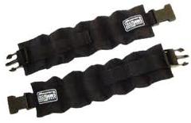
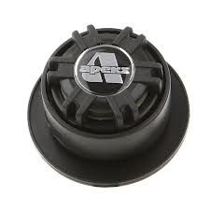
Correct weighting
Ankle weights may be used if feet float
If used:
  Consider weight as part of total
  Not as extra weight
When using an adjustable valve:
  Achieve neutral buoyancy as explained before
  Set valve so it starts to vent air
  No need to continually adjust during dive
  Press centre if over-ride is required
  During ascent manual venting may be necessary

Slide 34
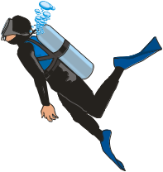
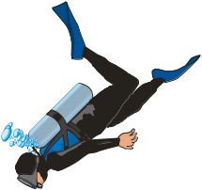
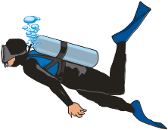
Buoyancy and Diving
  Descent
  Combined effect of diver’s body, drysuit and SCUBA - positive buoyancy
  May need additional weight
  During dive
  Fine tuning with lungs
  Ascent
  Air in drysuit and BC will expand
  Controlled dumping of air equalises diver’s buoyancy
  Controls ascent
  Buoyancy - check correct weighting

Slide 35
Drysuit diving in safety
  Keep suit zipped up whenever in a boat
  Make sure controls not obstructed by other kit
  Do not dive overweighted
  Use BC for surface inflation and emergency buoyancy
  Ensure a thorough buddy check of ALL equipment
  Avoid overheating if zipped in a drysuit
  Use a drysuit for routine buoyancy
  Descend feet-first and add air to maintain buoyancy
  Ascend under control making sure to vent air from arms
  If ascent accelerates and vent cannot cope
    Pull neck seal or wrist seal

Slide 36
Emergency actions
Blow-up / inversion:
  Usually caused by inflator valve sticking open
  Too much air in suit
  Failure to vent on ascent
Try to disconnect direct feed
If too blown up and unable to regain control:
  Flare arms out
  Flare fins to create drag
If head is down, air will migrate to feet:
  Beware of feet-first ascents
Diver should be able to restore head-up position by forward roll

Slide 37
Emergency actions
Inversion at the surface
  Try forward roll into head-up position
  Continue to over-inflate suit until weight of legs causes toppling over
  Dump excess gas
  Inflate BC to regain horizontal
  Roll face-up by holding one arm out while pushing down hard with the other outstretched arm
  Buddy can assist with these actions

Slide 38
Emergency actions
Flooded suit
  Rare but possible if zip or seals fail or suit torn
  Abort dive
  Use BC for buoyancy
  Weight of water in suit may make the exit difficult
After effects
  Loss of control following above could lead to:
    Striking surface obstructions
    Lung damage
    DCI
    Drowning,
    Shock
    Hypothermia
  Treat accordingly

Slide 39
Emergency actions
Tight neck seals
  Sudden unconsciousness
    Tight neck seal
    Compression of neck seal on ‘carotid sinus’ in neck
  If it feels too tight, it IS too tight
    Carefully trim it to a more comfortable fit

Slide 40
Drysuit diver rescue
  Bring the casualty to the surface using CBL
  Technique will vary depending on configuration of controls
  At surface inflate the casualty’s BC:
    To help maintain a suitable posture
    To provide support if AV is needed and neck seal is leaking

Slide 41
Summary
Introduction: lesson objectives
Drysuit preparation and dressing
Correct weighting and buoyancy checks
Drysuit diving in safety
Emergency actions
  ‘Blow-up’
  Inversion
  Flooding
Drysuit diver rescue

