Slide 1
Document change record
Date published | Document Version Number | Slide(s) affected | Description of changes | Author
1/1/2024 | v1.0 | All | Course update | Maria Harwood

Slide 2
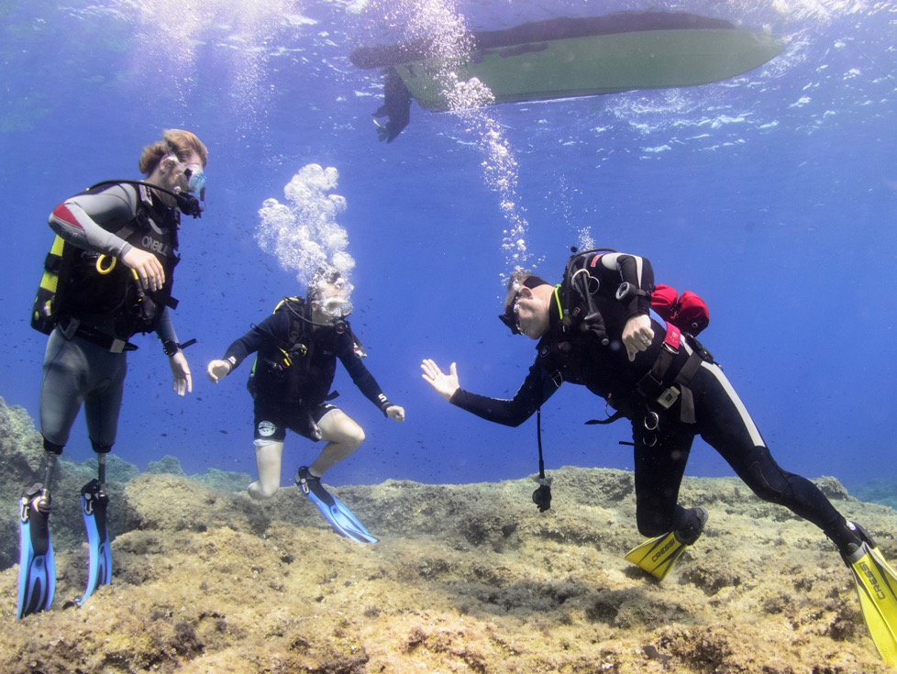

Instructor workshop
Module DIWT1
Diving for All

Slide 3
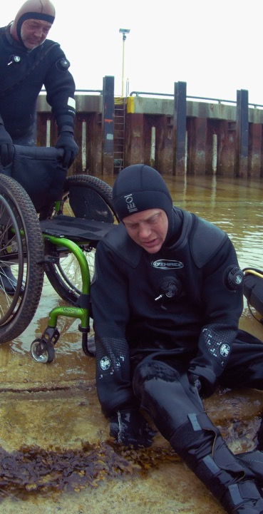

Aims of the workshop
Module DIWT1
At the end of this workshop students should:
Be confident to teach divers or snorkellers with disabilities.
Recognise that everyone is different and requires a unique approach.
Be confident in managing risks.
Know where to find additional information and how to seek help and advice.

Slide 4

Outline of the workshop
Module DIWT1
Recap of key lessons from DfA Awareness
Lesson planning
Site check
Demo lesson
Student lessons
Review of learning points
Hidden disabilities
Sources of information and support
Closing session

Slide 5

Recap of DfA Awareness
Key learning points?
20% of working age population
Disabilities not always visible
Treat everyone as individuals
Work together, don’t assume
Early and effective communication
Adapt, but only where necessary
Empathy, dignity and respect
Safety always
Sources of additional information

Slide 6
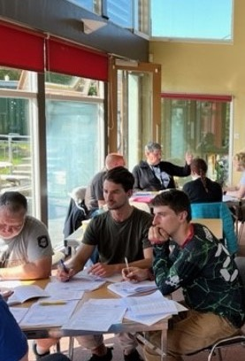
Lesson planning
In groups
Scenario of student with disability
How to adapt your lesson plans
Consider all aspects, from carrying kit through to exit and de-kit
Work with the student with (simulated) disability

Slide 7
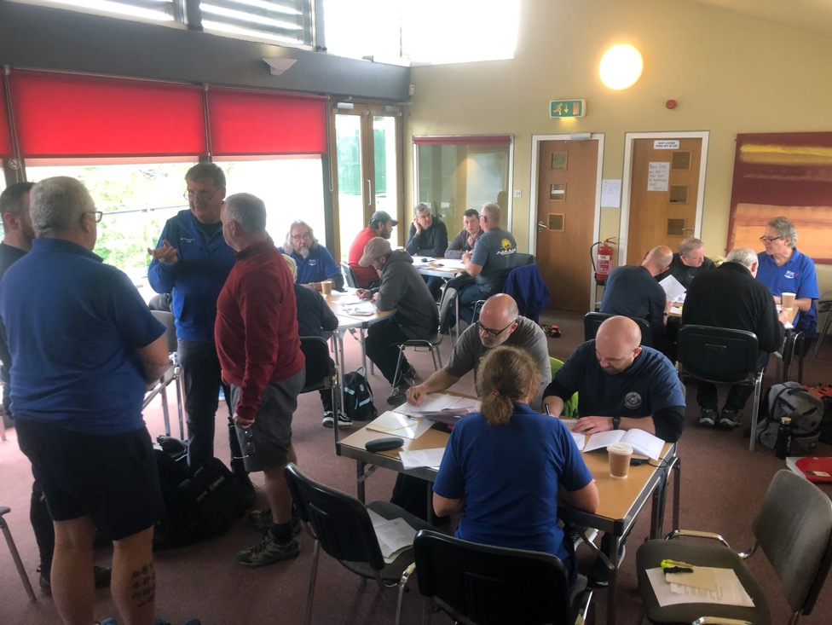
Lesson planning
Module DIWT1

Slide 8
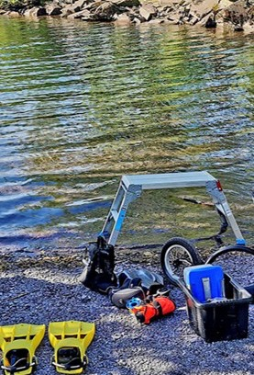
Site check
In groups
Check out the site facilities, including:
Car parking: close and enough space.
Ground / floor surfaces: uneven, gravel, slippery, trip hazards
Steps and steep inclines
Doors: are they wide enough/ easily operated?
Changing rooms and toilets
Benches for kitting up, if appropriate
Access to pool / open water
Social area

Slide 9
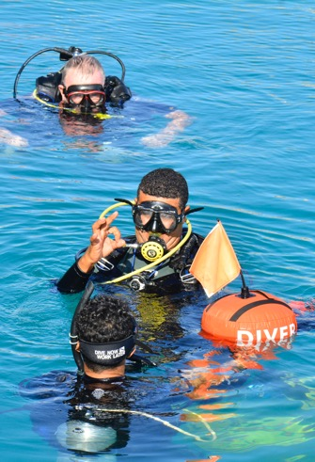
Practical lessons
In groups
IT demo lesson
Student lessons
Safe – how did they make the lesson safe? Anything that would have made it safer?
Technically correct – were the demos clear? Did the (adapted) technique work? Any ways we could improve on this?
Effective – did they demonstrate, mimic and correct? Could the student do the skill at the end?
Progressive – what steps was the skill broken down into? Any additional steps that would have helped? E.g., a dry run.

Slide 10
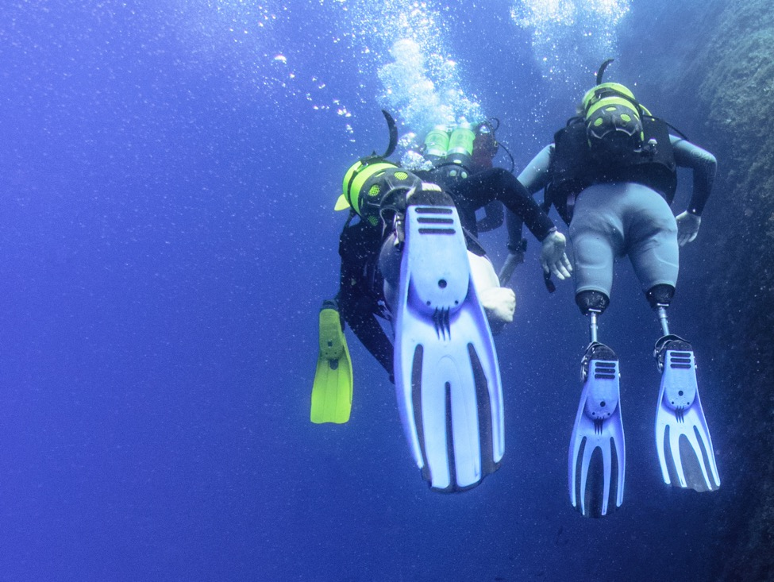
Practical session
Module DIWT1

Slide 11
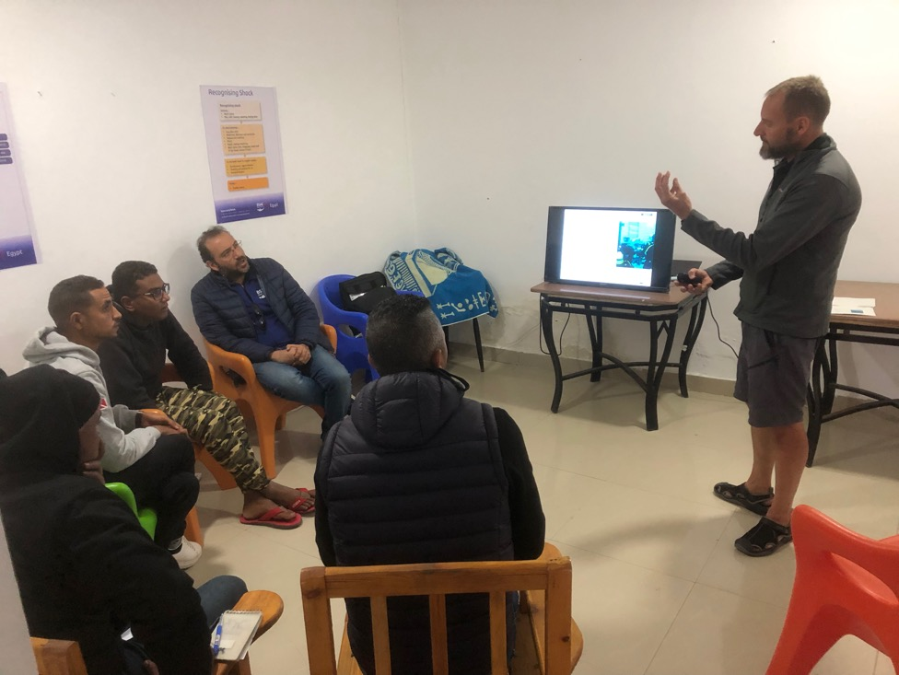
Hidden disabilities
Module DIWT1

Slide 12
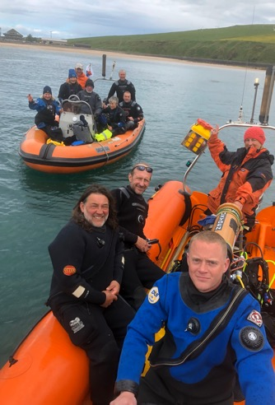
Hidden disabilities
Many disabilities aren’t visible
General
Everyone is different
Be patient
May need 1:1 instruction
Classroom
Might struggle to understand or might have read more than you!
Might need more breaks
Distractions
Stick to key principles: PAVE

Slide 13

Hidden Disabilities (2)
Theory assessments
Allow extra time? Oral?
Informal knowledge checks
Pool
1:1 instruction (empathy and patience)
Clear SEEDS brief
Split skills over multiple sessions
If they become overwhelmed agree a time-out (maybe a time out signal?)
Emphasise basics, e.g., buddy diving
Ensure instructor is aware of any needs.
Poolside environment, e.g., noise
Open water
As above

Slide 14
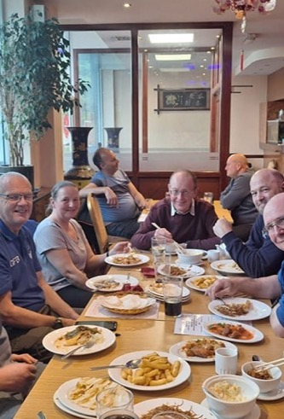
Club environment
Neurodiverse people might behave differently.
What others regard as friendly banter might easily drift into bullying.
Be specific about where to be, at what time, with what kit, etc.
Apparent over-reacting might just be someone’s coping mechanism. Try to calm things down.
If someone pulls out of arrangements at the last minute, recognise that they have their reasons.

Slide 15
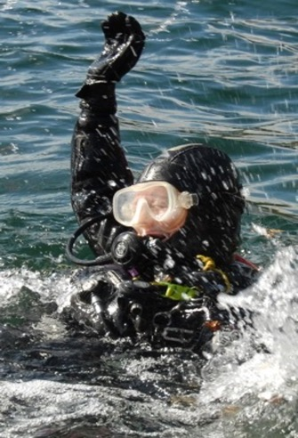
Safety
Safeguards built into the system:
Medical
Meeting the performance standards set out in the instructor notes.
Conditional qualifications by exception
On site
Risk management

Slide 16
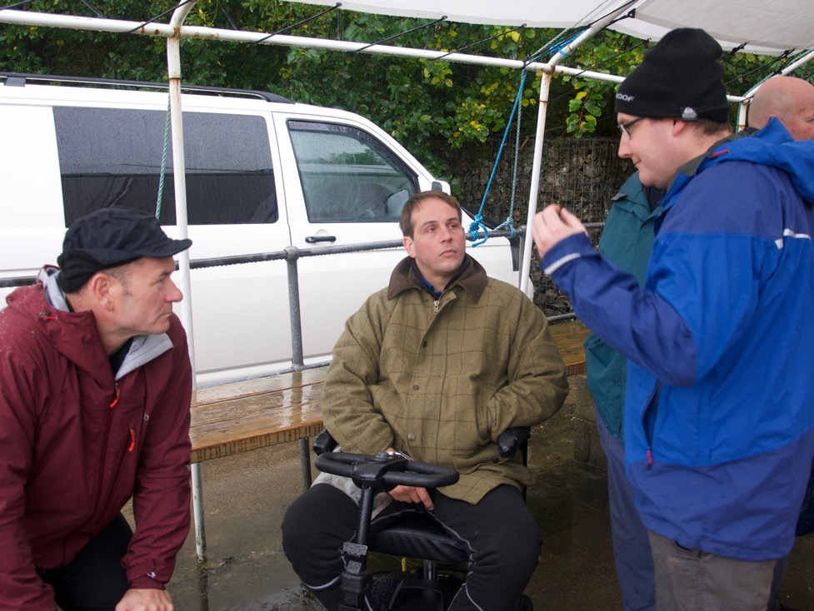
Closing session
Module DIWT1

Slide 17
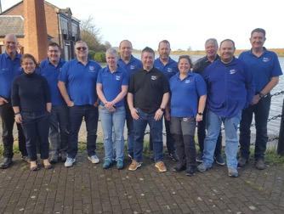
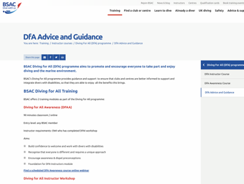

Further information
Sources of information and support
BSAC DfA team
BSAC HQ
Medical Referees (if a medical matter)
Website https://www.bsac.com/training/instructor-courses/diving-for-all-programme/dfa-advice-and-guidance/

Slide 18
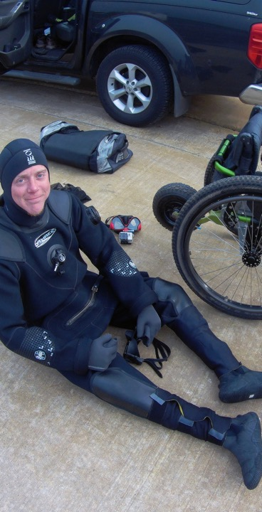
Summary
Module DAT1
Module DAT1
At the end of this workshop students should:
Be confident to teach divers or snorkellers with disabilities.
Recognise that everyone is different and requires a unique approach.
Be confident in managing risks.
Know where to find additional information and how to seek help and advice.

Slide 19

Way forward
Module DAT1
Congratulations, you are now DfA Instructors
Can also teach the DfA Awareness module
To teach on this course:
Gain experience
Satisfactorily teach DfAI course under supervision of an ITS Instructor who is also a DfA IT

Slide 20

Any questions &
feedback?
bsac.com
facebook/britishsubaquaclub | twitter.com/bsacdivers
(0)151 350 6200 | info@bsac.com

