Slide 1
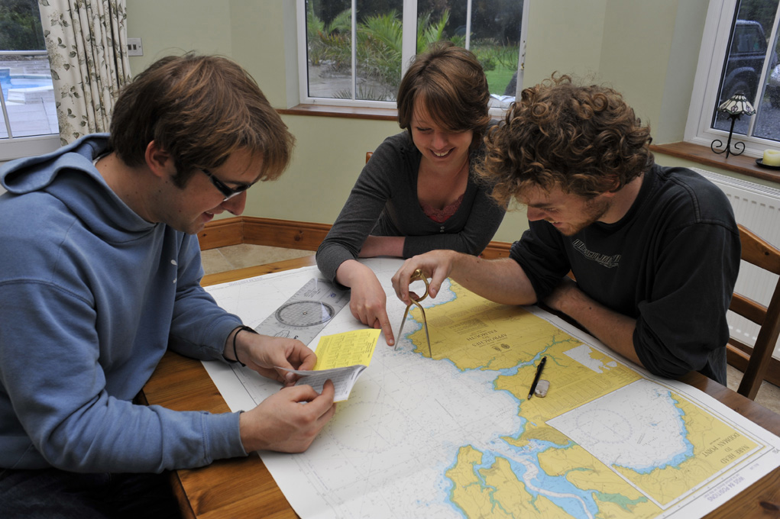

Chartwork and Position Fixing
Chart Basics

Slide 2
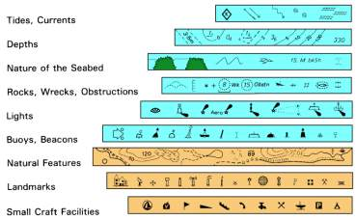
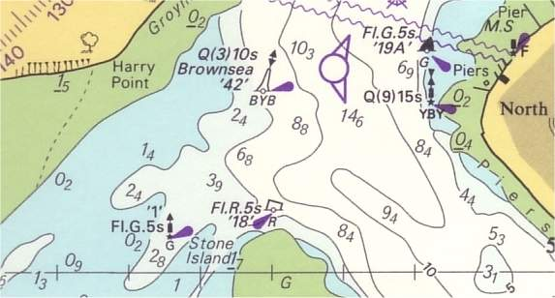
Outline
Objectives
  introduction to nautical charts
  learn to extract information relevant to divers
  plot and record positions
Availability
Scale
Chart layout
Symbols and abbreviations
Latitude & longitude
Exercises

Slide 3
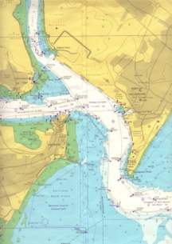
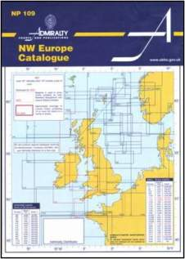
Availability
Primarily designed for mariners
Paper or digital
Main brands
  Admiralty
  Imray, Stanford
  C-Map
  Navionics
  BlueChart
Chart agents, chandlers, websites
Admiralty charts
  catalogues
  Notices to Mariners on web

Slide 4
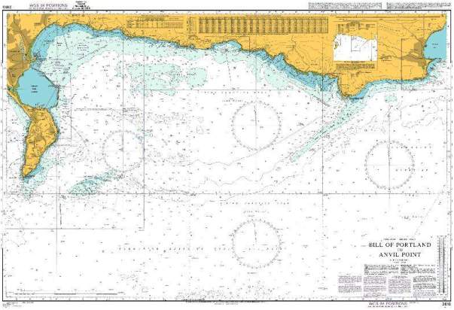
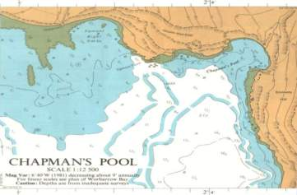
Scale
Various scales (1:2,500 - 1:20,000,000)
  small scale - large area - little detail
  large scale - small area - more detail – best for divers

Slide 5
Chart Layout
Title and number
Scale
Positions/datum
Cautions
Source data
Corrections
Tidal levels
Tidal streams
Compass rose

Slide 6
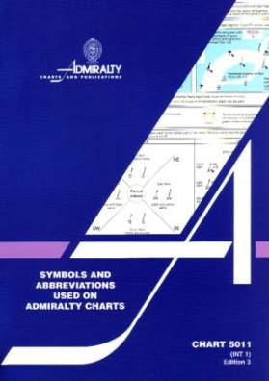
Symbols and abbreviations
Over 1000 different symbols and abbreviations
Chart 5011
For this course
  colours
  depths
  buoys
  wrecks
  rocks
  landmarks
  nature of seabed
  tides and currents

Slide 7
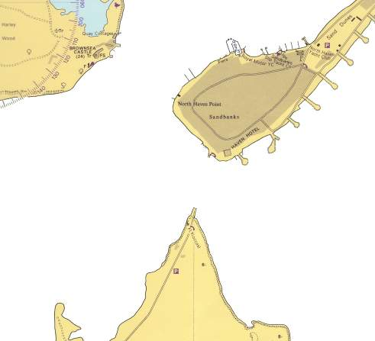
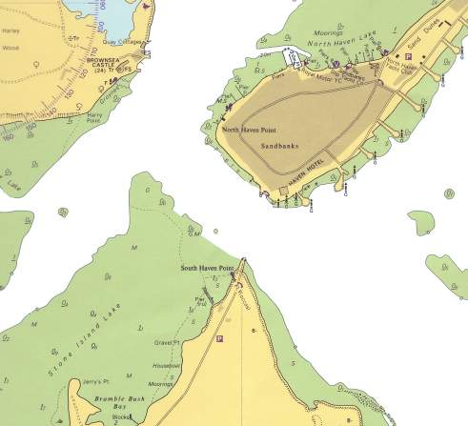
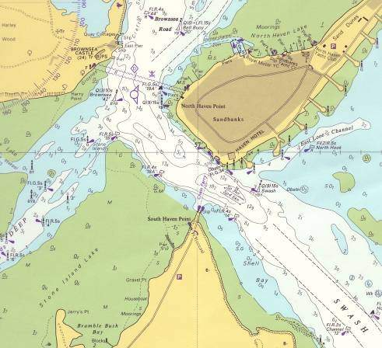
Colours
Dry land is shown as a buff colour
Areas that cover and uncover with the tide are green
Sea is mainly white, with shallow areas either shades of solid blue or edged in blue

Slide 8
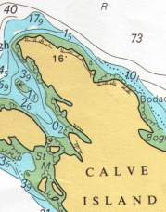
Depths
  14₆ sounding 14.6m
  1₅ drying height 1.5m
  ----10---- depth contour (isobath) 10m
    merging contours = wall

Slide 9












Buoys
Colour and shape, light characteristics
Meaning
  lateral – marks edge of channel
  cardinal – marks area to avoid
  others
Fl.R
Fl.R
Fl.G
Fl.G
VQ(3)5s
VQ(6)+L.Fl10s
Lt Lt Ho
Oc.R.4s 10M

Slide 10

Buoyage - lateral
  red = port green = starboard
  going in direction of rising tide
  going in direction of falling tide
  direction of buoyage symbol used where direction not obvious

Slide 11
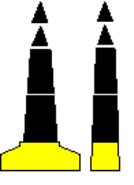

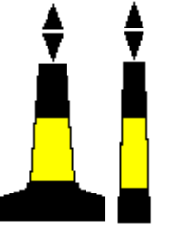
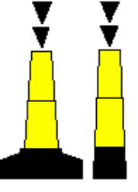
Buoyage - cardinal
N
  and black
yellow
VQ or Q
Danger
W
E
VQ or Q(9)
VQ or Q (3)
VQ or Q (6) + long fl
S

Slide 12
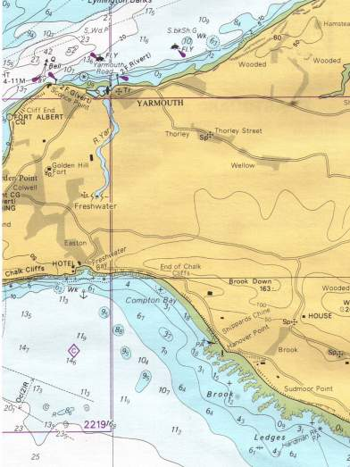

Wrecks
Wreck which has been swept by wire to the depth shown
15
Wk
Wreck which exact depth is unknown, but is considered safe at depth shown
11₈
Wk
Wreck, depth unknown, but is considered dangerous to surface navigation
Wreck, depth unknown, not considered dangerous to surface navigation
Wreck over which depth obtained by sounding but not by wire sweep
18₂
Wk
Wreck showing any portion of hull or superstructure at level of chart datum

Slide 13
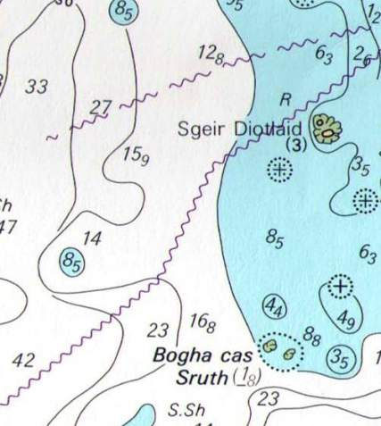
Rocks
Rock which covers & uncovers, height above chart datum where known
Note () show depth is out of position
(4₆)
Rock awash at the level of Chart Datum
Dangerous underwater rock of known depth
(5₇)
Rock which covers & uncovers, height above Chart Datum, where known
(1₈)
Underwater rock depth unknown, but considered dangerous to surface navigation

Slide 14






Landmarks
Church
Tower
Ch
Sp
Fort with flagstaff
Chimney
Tanks
Water tower, Water tank on a tower
Contours
Spot heights

Slide 15
Nature of seabed
Abbreviations for material
  R = rock
  G = gravel
  S = sand
  Sh = shells
  Sn = shingle
  M = mud, etc
Qualifying terms
  bk = broken
  f = fine
  m = medium, etc
Used in combination
  fS.M.Sh?
  fine sand.mud.shells

Slide 16
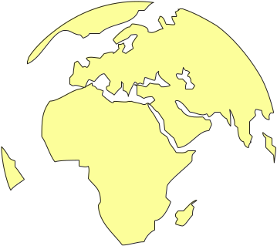
Grid reference system
Parallels of Latitude
Meridians of Longitude
Parallels of latitude
Meridians of longitude
Chart No. 45

Slide 17
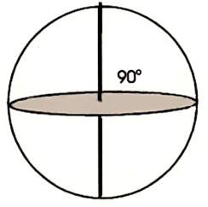

Latitude
N
N
Equator to Pole angle = 90°
90º
50º
50º
Parallels of latitude
S
S
50º
50º
N
30º
30º
Equator divides earth into north & south
Equator
30º
S
30º
50º
50º

Slide 18
Longitude
180º
150º
N
Looking down on equator plan from North Pole
150º
120º
120º
90º
90º
60º
60º
30º
0º
30º
N
N
Greenwich Meridian
W
E
60º
30º
0º
30º
60º
60º
30º
0º
30º
60º
S
S

Slide 19
Latitude & longitude
Lat & long angles measured in
  degrees° minutes.decimal´ (hemisphere)
  hemisphere = N, S, E, W
A position
  latitude = 51° 43.250´ N
  longitude = 002° 59.950´ W
1 degree = 1° = 60 minutes = 60´
Each minute can be subdivided with decimals to any precision required
  50°30´N 50°30.2´N 50°30.21´N 50°30.207´N 50°30.20669´N
Mapping programs sometimes use decimal degrees
  50°30´N = 50.(30/60) = 50.5°
Degrees/minutes/seconds becoming obsolete
  51° 43.250´ = 51° 43´ 15˝

Slide 20


Latitude & longitude
2`
55° 00.92’N
000° 59.79’E
55°
00
.92’N
54° 59.26’N
003° 59.68’W
1`
0`
55°N
000°
59
.79’E
003°
59
59`
.68’W
54°
59
.26’N
2`
1`
0`
59`
59`
0`
1`
2`
4°W
1°E

Slide 21
Summary
Availability
Scale
Chart layout
Symbols and abbreviations
Latitude & longitude

Slide 23
Chart basics exercises
What is the least depth likely to be found at 50°36.70´N 001°55.00´W ?
What type of seabed are we likely to find at 50°38.23´ N 001°54.54´ W ?
What type of foreshore is likely to be found at CD in position 50°40.30´N 001°59.00´W?
What is at the following 2 positions
  50°38.53´N 001°54.60´W
  50°39.24´N 001°54.97´W ?
What is the lat/long of
  The end of Swanage slipway
  ‘Bell Buoy’ - cardinal buoy East of Brownsea Island
  the Flag Staff at Brownsea Castle
  the Red Lateral buoy off Peveril Ledge?
The wreck at: 50°37.47´N 001°56.15´W
  how deep is it at Chart Datum?
  how was the depth of the wreck originally determined

Slide 24
Chart basics exercise answers
What is the least depth likely to be found at 50°36.70´N 001°55.00´W ? 21.5m (CD)
What type of seabed are we likely to find at 50°38.23´ N 001°54.54´ W ? coarse sand/coral/broken shells/pebbles
What type of foreshore is likely to be found at CD in position 50°40.30´N 001°59.00´W? marsh, swamp, saltmarsh
What is at the following 2 positions
  50°38.53´N 001°54.60´W race on ebb stream
  50°39.24´N 001°54.97´W ? Tidal Diamond ‘A’
What is the lat/long of
  The end of Swanage slipway 50°36.47´N 001°56.78´W
  ‘Bell Buoy’ - cardinal buoy E of Brownsea Island 50°41.38´N 001° 57.10´W
  the Flag Staff at Brownsea Castle 50°41.30´N 001°57.50´W
  the red lateral buoy off Peveril Ledge? 50°36.42´N 001°56.10´W
The wreck at: 50°37.47´N 001°56.15´W
  how deep is it at CD? 9.0m (CD)
  how was the depth of the wreck originally determined?
  By sounding but NOT by wire sweep

Slide 25
Voyage plan exercise
Make the answer to question 5A the start point for your voyage on your voyage plan. Fill in the description and lat/long under Waypoint details.

