Slide 1
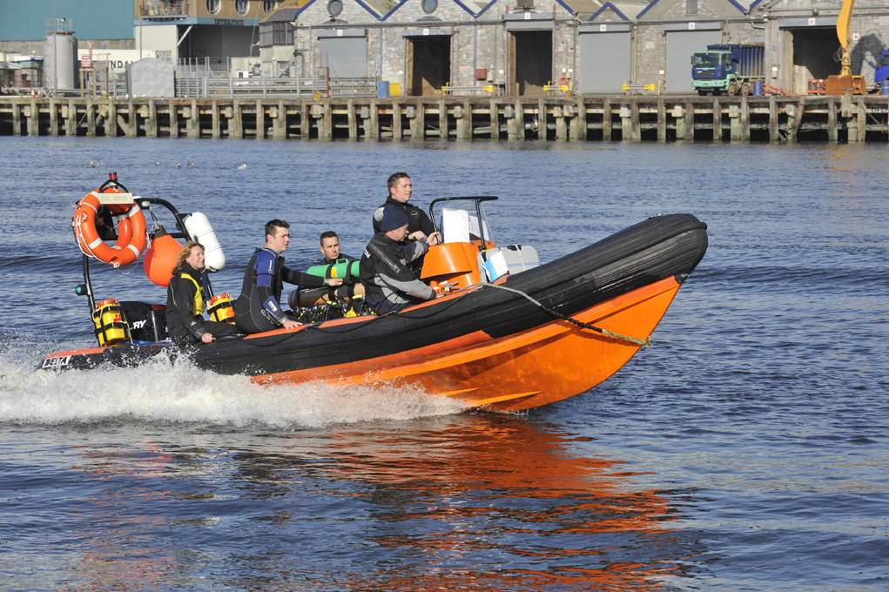

Boat Handling Course
Boat Handling Basics

Slide 2
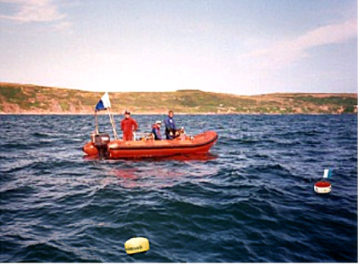
Lesson outline
Operating a boat
Launching and loading
Handling the boat
Recovery

Slide 3
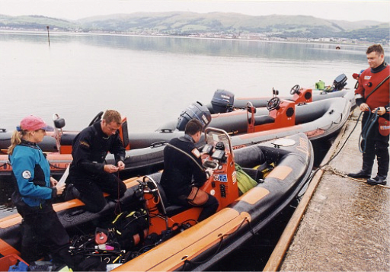
Operating a boat
Operating a dive boat requires teamwork
Designated Cox’n is responsible for boat and occupants
Cox’n needs assistance
  Pre-launch checks
  Launching
  Lookout
  Diving operations
  Boat housekeeping
  Recovery

Slide 4
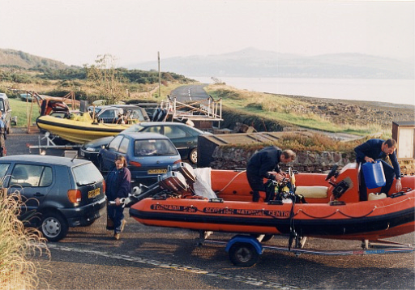
Pre-launch checks
Remove all covers and trailer fastenings
Check:
  Engines secure
  Adequate fuel / oil
  Electrical equipment functioning
  Anchor and line untangled and stowed accessibly
  Boat and engine tools/spares present and secured
  All safety equipment present, functional and secured
  Spare fuel

Slide 5
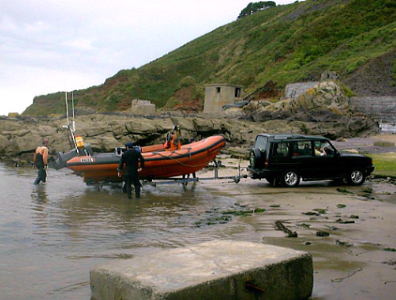
Launching
Sufficient depth of water!
Boat
  Engine(s) tilted
  Fully disconnected from trailer
Personnel
  One person co-ordinating
  No-one ‘downhill’ of boat/trailer
  Clear of wheels
Float / slide boat slowly off trailer
Keep secure hold of boat / bow painter

Slide 6
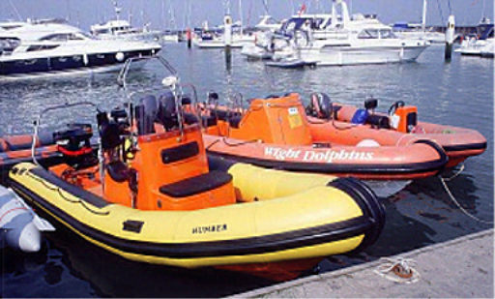
Post launch and loading
Post launch
  Check engine operation before loading
  Start / coolant tell-tale / warm-up
Loading
  Equipment loading order
  Keep clear of
    Anchor/line
    Safety and emergency equipment
  Lateral / fore and aft balance
  Don’t overload! – keep within manufacturer’s guidance

Slide 7
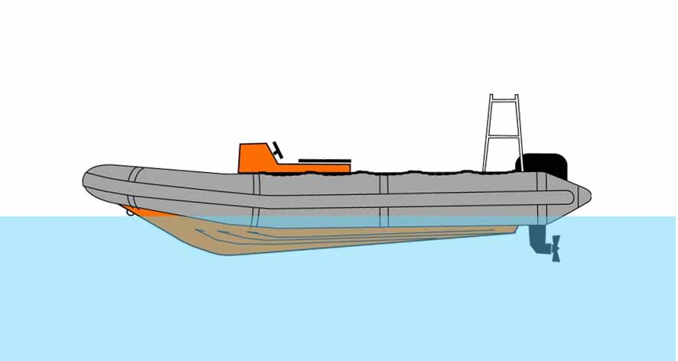
Balancing the forces
Windage on exposed hull
Tidal flow on submerged hull
Engine power –
strength
direction
High speed
  Engine power dominates
Low speed
  Windage and tidal flow become more significant
  Need more conscious balancing with engine power

Slide 8
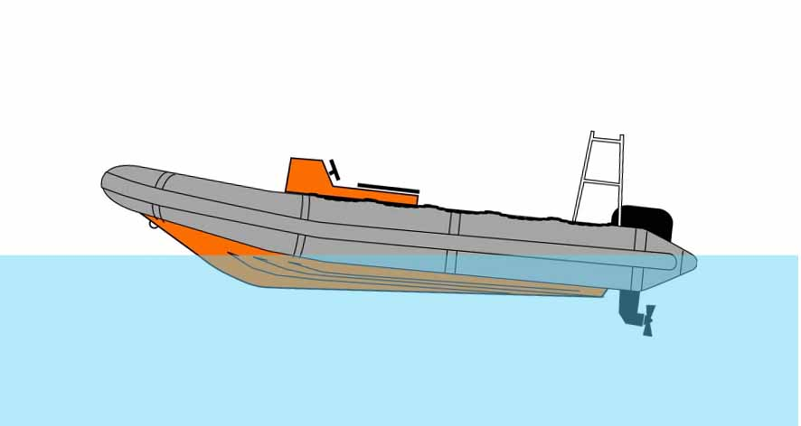
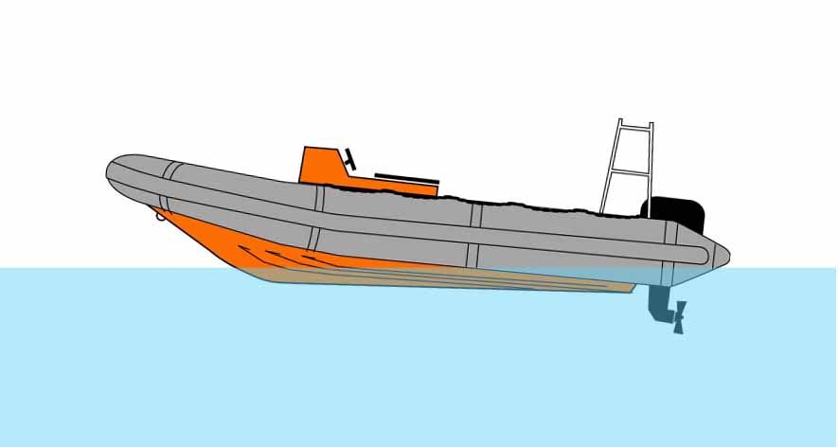
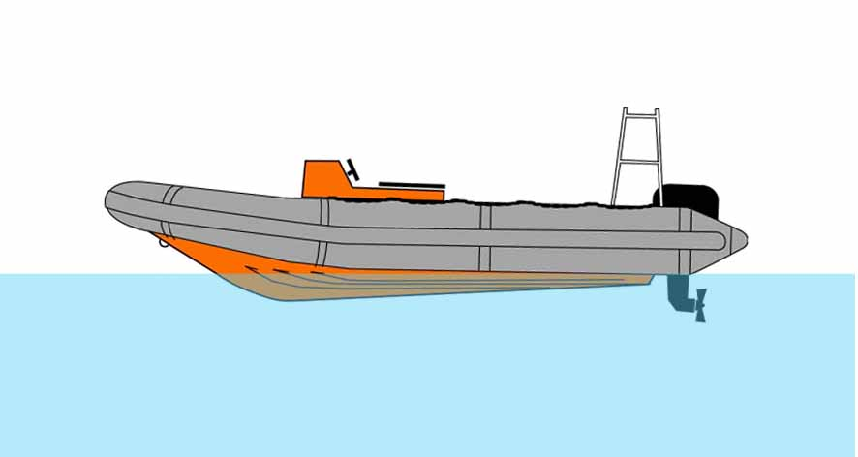
Getting ‘on the plane’

Slide 9
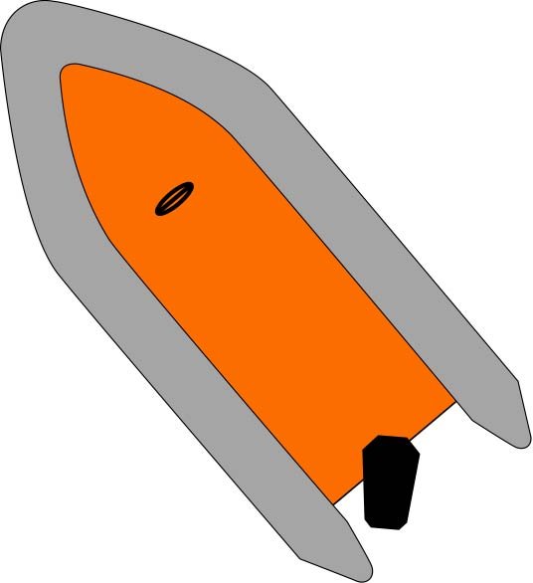
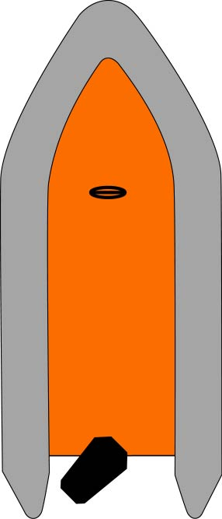
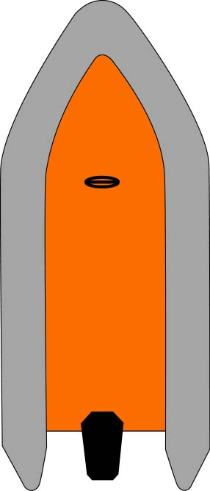
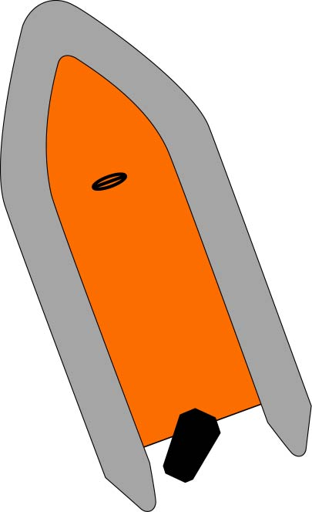
Turning
The stern moves first and in the ‘wrong’ direction!
High speed
  Effect small
  High side forces can be generated
  Warn crew before anything other than very gentle turns
Slow speed
  Effect much more pronounced
  Requires more vigorous steering
  Compounded by effect of wind or tidal flow?

Slide 10

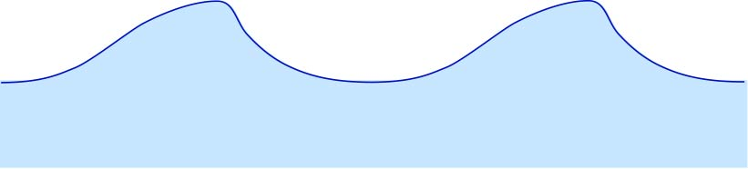
Surface conditions
Downwind - generally smoothest ride
Constant adjustment of power
  Head sea – reduce power approaching wave crest
  Overtaking (following) sea – power up in trough
Cross sea
  Turn bows into large waves
  ‘Zig-zag’ into / downwind
  Time turns for trough
Watch the sea
  At all times
  All around you
Wind
Wind
Wind
Tide

Slide 11
Recovery
Sufficient depth of water!
Remove heavy diving kit
Engine
  Turn off
  Disconnect kill cord
  Tilt
Align boat to trailer
Winch / guide boat onto trailer
Keep clear of winch strop / cable!
Keep clear of trailer wheels
Don’t stand downhill of the trailer

Slide 12
Summary
Operating a boat
Launching and loading
Handling the boat
Recovery

