Slide 1
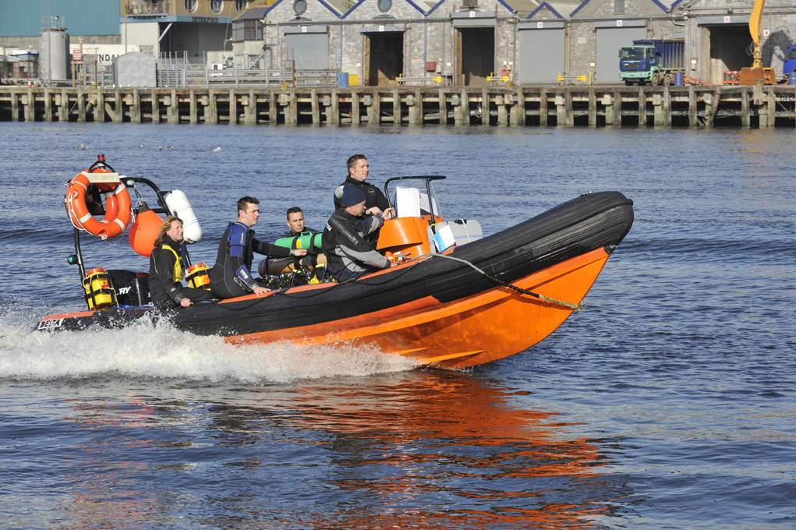

Boat Handling Course

Slide 2
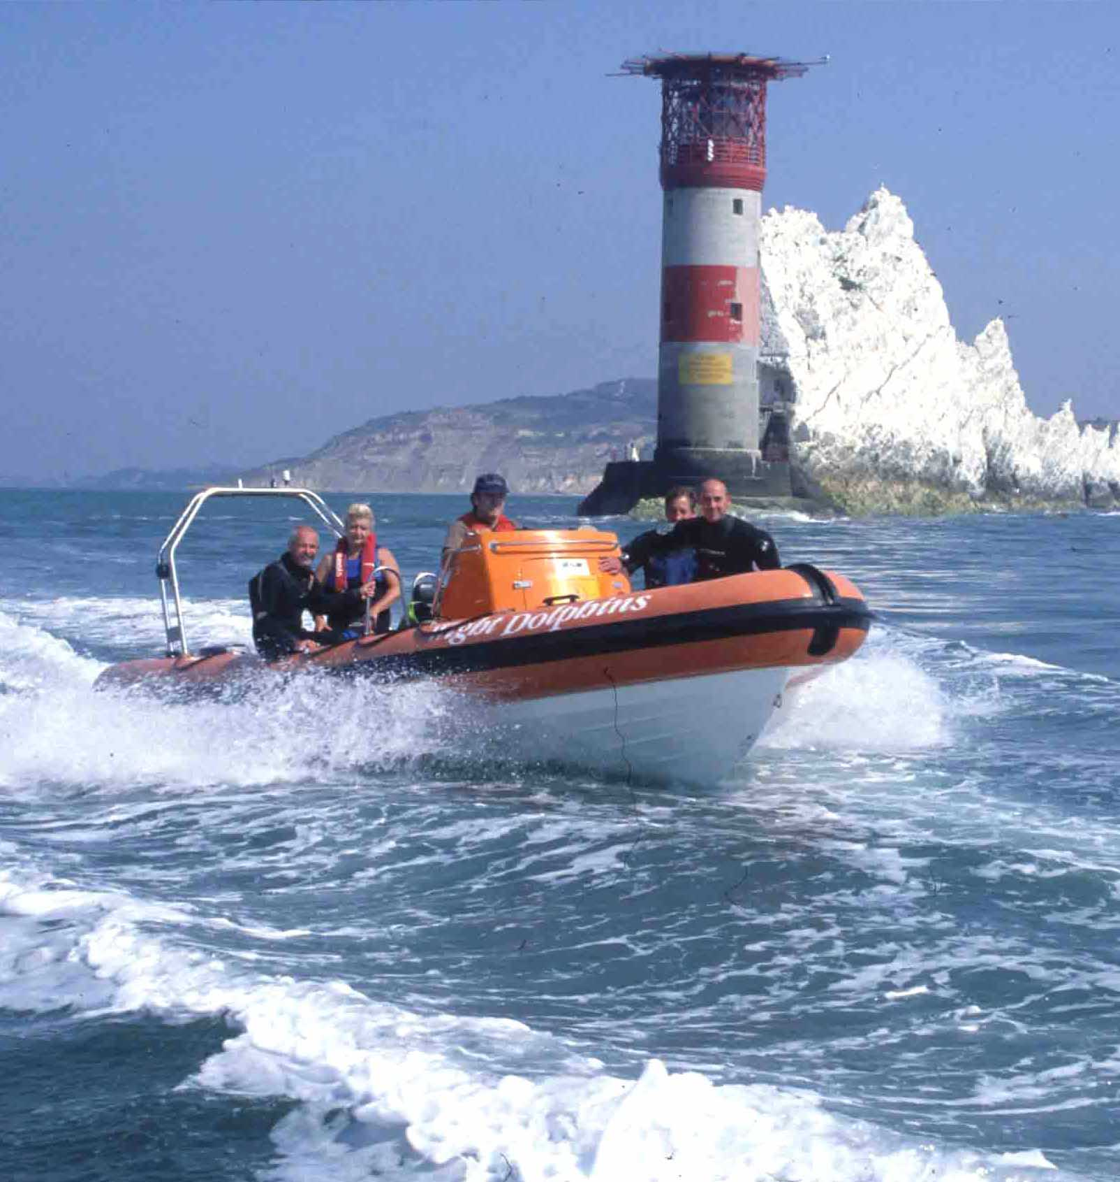
Course objectives
At the end of this course you should:
  Be familiar with the boat and its equipment
  Understand the factors affecting boat handling
    Boat configuration
    Weather and water conditions
  Understand pre-launch and passage planning
  Understand the responsibilities of the boat handler and owner
  Have gained at least two hours of hands-on boat handling experience

Slide 3
Course outline
Saturday
0900 Course Introduction
0915 The boat and its equipment
1030 Boat familiarisation ‘walk round’
1100 Owner and driver responsibilities
1200 Boat handling basics
1245 Pre-launch and voyage planning
1330 Lunch
1400 Sheltered water handling
1700 Finish
Sunday
0900 Pre-launch and voyage planning
0930 Open water handling
1230 Lunch
1330 Anchoring and diving
1630 Debrief

